Slide 1
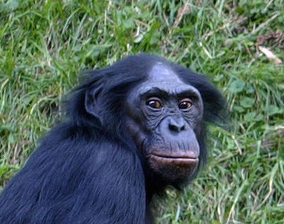
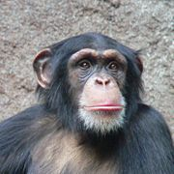

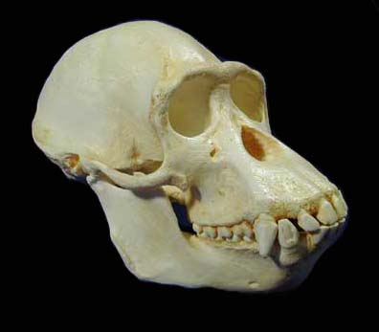
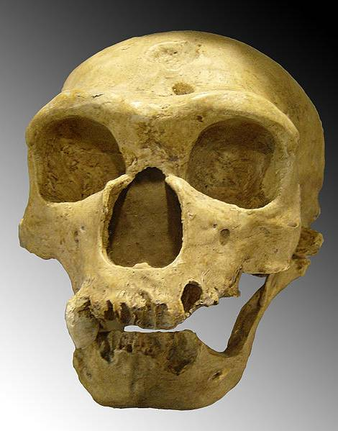
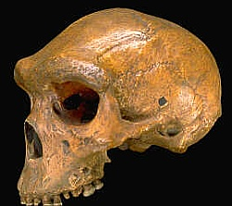
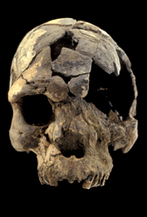
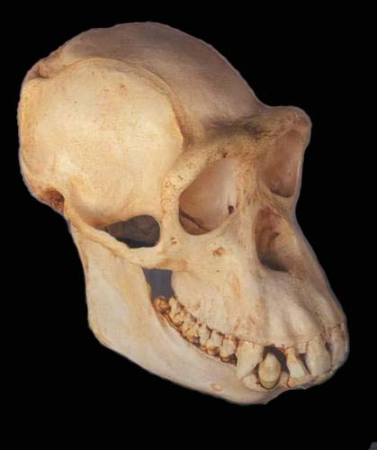
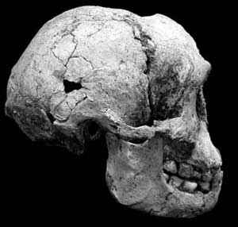
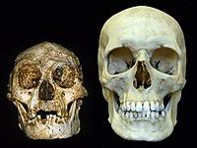
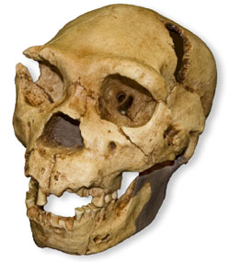
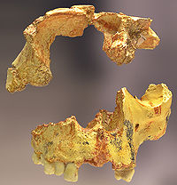
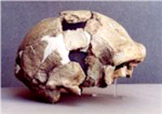
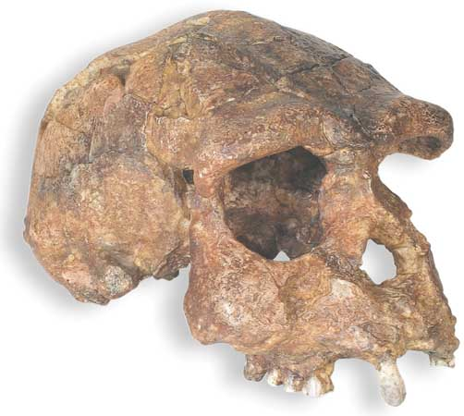
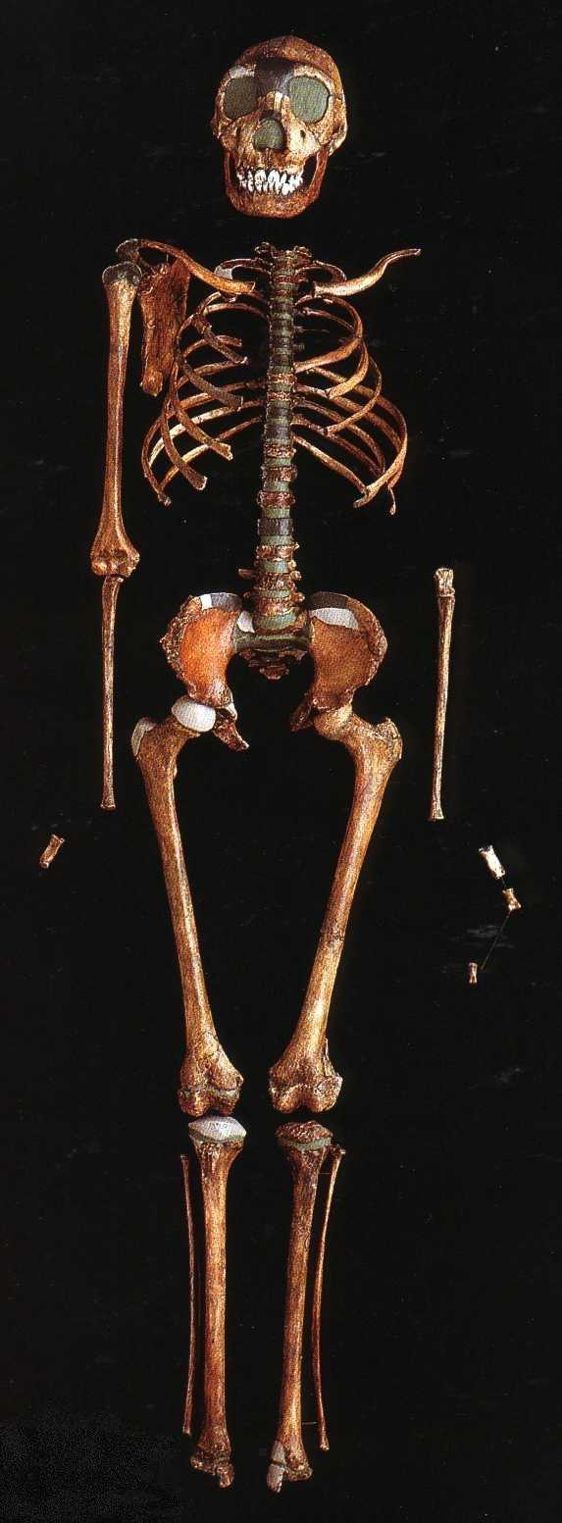
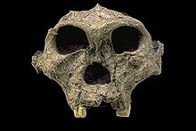
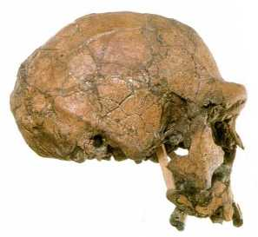
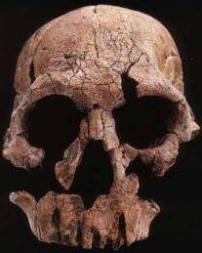
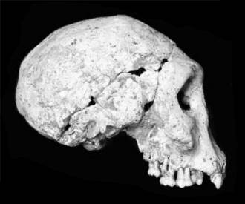
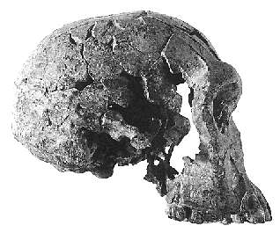
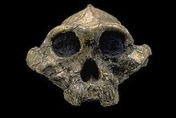
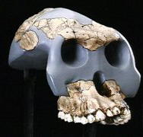
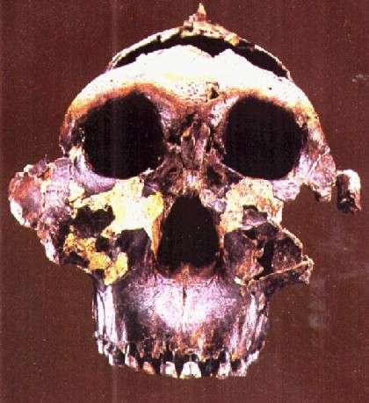
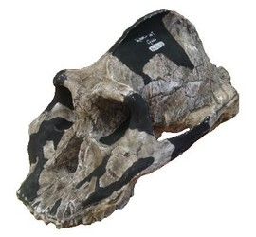
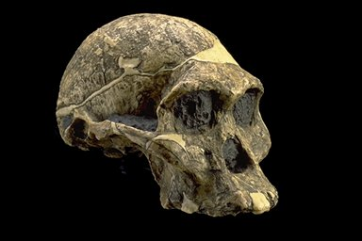
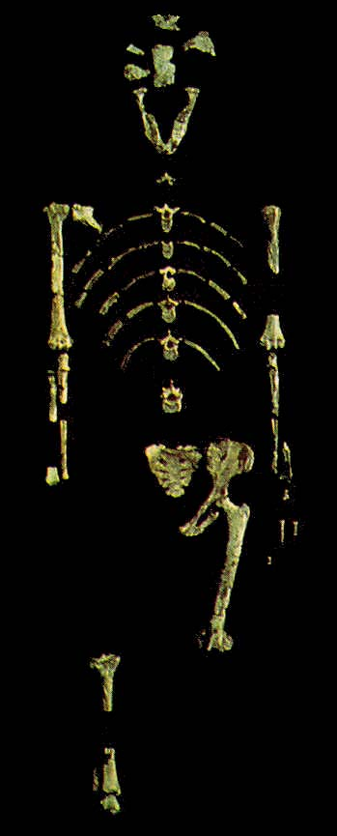
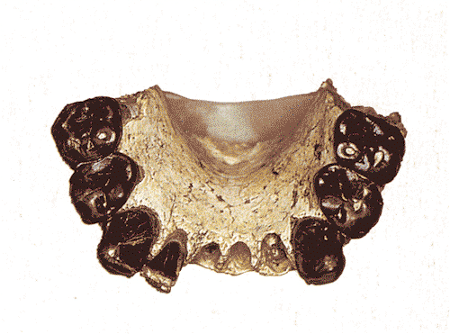
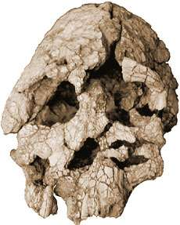
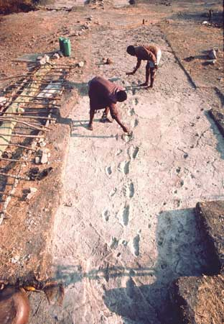
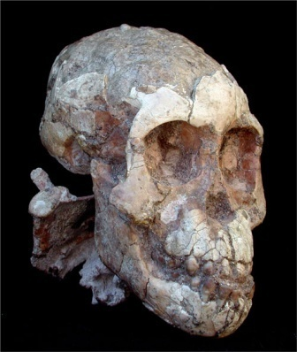
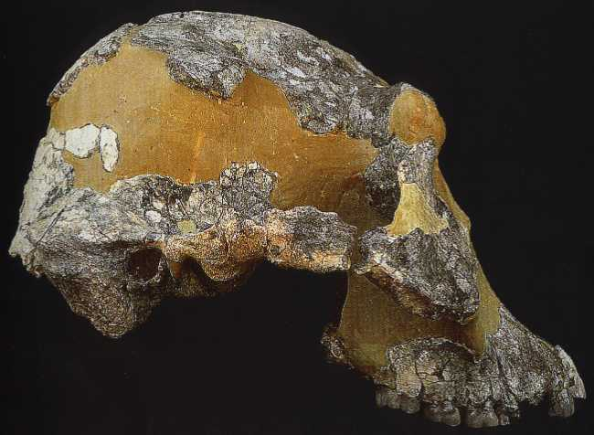
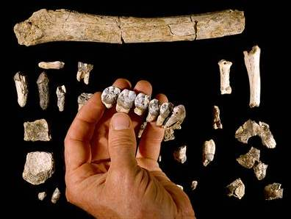
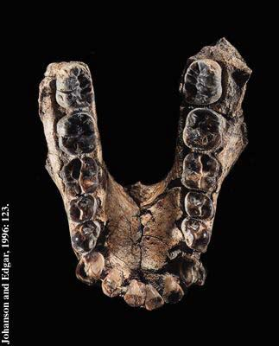
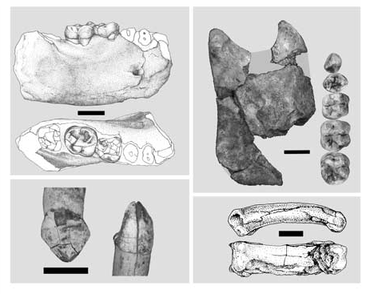
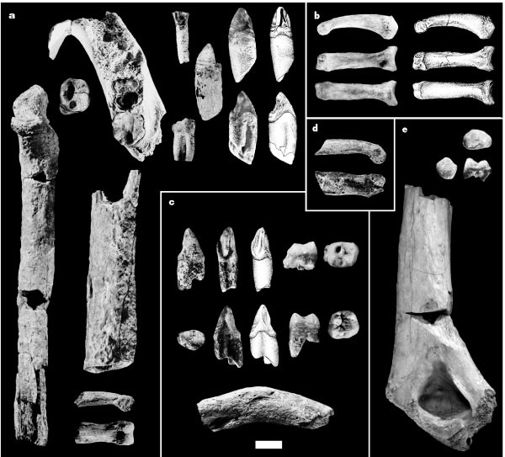
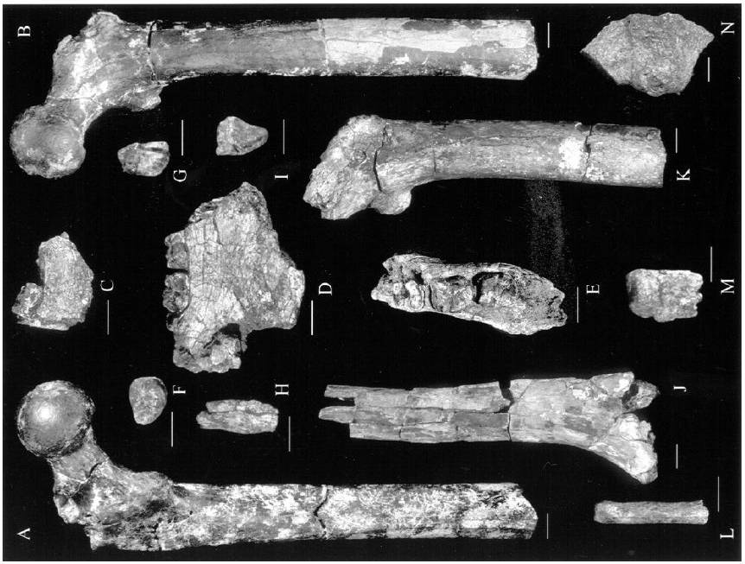
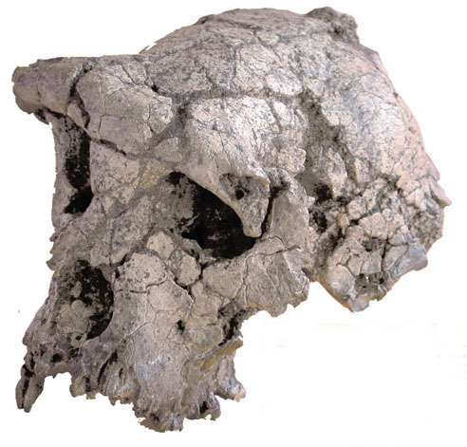
Pan paniscus
9
0-----
1.0--
2.0--
3.0--
4.0--
5.0--
6.0--
7.0--
500
5
Homo sapiens
Homo floresiensis
Homo neanderthalensis
50
Homo rhodesiensis
Pan troglodytes
5
H. floresiensis (“the Hobbit”) and H. sapiens skulls. H. floresiensis fossils date from 13,000 to 94,000 years.
Homo heidelbergensis
10
Homo cepranensis
20
Homo antecessor
1
Homo erectus
4
Paranthropus robustus
90
20
6
20
5
Homo georgicus
Homo ergaster
“Turkana Boy”, H. ergaster, found in 1984 by Richard Leakey’s team near Lake Turkana, Kenya. The fossil is of a boy, 11-12 years old, standing 1.6m. Dated to 1.5 mya.
Homo habilis
15
Homo rudolfensis
2
Paranthropus boisei
5
3
P. boisei (called the‘Nutcracker Man’) discovered in 1959 by Mary Leakey in Oduvai Gorge, Tanzania. Dated to 1.8 mya
130
1
Australopithecus garhi
Paranthropus aethiopicus
Australopithecus africanus
1
120
Australopithecus bahrelghazali
1
MILLIONS OF YEARS BEFORE PRESENT
Kenyanthropus platyops
Adult male skull of A. afarensis discovered By Bill Kimbel and Yoel Rak in Ethiopia in 1991.
Dated to 3.0 mya
Australopithecus afarensis
Two sets of bipedal tracks at Laetoli, Tanzania. Discovered by Mary Leakey’s team in 1976 and attributed to A. afarensis. Dated to 3.6 mya.
6
The “Lucy” specimen of A. afarensis, discovered by Donald Johanson’s team in Ethiopia in 1974. Dated to 3.2 mya
Jaw from A. anamensis, discovered in Kanapoi, Kenya by Meave Leakey. Dated to 4.15 mya.
Australopithecus anamensis
Legend:
= Genus Pan
= Genus Homo
= Genus Australopithecus
= Genus Paranthropus
= Genus Kenyanthropus
= Genus Ardipithecus
= Genus Orrorin
= Genus Sahelanthropus
15
1
‘Molecular clocks’ based on DNA mutation rates date the split between the human lineage and chimpanzee lineage to 6-8 million years. Bipedality (and its many associated traits ) and subtleties of dentition are the benchmarks used to place fossils in the human lineage. Based on the structure of the femur, O. tugenensis was bipedal. However, the bipedality of S. tchadensis is still debated.
Ardipithecus ramidus
2
There is considerable debate regarding the ancestry of Homo habilis, because each of the possible Australopithecus ancestors are more similar to H. habilis in some characteristics but more different in others. In addition, the origin and affinity of A. garhi is also debated because it has a mixture of Australopithecus and Homo features.
Ardipithecus kadabba
Family Hominidae
Genus: Pongo Gorilla Pan Homo
Tribe: Gorillini Hominini
Subfamily: Ponginae Homininae
Family: Hominidae
Living species in each genus:
Pongo (Orangutans):
Pongo pygmaeus (Bornean Orangutan)
Pongo abelii (Sumatran Orangutan)
Gorilla (Gorillas):
Gorilla gorilla (Western Gorilla)
Gorilla beringei (Eastern Gorilla)
Pan (Chimpanzees):
Pan troglodytes (Common Chimpanzee)
Pan paniscus (Bonobo Chimpanzee)
Homo (Human):
Homo sapiens (Modern human)
3
H. rudolfensis , K. platyops, and A. bahrelghazali are represented by very few fossils. The skulls are argued (by some) to differ enough from H. habilis (for H. rudolfensis) and A. afarensis (the two others) to warrant species recognition. Their relationships to A. garhi and H. ergaster are also debated.
5
Pictures are not to the same scale.
The number inside each bar is the minimum number of individual organisms found of each extinct species (up to 1996), not the number of single fossil bones or fragments. For example, the entire “Lucy” skeleton (shown above) counts as ‘1’. Most values are from Johanson and Edgar (1996); others (like species discovered in the last 10 years – see citation list on right wall) were compiled from the literature.
4
The name H. ergaster is applied to early populations of H. erectus from Africa. Fossils from Dmanisi, Georgia,have been named H. georgica, and represent the earliest Homo fossils found outside of Africa. They are also intermediate between H. habilis and H. erectus. The ancestry among these four species is debated.
Orrorin tugenensis
5
5
H. cepranensis, H. antecessor, H. heidelbergensis, and H. rhodesiensis are combined in different ways, sometimes all as H. heidelbergensis. H. heidelbergensis is accepted as the ancestor of H. neanderthalensis, and is often referenced as ancestral to H. sapiens. But a recent study (Gonzalez-Jose et al., 2008) suggests that H. sapiens and H. rhodesiensis are more similar to H. erectus and H. ergaster.
1
References used for constructing the timeline:
Foley, J. 2009. Fossil hominids. Talk Origins Archive. http://www.talkorigins.org/faqs/homs/index.html Accessed February 16, 2009.
Freeman, S., and J. C. Herron. 2004. Evolutionary analysis (3rd Ed.). Pearson Education, Inc.
Smithsonian Institution. 2006. The human origins program. http://anthropology.si.edu/humanorigins/index2.htm. Accessed February 12, 2009.
MacEvoy, B. 2008. Human Evolution. http://www.handprint.com/LS/ANC/evol.html. Accessed February 12, 2009.
Sahelanthropus tchadensis
3

