Slide 1
Genetic Patterns of Ashkenazi Jews
Victoria Olson

Slide 2
Ashkenazi Jews
A subculture of Judaism consisting of the descendants of Jews from France, Germany, and Eastern Europe
The largest genetically isolated group in the United States
About 47% more mutations than non-Jewish Europeans
High incidence of rare genetic diseases, as well as more common disorders and cancers

Slide 3
Ashkenazi Jewish Genetic Diseases
38 known diseases
1 in 2 Ashkenazi Jews are a carrier for at least one
Most are autosomal recessive
Gaucher Disease-Type 1 is the most common
1 in1,000 AJs, 1 in 14 are carriers

Slide 4
Gaucher Disease-Type 1
Enlargement of liver and spleen
Low red blood cell count
Low platelet count
Lung disease
Fragile bones
Autosomal recessive
Mutation on chromosome 1
Fats accumulate in cells and organs due to enzyme deficiency

Slide 5
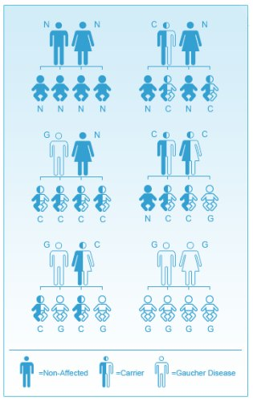

Slide 6
Breast Cancer
Higher risk of BRCA1/2 mutations
1/400 of general population have a mutation
1/40 of AJs have a mutation
Population-based genetic testing may detect 56% more BRCA carriers than family history-based testing alone
BRCA 1/2 increases breast cancer risk 40-70% (general population=12%)

Slide 7
Carmi Study
Most thorough study of Ashkenazi Jewish genetics
Sequenced genomes of 128 individuals and compared with non-Jewish Europeans
So similar, 30th cousins
Descended from 350 people
600-800 years ago

Slide 8
Benefits
Knowing which mutations are normal for a person of Ashkenazi Jewish heritage
Mapping disease-causing alleles
Finding new disease-causing alleles
Research of disorders
Identifying the genetics of founding population
Understanding AJ history

Slide 9
Risch Study

Slide 10
Causes of Genetic Patterns
Isolation
Genetic Drift
Founder’s Effect

Slide 11
Founder’s Effect
Started with subgroup of only 350
Members happened to have certain alleles
Disease-causing mutations were not selected out
Diverged from main population in Middle East, subpopulation moved to Central Europe, subpopulation moved to Eastern Europe
More mutations taking hold each time

Slide 12
Genetic Drift
Historical tendency of Jewish people to marry and reproduce within their faith and community
Limited introduction of new alleles to lower frequency of deleterious alleles
Alleles passed on by chance, not fitness
Less and less genetic variation in population
Low genetic variation+high mutation load =increased chance of 2 parents w/ disorder allele
Lack of gene flow between Jewish and Non-Jewish populations, keeping the diseases within the AJ community

Slide 13
Citations
Bray, Steven M., Jennifer G. Mulle, and Anne F. Dodd. "Signatures of Founder Effects, Admixture, and Selection in the Ashkenazi Jewish Population." Proceedings of the National Academy of Sciences of the United States of America 107.37 (2010): 16222-6227. Www.pnas.org. HighWire Press, 14 Sept. 2010. Web.
Carmi, Shai, Ken Y. Hui, and Ethan Kochav. "Sequencing an Ashkenazi Reference Panel Supports Population-targeted Personal Genomics and Illuminates Jewish and European Origins." Nature Communications 5 (2014): n. pag. 09 Sept. 2014. Web.
Charrow, Joel. "Ashkenazi Jewish Genetic Disorders." Familial Cancer 3 (2004): 201-206. Web.
"Jewish Genetic Diseases." Jewish Genetic Disease Consortium. N.p., 2014. Web.
"Jewish Genetics." Center for Jewish Genetics. N.p., 2014. Web.
Manchanda, Ranjit, Kelly Loggenberg, and Saskia Sanderson. "Population Testing for Cancer Predisposing BRCA1/BRCA2 Mutations in the Ashkenazi-Jewish Community: A Randomized Controlled Trial." Journal of the National Cancer Institute 107.1 (2014): n. pag. Oxford University Press, Nov. 2014. Web.
Neil, Risch, Hua Tang, Howard Katzenstein, and Josef Ekstein. "Geographic Distribution of Disease Mutations in the Ashkenazi Jewish Population Supports Genetic Drift over Selection." American Journal of Human Genetics 72.4 (2003): 812-822. 24 Feb. 2003. Web.
Stadler, Zsofia K., Erin Salo-Mullen, and Sujata M. Patil. "Prevalence of BRCA1 and BRCA2 Mutations in Ashkenazi Jewish Families with Breast and Pancreatic Cancer." Cancer 118.2 (n.d.): 493-499. 19 May 2011. Web.

