Slide 1
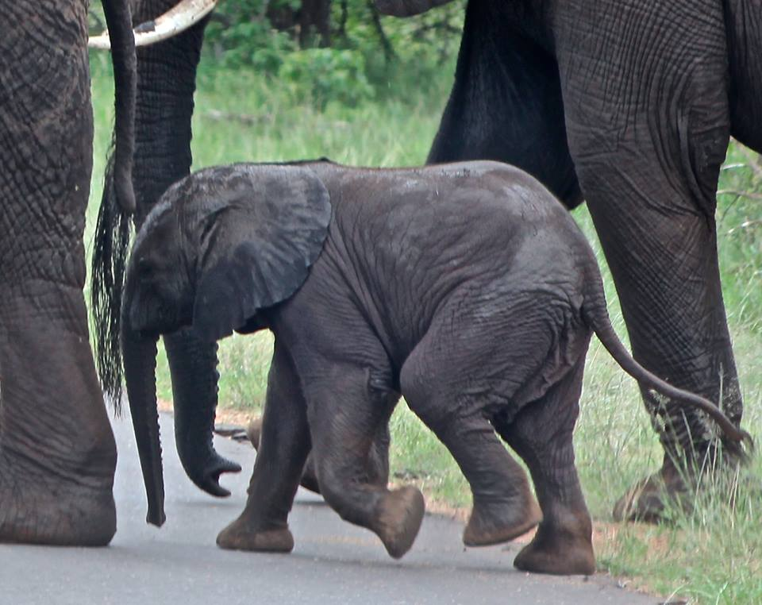
Elephantidae

Slide 2
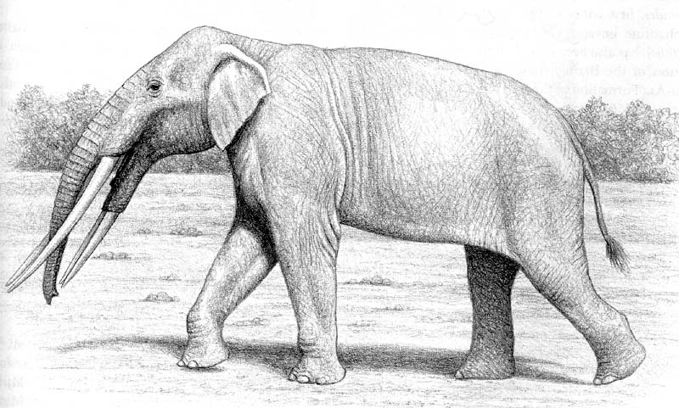
Stegotetrabelodon
Stegotetrabelodon
Ancestor to Primelelaphus gomphotheroides,
Found in the Miocene and Pliocene deposits 7 million years ago
Had a large pair of mandibular incisors and other characters common in the Gomphotheriidae, but absent in all late elephants.

Slide 3
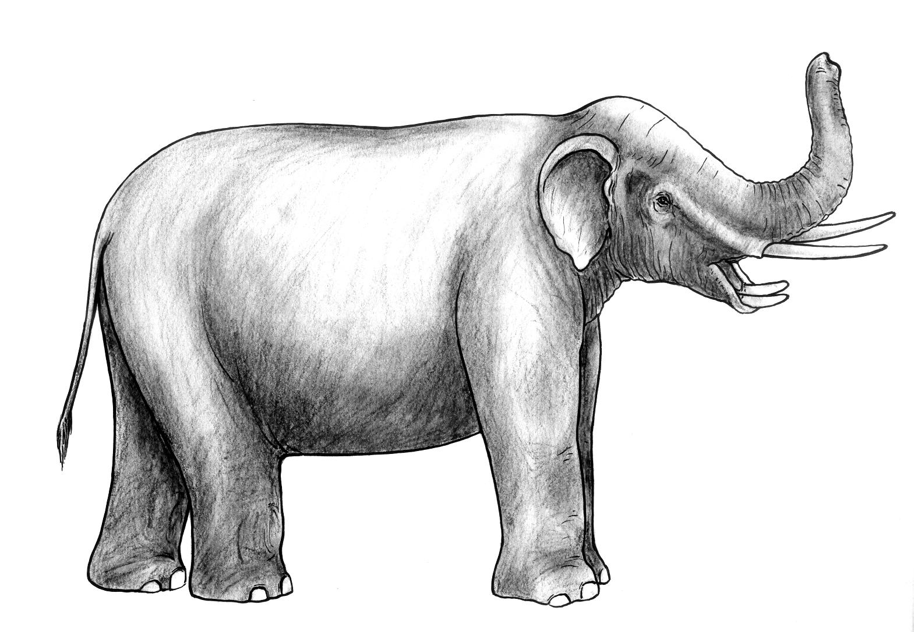
Primelelaphus gomphotheroides
Physical features in dentition that set P. gomphotheroides apart from Stegotetrabelodon.
P. gomphotheroides
more consolidated teeth plates
a median cleft that is lacking (except on 1st plate)
an increased number of plates
individual pillars that are less defined.
Also species of both Stegotetrabelodon orbus and P. gomphotheroides are found to have been living simultaneously approximately 4-5 mya.
likely share a Stegotetrabelodon ancestor.
Elephants and Mammoths are thought to be descendants of the common ancestor Primelephas gomphotheroides.
The molar teeth of Gomphotheriidae are already modified to the elephant type shearing mechanism we see in early species and in species today.

Slide 4
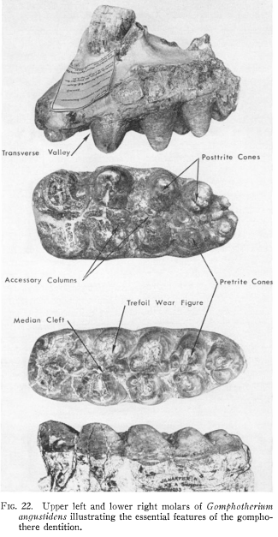

Slide 5
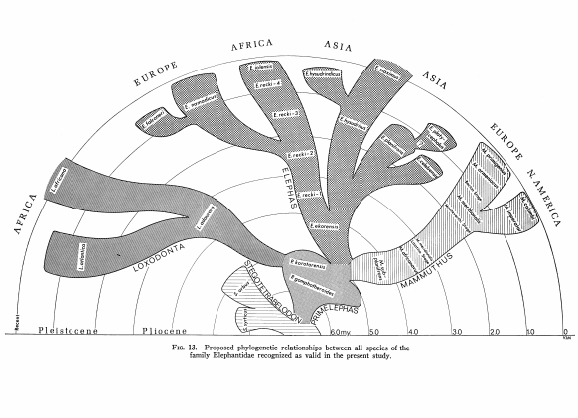

Slide 6
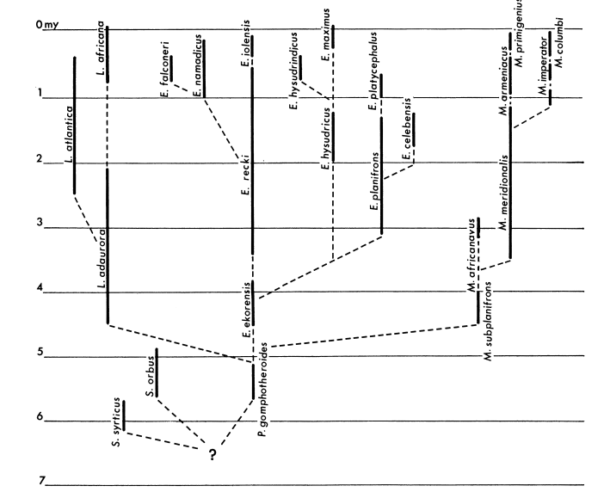

Slide 7
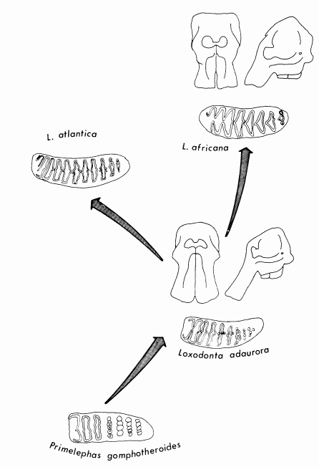
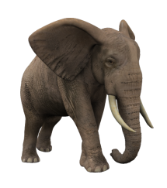
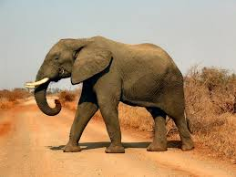
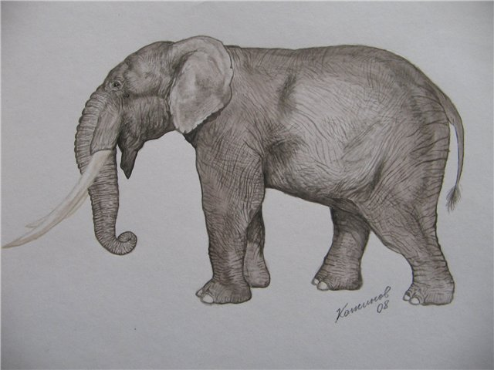
Numerous isolated teeth
A fragmentary skull
Molars more progressive
Greater number of plates
Higher crowns L
Larger median loops,
Teeth are often distinctly bifurcated
Less progressive
Enamel is not folded
They have a lower crown
Median enamel loops that are simple
Number of teeth plates is not as great
Large loops of wear
Posterior column partially fused

Slide 8
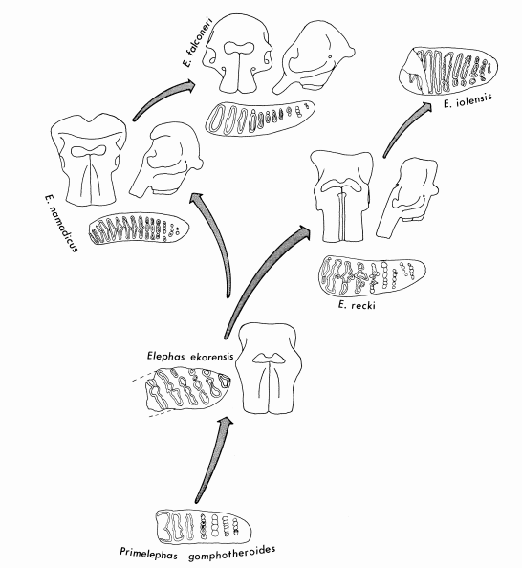
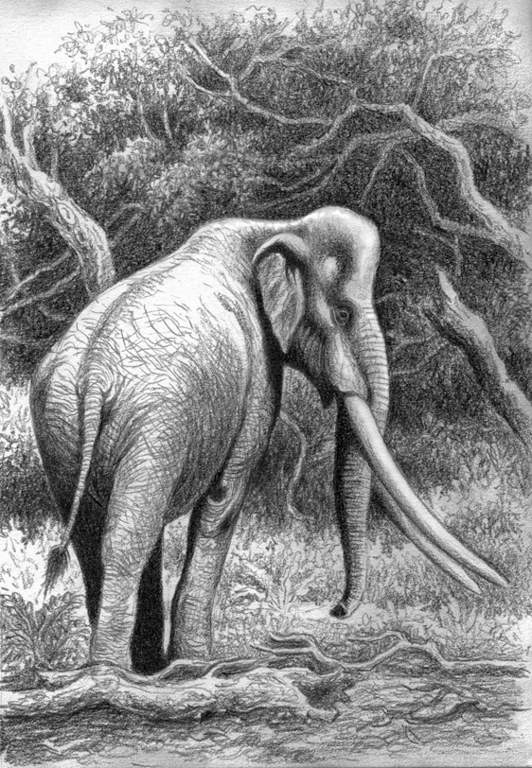

Slide 9
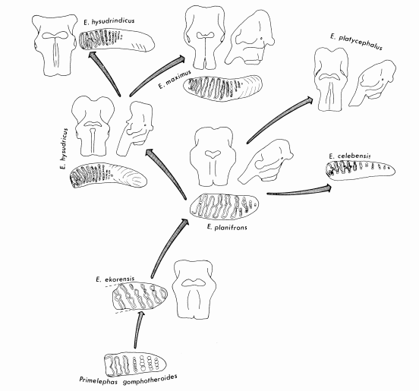
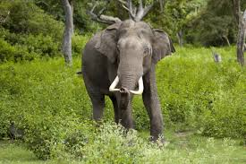
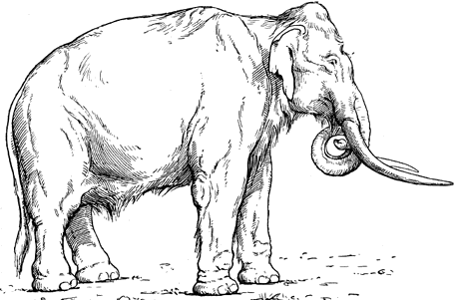
Reduction of tusks
Reduction of premaxillary region
Greater absolute size than E. maximus.

Slide 10
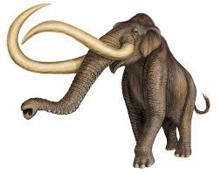
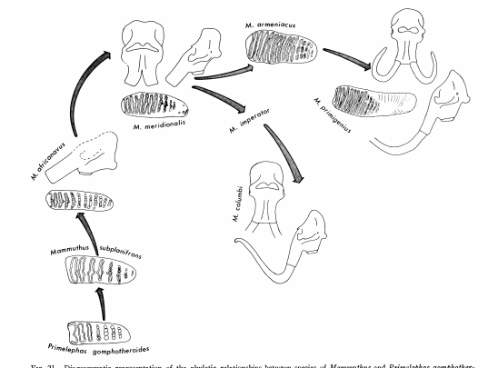
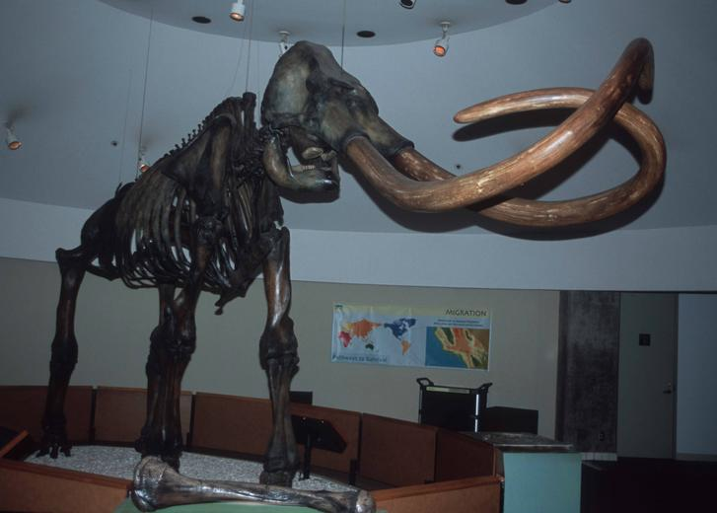
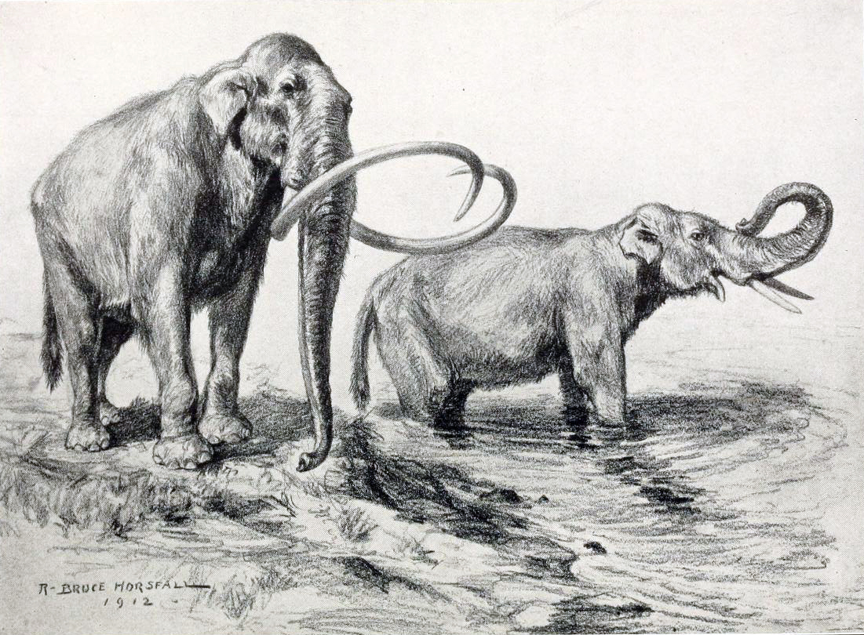
shows progressive molar and cranial changes through middle to late Pleistocene
Broader molars
More massive jaws

Slide 11
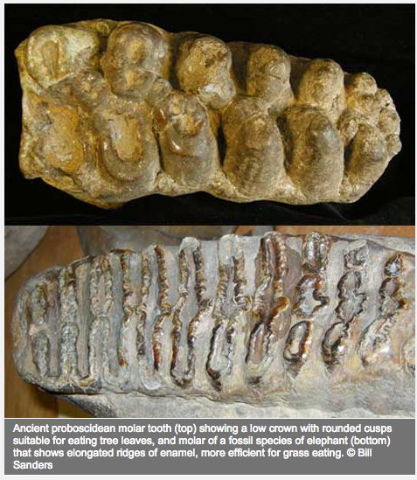
Teeth Evolution
Highly efficient molar change over time.
Predominant movement during power-shearing is a fore and aft movement.
Not as much a lateral movement.
This is one of the major adaptive changes that characterized the rise of the Elephantidae.
This movement showed a rapid reduction of the grinding component of mastication in favor of the shearing component, which overall reduces the wearing of teeth to a slower rate
Important because the growth of new teeth is what they depend on for survival.
Otherwise they starve to death.

Slide 12
End of the Pleistocene—mass extinction event—the majority of the member of the Elephantidae group went extinct.
Human colonization is one of the primary triggers for this event
Based on many characteristics unique to elephants—size, generation time, reproductive characteristics, etc.
Late glacial environmental change, including rising CO₂ concentrations and elevated temperatures and precipitation, prompted nutrient deceleration in North America.
The carrying capacity of the ancient landscape declined and mega faunal populations collapsed.

Slide 13
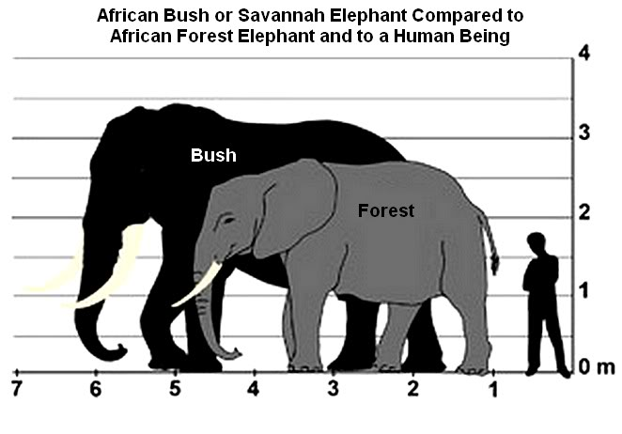
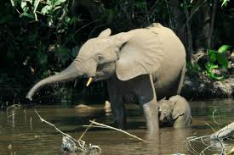

Slide 14
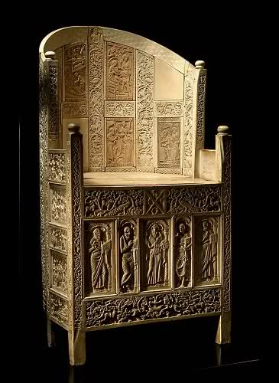
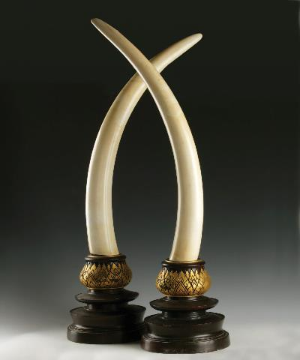
Ivory Chair of Bishop Maximianus (Italy)
Elephant population size concerned with poaching.
Tusks are specialized teeth with very little enamel except for at the tip and are instead composed almost entirely of dentine. Top incisors.
They can up root entire trees and use them in male to male competition.
The Convention of International Trade in Endangered species, CITES, has outlawed the trade of African ivory, except for artifacts known to predate 1947

Slide 15
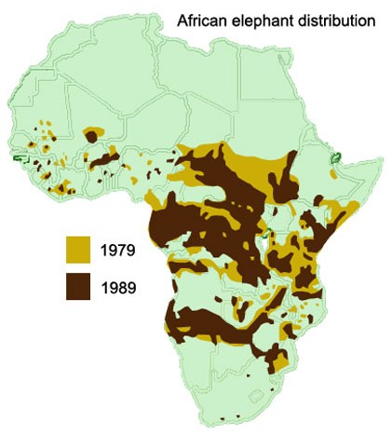
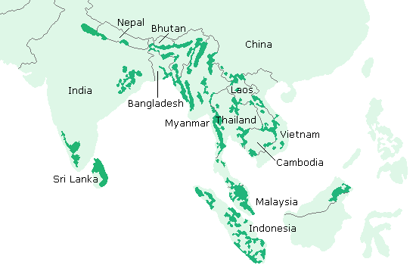
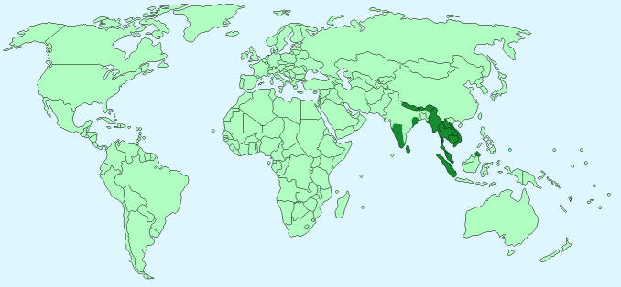
Elephant Distribution

Slide 16
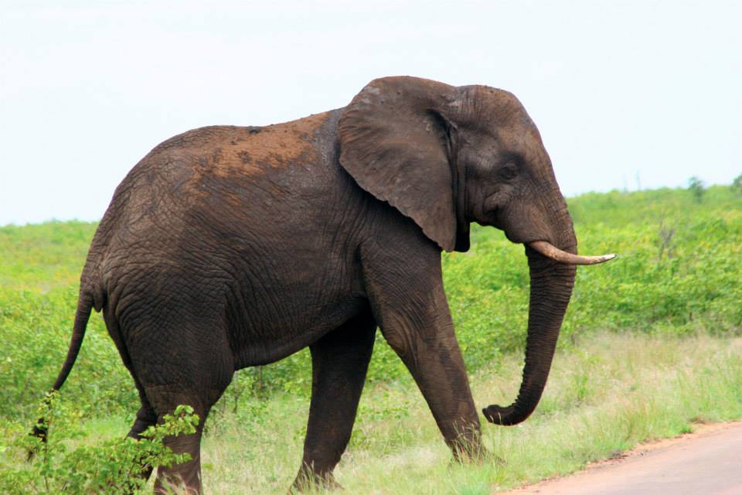
African Elephants…
Five meters in height
Five to seven tons
Consumes 300 kg of food daily
Drinks 200 liters of water
Produces 150 kg of dung.
They can live for 60 years
Die of malnutrition in absence of predation disease, and poaching.
Culling: For example in Kruger National Park 400- 500 are each year. Necessary to maintain habitat and control population growth.
They increase 6% per year in population size and calve every four to eight years.
Meaning that their numbers double every 12 – 15 years.

Slide 17
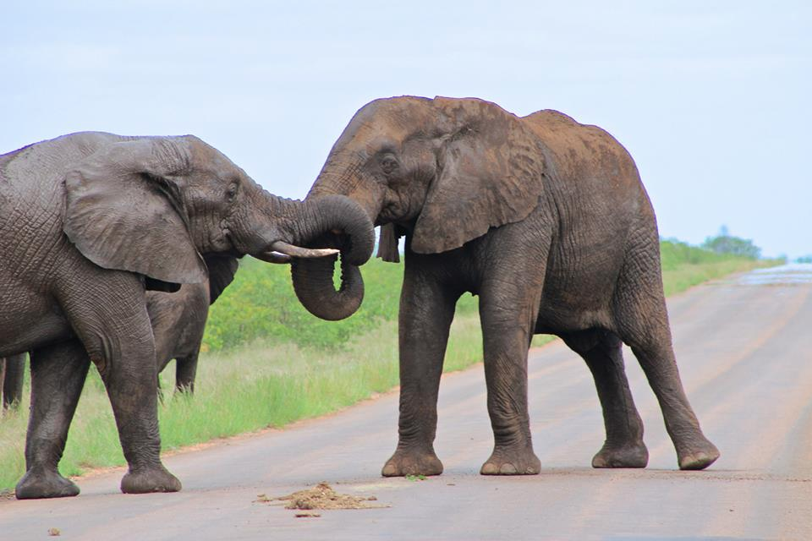
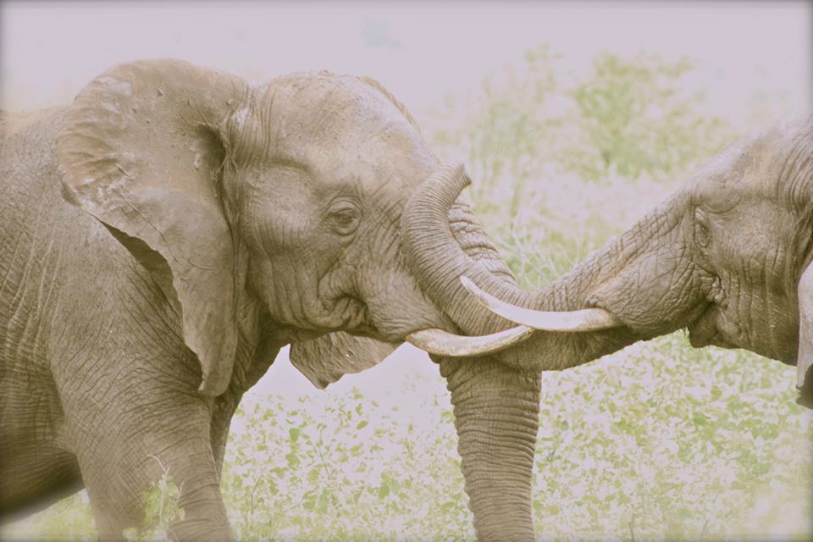
Another interesting topic to look into is Elephants Social Behaviors.
They are actually quite complex, including their communication.
A matriarch and separate male and female groups
Also check out the uneven tusks.

