Slide 1

Inbreeding in Thoroughbred Racehorses
By Katherine Taylor

Slide 2
Inbreeding
When genetic relatives breed with one another
Effects?
  Loss of heterozygosity across the entire genome
  Increase in reproductive depression
  Decrease in overall fitness
Inbreeding coefficient “F” measures the probability of autozygosity (both gene copies are identical by descent)

Slide 3
Inbreeding in Thoroughbreds
Dr. M Binns performed a study where 467 foals’, born between 1961 and 2006, DNA was evaluated through 5000 SNPs to determine how the inbreeding coefficient F has changed over the past 45 years
Proved that over the past 45 years inbreeding has increased significantly in the race horse industry
  Majority post 1996

Slide 4
Why has inbreeding increased?
Stallions are covering more mares
  Stallions used to bred with around 40 mares per breeding season, now top stallion are breeding with around 200

Slide 5
Pedigree Studies
Even though there is DNA evidence that inbreeding has increased there still isn’t any DNA evidence that inbreeding is causing the breed to become less fit
Many people have come to the conclusion that the breed has become less fit because of inbreeding thorough pedigree analysis
Many horses that have Native Dancer and Mr. Prospector in their pedigree and are inbreed are much more likely to break down

Slide 6
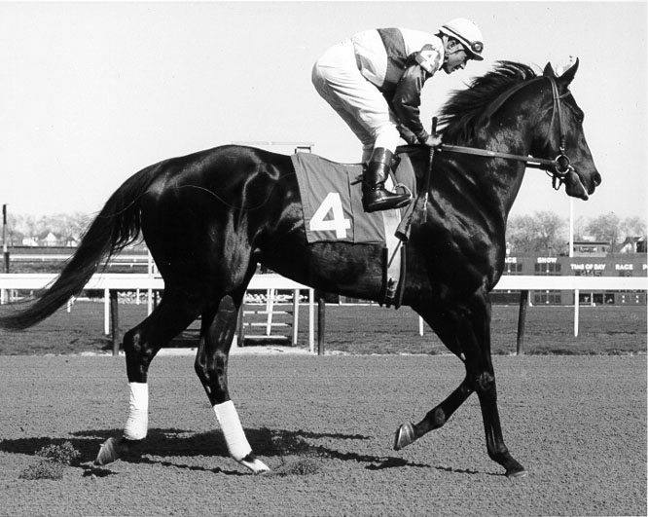
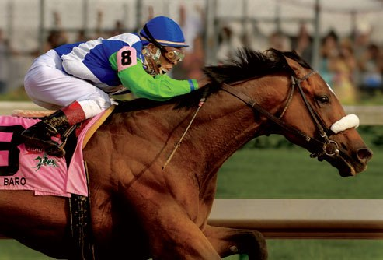
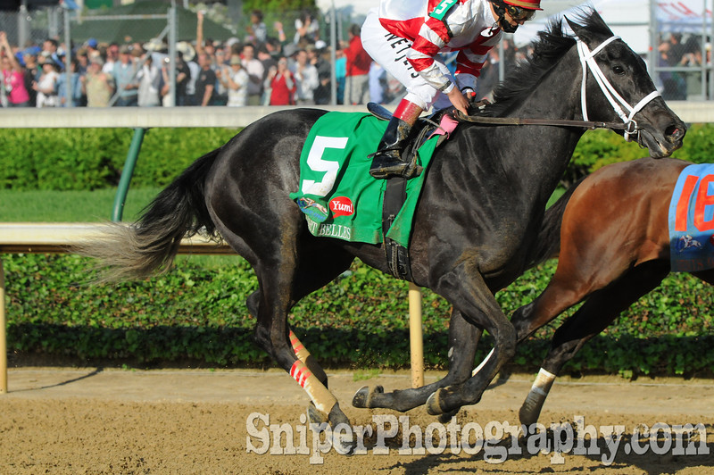
Recent breakdowns
Ruffian (1975)
Barbaro (2006)
Eight Belles(2008)
Many more

Slide 7
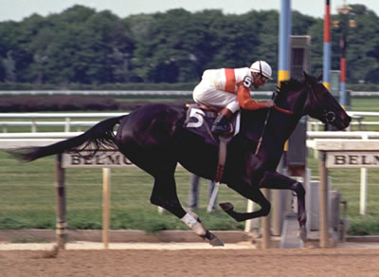
Ruffian
Broke front leg at the end of a race
Sire was known for breaking down
Grandfather on Dams side was Native Dancer
4 cases of inbreeding
http://www.equineline.com/Free-5X-Pedigree.cfm?page_state=ORDER_AND_CONFIRM&reference_number=430198&registry=T&horse_name=Ruffian&dam_name=Shenanigans&foaling_year=1972&nicking_stats_indicator=Y

Slide 8
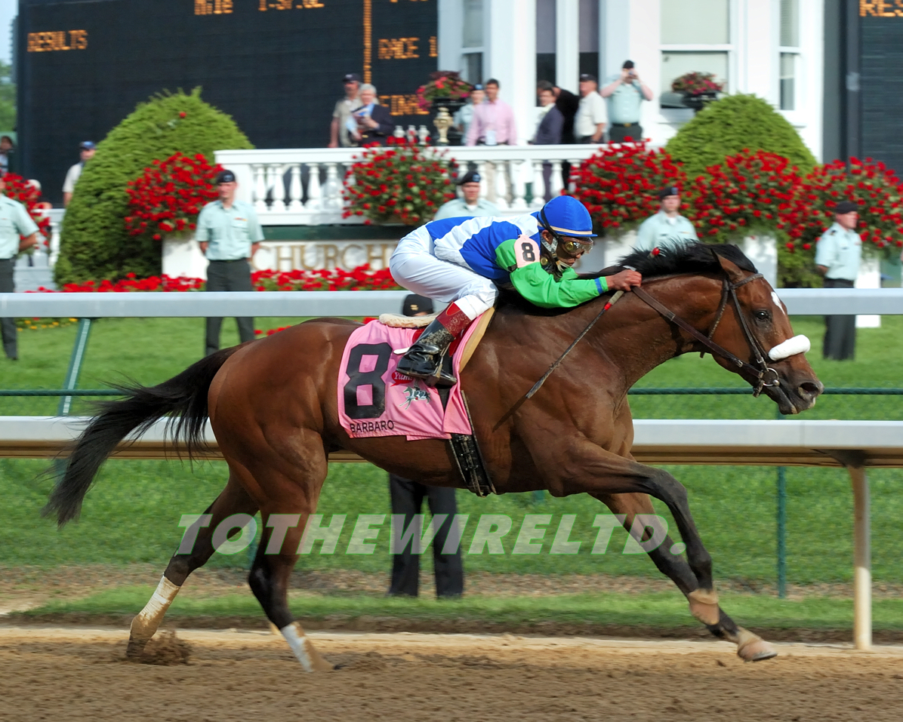
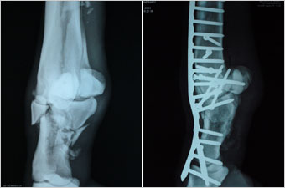
Barbaro
Broke hind leg at the start of the Preakness after winning the Kentucky Derby
Both Native Dancer and Mr. Prospector
Only 1 case of inbreeding
http://www.equineline.com/Free-5X-Pedigree.cfm?page_state=ORDER_AND_CONFIRM&reference_number=6892710&registry=T&horse_name=Barbaro&dam_name=La%20Ville%20Rouge&foaling_year=2003&nicking_stats_indicator=Y

Slide 9
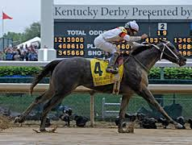
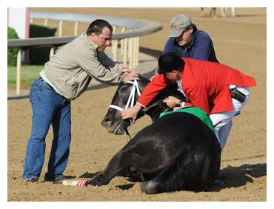
Eight Belles
Broke one front ankle after finishing 2nd in the Kentucky Derby and then broke the other front ankle after compensating the for the first broken ankle
Euthanized on the track
Inbreed four time total
Inbreed with Native Dancer and Mr. Pospector
http://www.equineline.com/Free-5X-Pedigree.cfm?page_state=ORDER_AND_CONFIRM&reference_number=7406694&registry=T&horse_name=Eight%20Belles&dam_name=Away&foaling_year=2005&nicking_stats_indicator=Y

Slide 10
Secretariat…a comparison
Born in 1970
21 starts
No inbreeding
No life threating injuries
http://www.equineline.com/Free-5X-Pedigree.cfm?page_state=ORDER_AND_CONFIRM&reference_number=444670&registry=T&horse_name=Secretariat&dam_name=Somethingroyal&foaling_year=1970&nicking_stats_indicator=Y

Slide 11
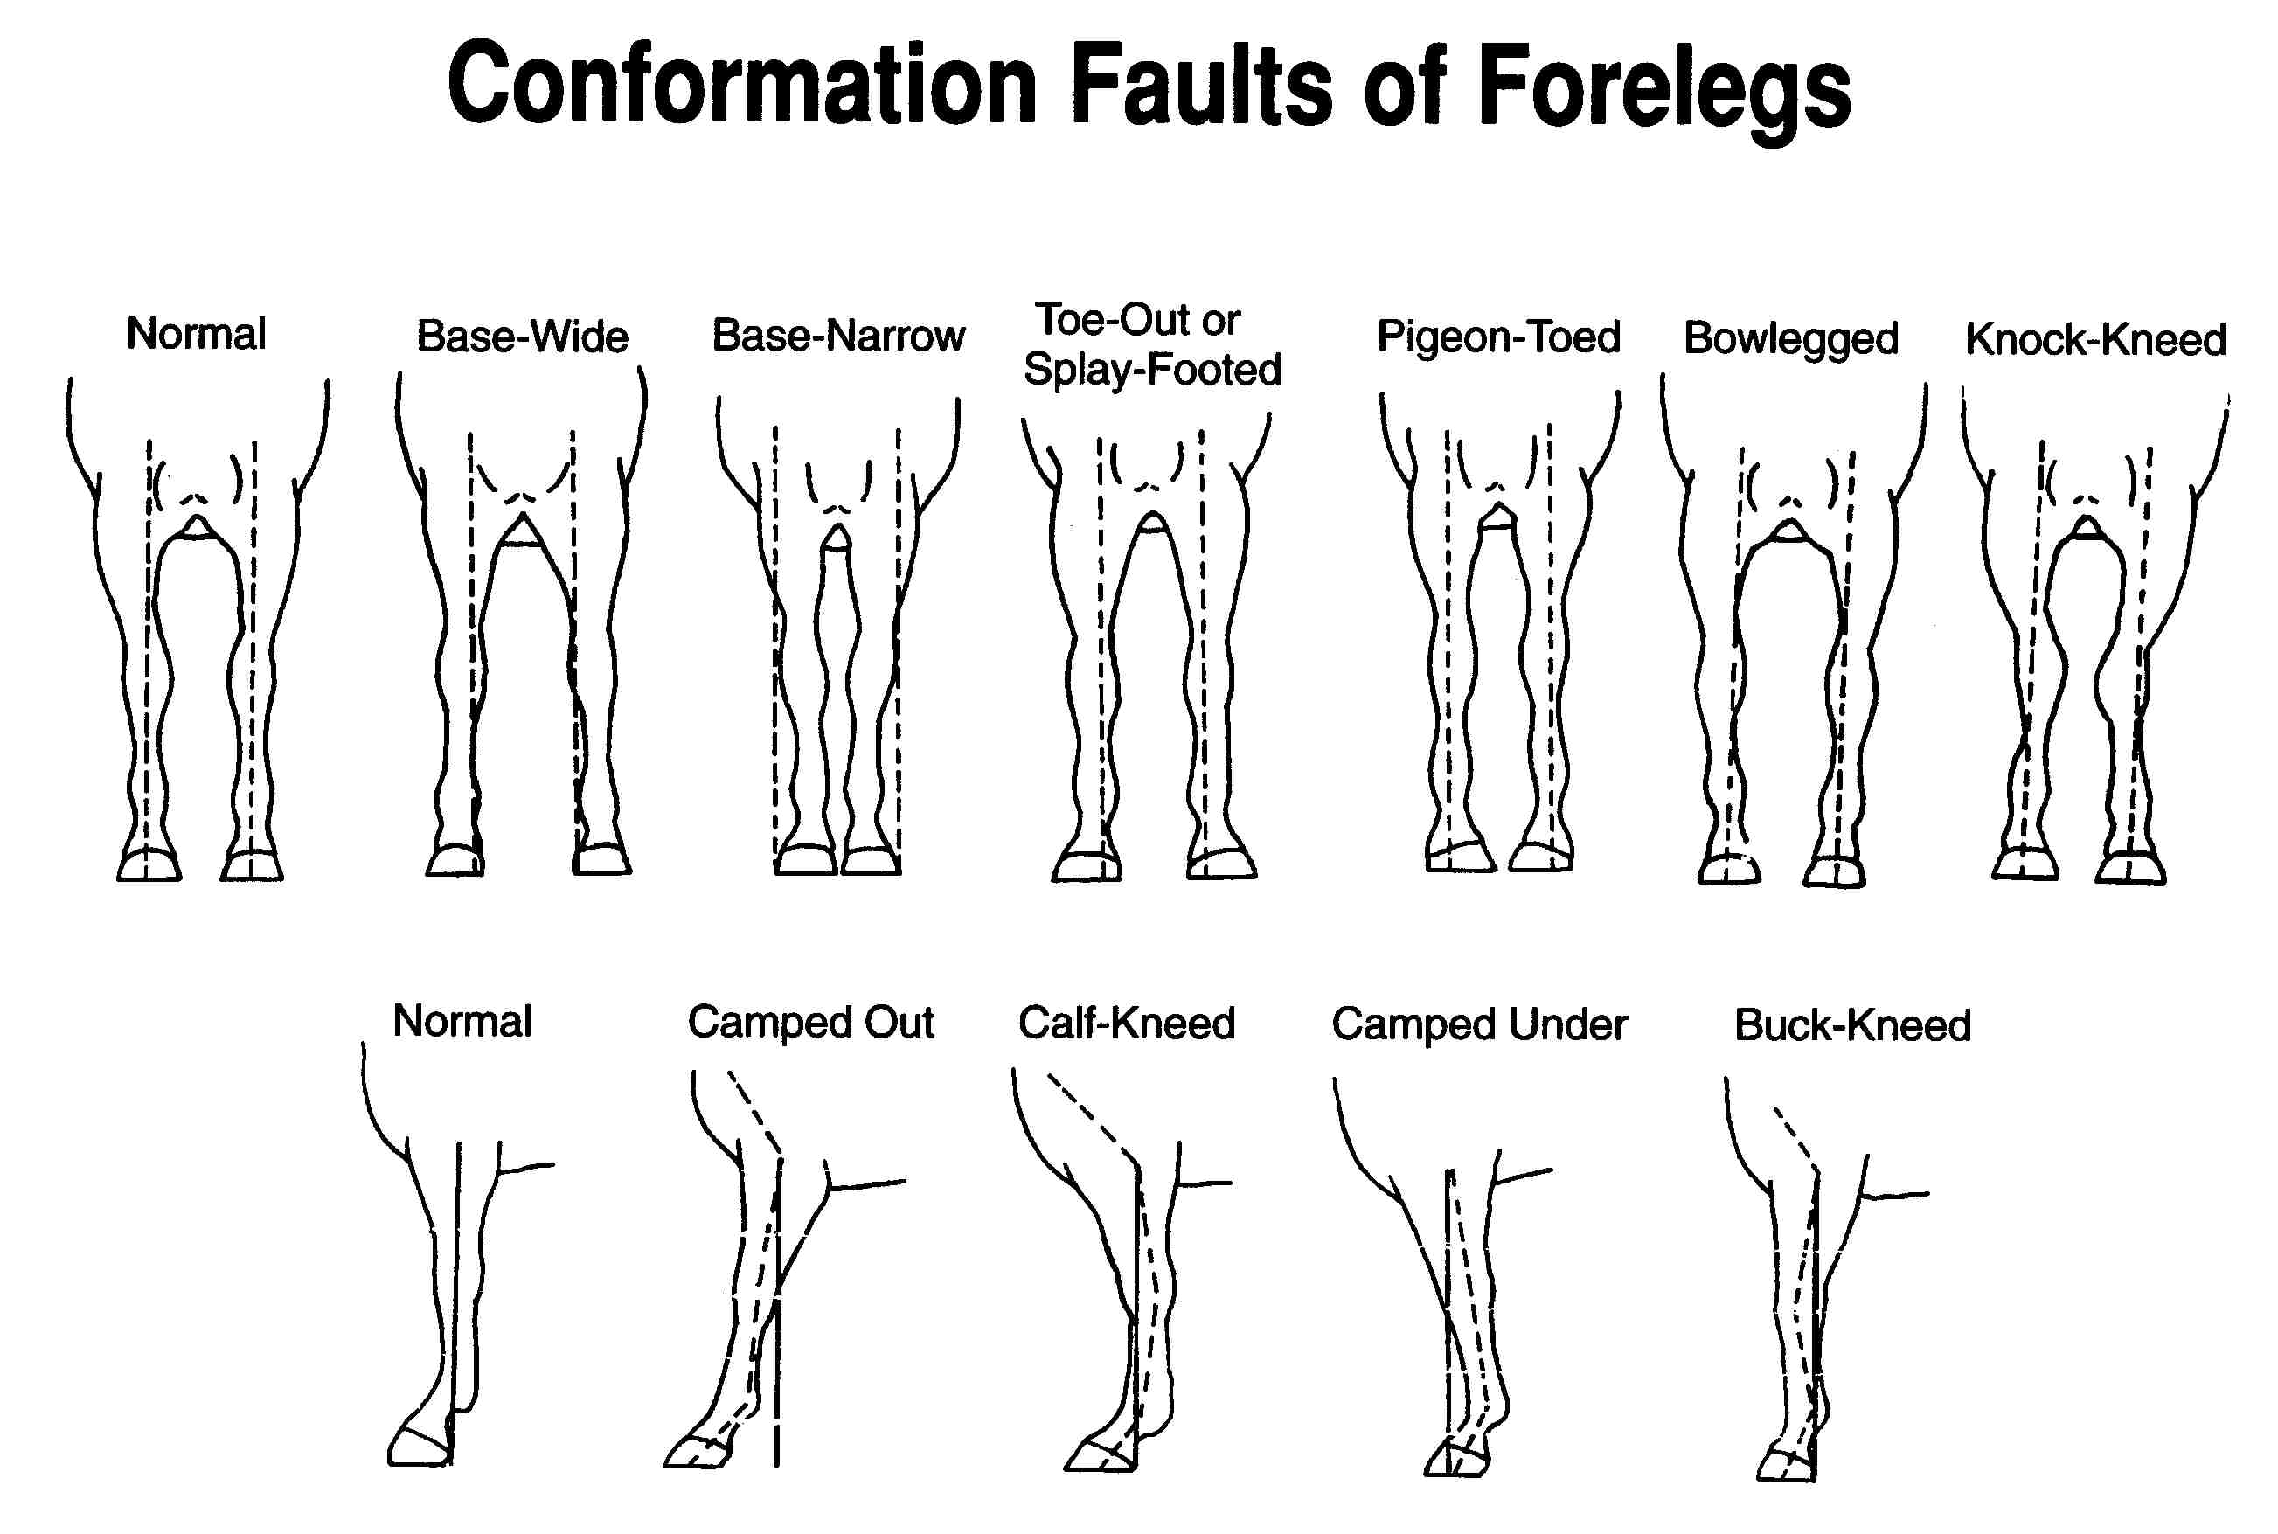
How else do we know they are becoming less fit?
Horses are racing in less races per year
  Horses in the 70’s raced in around 12 races per year, now they are only racing in 6 because they can’t hold up to more work
The build, or conformation, of the thoroughbred has changed
  Used to be broad chested and knock-kneed, similar to a human distance runner
  Now they are narrow chested and bowlegged, similar to a human sprinter

Slide 12
Why do breeders want this type of foal?
Instead of keeping the foals to race they get sold at auctions
In order for the foal to get sold for a large sum of money they must have the sprinter-like build and certain bloodlines so they will be competitive

Slide 13
Works cited
Allin, Jane. "Breeding for Breakdowns." Breeding for Trouble Part 1. HorseFund, Apr. 2011. Web. 02 Dec. 2014.
Allin, Jane. "Horse Racing." Breeding for Trouble Part 3. HorseFund, Apr. 2011. Web. 02 Dec. 2014.
Binns, M. M. "Inbreeding in the Thoroughbred Horse." Animal Genetics, 8 Nov. 2011. Web. 02 Dec. 2014.
Nack, William. "Eight Belles' Breakdown: A Predictable Tragedy."ESPN.com. ESPN, 16 Jan. 2009. Web. 02 Dec. 2014.
Peters, Anne. "Why Inbreeding." The Pedigree Post. N.p., 16 Sept. 2001. Web. 02 Dec. 2014.
Walker, Matt. "Are Racehorses Being Breed to Destruction?" BBC News. BBC, 18 Nov. 2011. Web. 02 Dec. 2014.

