Slide 1
Importance of Genetic Variation in Captive Breeding Programs
How to conserve and manage specific species populations
Jenny J. Warnken

Slide 2
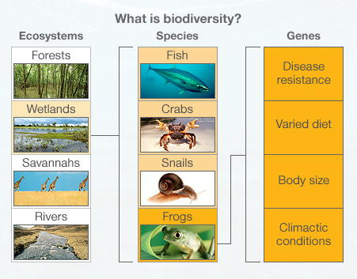
Global Biodiversity
*The variety of living organisms and the variety of processes
that support these organisms*

Slide 3
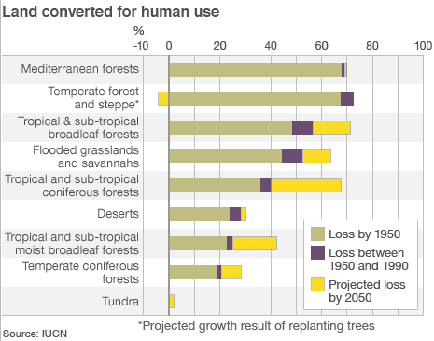
Global Biodiversity
Notes:
Dwindling due to human impacts – give examples
We should value biodiversity – give reasons
Due to this habitat loss, biodiversity is being lost at all levels, ecosystem, species are deceasing, pop size decreasing, genetic diversity decreasing
Genetic diversity has become a major issue in conservation biology

Slide 4
Genetic Diversity – major issue in Conservation Biology
Preservation of genetic variation among and within individuals is imperative
to maintain viable populations
to support higher levels of biodiversity
Genetic diversity of a population suggests its evolutionary potential to adapt to novel environmental changes

Slide 5
Ways to Measure Genetic Diversity
Correlation between individual variation and variation within a population
Individual Variation:
Proportion of heterozygous loci in an individual
Variation within Population:
Characterized by inter-individual diversity
Fraction of polymorphic loci
Gene diversity (heterozygosity expected under HWE)
Amount of distinctive alleles per locus

Slide 6
Reduction in Population Size
Susceptible to environmental, catastrophic, demographic, or genetic “stochastic” events
Inbreeding depression
Loss of genetic variation
Inbreeding
Action of mating between closely related individuals
Leads to reduced heterozygosity and fitness
Notes:
Examples of genetic events
Inbreeding - Increased likelihood of two alleles at a single locus beign identical by descent from a common ancestor from both parents

Slide 7
Negative Effects on Fitness
Individual Level
Increase mortality
Lower fecundity
Slower growth rates
Increase developmental defects
Population Level
Extinction more likely
Less likely to be able to rebound
Notes:
On individuals Increase mortality
Lower fecundity
Difficulty mating
Slow growth rates
Destabilizing development
Increase developmental defects
Lower immunity to diseases
Decrease ability to handle stress
Lower competitive abilities
Population –
Extinction becomes more likely as lowered fecundity and survival of inbred individuals slows growth rate
Slow growth rate reduces ability of population to rebound after a stochastic event

Slide 8
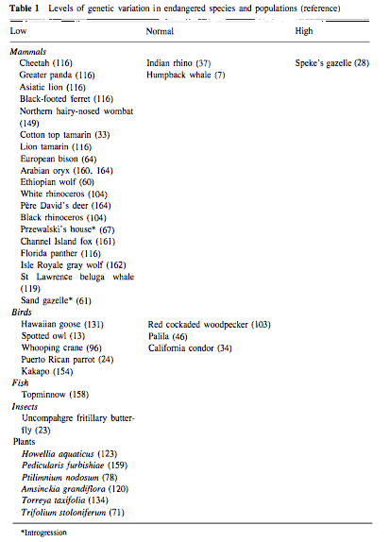
(Frankham 1995)

Slide 9
Human Intervention
Optimize species management to ensure survival
Captive breeding programs
Help grow population sizes
Save threatened/endangered species from extinction
*Due to small size of captive populations – typically have lower genetic variability than wild populations*

Slide 10
SSP Programs
Species Survival Plans managed by the AZA
Cooperative population management and conservation programs for particular species (usually endangered) in captivity
450 SSP Programs exist
Managed by a Taxon Advisory Group (TAG)
Identify population management goals
Make recommendations to support the resilience of a healthy, genetically diverse, and demographically varied captive population
Manage breeding plans (studbook, breeding vs. non-breeding, transfers)
Research, public education and outreach, in situ reintroduction, field projects

Slide 12
Richard Frankham
Conservation and Evolutionary Genetics
Research on evolution in captivity, how this affects reintroduction into the wild
Suggests to first define program’s objectives
Maintain gene diversity
Avoid inbreeding
Conflicts between these two goals?
Now alleles from both families will have an equal opportunity to increase in frequency – leads to higher diverse gene pool within the population while avoiding inbreeding
Notes:
Maintain gene diversity – maintained by breeding populations made up of indivudals from many diffent family groups or lineages
Each family group should have an equal number of descendants
Avoid inbreeding - Breed individuals form one family group with an individual from an entirely different family group
To reach both goals – families with too many living members need to be bred less often, families with too few need to be bred more
Avoid inbreeding while equalizing family groups by breeding unrelated individuals from similarly sized family groups with each other

Slide 13
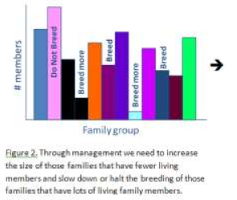
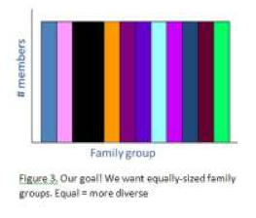
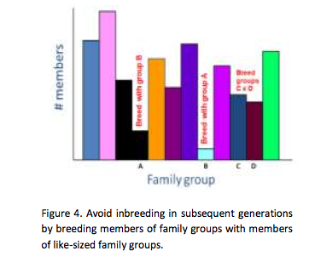
(Population Management Center)

Slide 14
9 Categories of Captive Populations
Living Museum Status of Common Species
Long-term Conservation of Endangered Species
Captive Breeding for Release Back into the Wild
Rare Species not yet Capable of Self-Sustaining Reproduction in Captivity
Germ Plasm Resources
Game Farms
Domestic Plants and Animals
Laboratory Species for Research Purposes
Pet Animals
Notes:
#1-4 typically dealt with in zoos and aquariums and include the species that may be found in SSP Programs

Slide 15
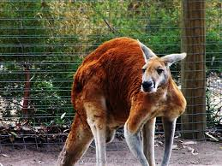
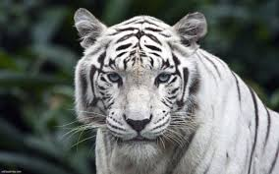
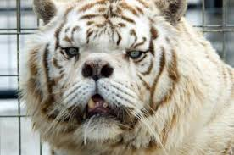
Recommendations for Captive Population Management
*Keep genetic load under control by eliminating deleterious alleles found in outliers*
*Any selection actively applied should have a clearly defined purpose*
Living Museum Status of a Common Species
Educational purposes, not intended for release
Select for ease of breeding in captivity, tameness, cheap diet
No objection selecting for “classical” phenotype
Mutant animal populations
Status may change in wild – change genetic management
Insert “wild” genes before wild population lost
Notes:
Example – red kangaroo, cow, squirrels

Slide 16
Long-term Conservation of Endangered Species
Natural habitat at risk, entire future relies on management in captivity
Maintain genetic variation
Keep option of reintroduction possible
Equalize founder representation and maximize population size
Conflict between maintaining equal representation of founders and keeping genetic load under control by eliminating outliers if there are few founders
Conflict between selecting for a viable population in captivity while trying to maintain option of reintroduction into wild
Captive Breeding for Release Back into the Wild
Little time spent in captivity
Numbers are the main management concern
Minimize number of generations so species doesn’t genetically adapt to captivity
Maximize genetic variation possible
Maintain genetic adaption to disease, parasites, and extreme environments
Rare Species not yet Capable of Self-Sustaining Reproduction in Captivity
Captive breeding efforts harmful, hinder conservation
Geneticists improve success rate by performing intensive selection for adaption to captive conditions
Maximize sampling of genetic variation
Find genetic combinations that are preadapted to captive breeding
Once successful, genetic variation can be introduced form wile, steps to achieve founder equality can begin, inbreeding can be minimized, size of effective population can be maximized
Notes:
Conflict 1 – delay elimination of outliers so that there ins’t too much genetic loss until pop Is large enough
Conflict 2 – first priority is to preserve species, but they will undoubtedly lose traits essential to surving in wild

Slide 17
Harmful Human Impacts
Decrease Biodiversity
Endangered Species Especially Susceptible
Captive Breeding
Species Survival Plan
Ensure Healthy, Genetically Diverse Populations
Restore Biodiversity through Reintroduction

Slide 18
Allendorf, F. W. (1986). Genetic drift and the loss of alleles versus heterozygosity. Zoo biology, 5(2), 181-190.
AZA. (2014, January 1). Species Survival Plan® (SSP) Programs. Retrieved November 25, 2014, from https://www.aza.org/species-survival-plan-program/
Frankel, O. H., Soulé, M.E. (1981). Conservation and evolution. CUP Archive.
Frankham, R. (1995). Conservation genetics. Annual review of genetics, 29(1), 305-327.
Frankham, R., Hemmer, H., Ryder, O. A., Cothran, E. G., Soulé, M. E., Murray, N. D., & Snyder, M. (1986). Selection in captive populations. Zoo biology, 5(2), 127-138.
Frankham, R. (2008). Genetic adaptation to captivity in species conservation programs. Molecular Ecology, 17(1), 325-333.
Garner, A., Rachlow, J. L., & Hicks, J. F. (2005). Patterns of genetic diversity and its loss in mammalian populations. Conservation Biology, 19(4), 1215-1221.
Hedrick, P. W., & Kalinowski, S. T. (2000). Inbreeding depression in conservation biology. Annual Review of Ecology and Systematics, 139-162.
Jiang, P. P., Lang, Q. L., Fang, S. G., Ding, P., & Chen, L. M. (2005). A genetic diversity comparison between captive individuals and wild individuals of Elliot’s Pheasant (Syrmaticus ellioti) using mitochondrial DNA. Journal of Zhejiang University. Science. B, 6(5), 413.
Lacy, R. C. (1997). Importance of genetic variation to the viability of mammalian populations. Journal of Mammalogy, 320-335.
Laikre, L., & Ryman, N. (1991). Inbreeding depression in a captive wolf (Canis lupus) population. Conservation biology, 5(1), 33-40.
PMC. (2014, January 1). Population Management Guidelines. Retrieved November 25, 2014, from https://www.aza.org/uploadedFiles/Animal_Care_and_Management/Animal_Management/Population_Management_Centers/PopulationManagementGuidelines.pdf
Soulé, M., M. Gilpin, W. Conway, and T. Foose. 1986. The millenium ark: How long a voyage, how many staterooms, how many passengers? Zoo Biology 5:101-113.

