Slide 1
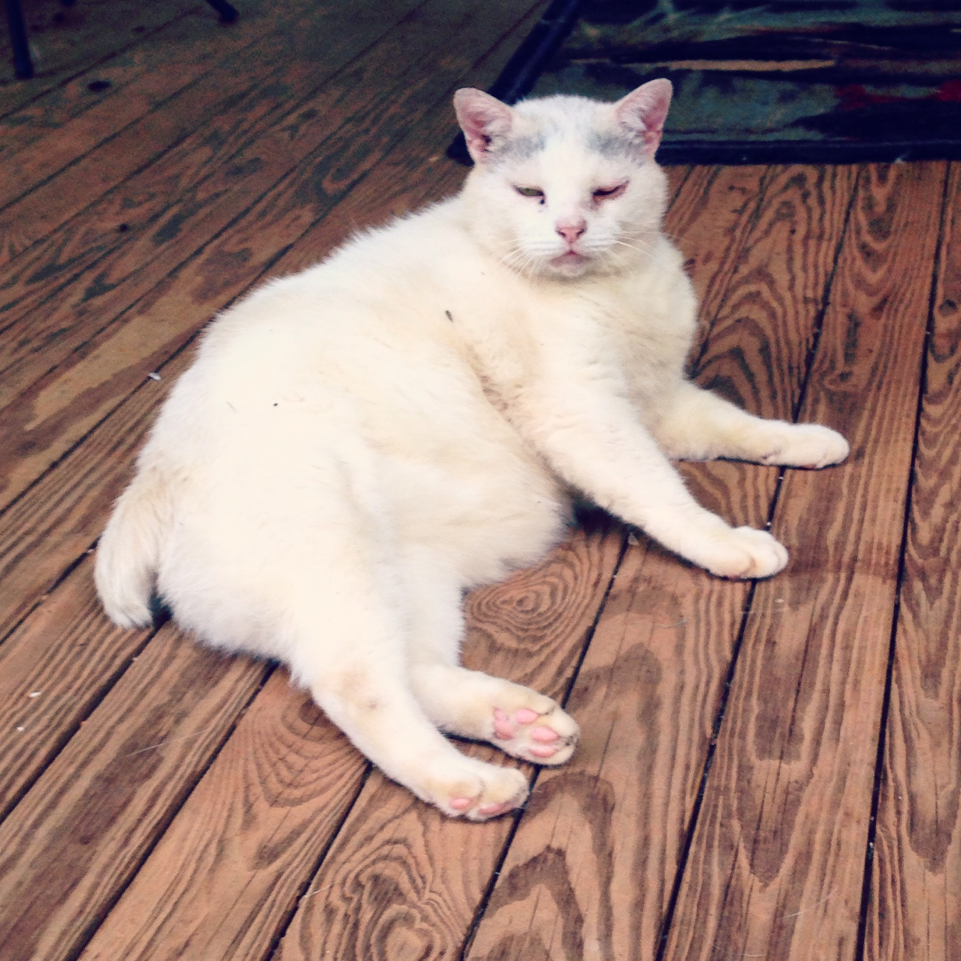
The Long and Short of it: Mammalian Tail Genetics and Evolution
Dainee Gibson
Biology 440: Population Genetics

Slide 2
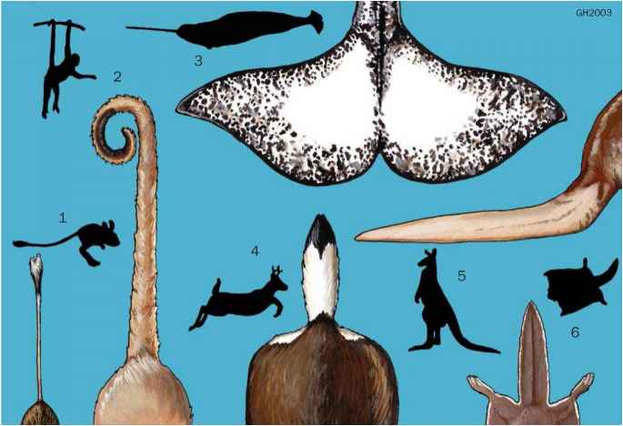
T Gene
Part of T-Box Complex
Important for anterior-posterior development
Mutations in this gene influence tail/taillessness

Slide 3
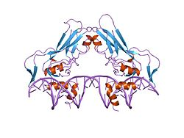
Brachyury in the T Gene
Affects tail length and spinal cord
Results in shortened tail
Anury is complete taillessness—related to Brachyury
Homozygous usually lethal

Slide 4
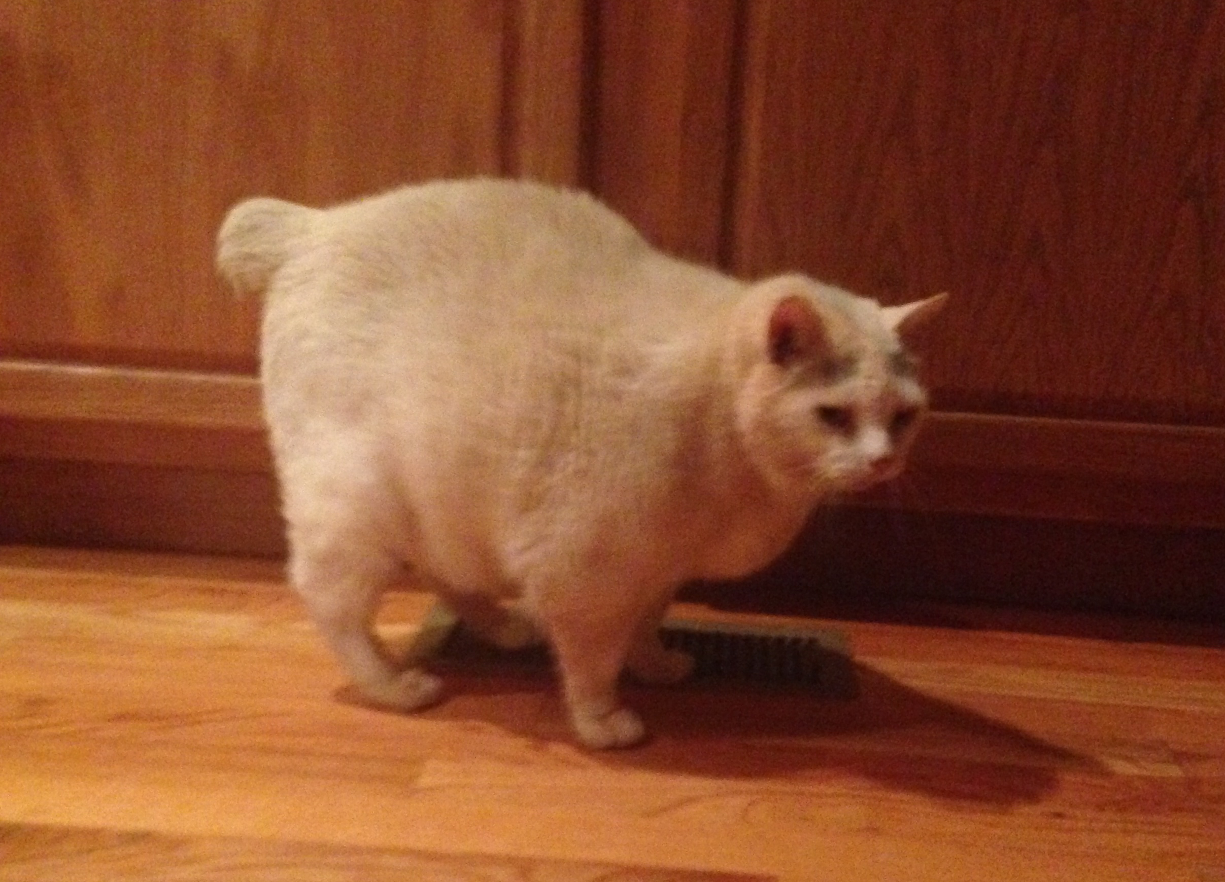
Manx Cats
Dominant Manx Gene allele
Homozygous lethal
Spinal and colon malformations

Slide 5
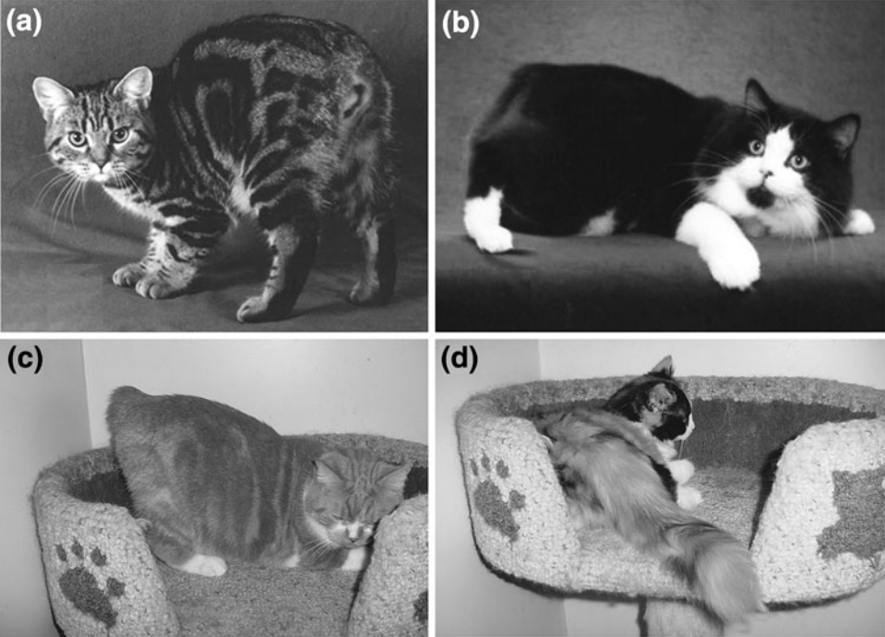
Manx Cats
Selective fertilization for sperm carrying Manx gene
T Gene versus Manx Gene?

Slide 6
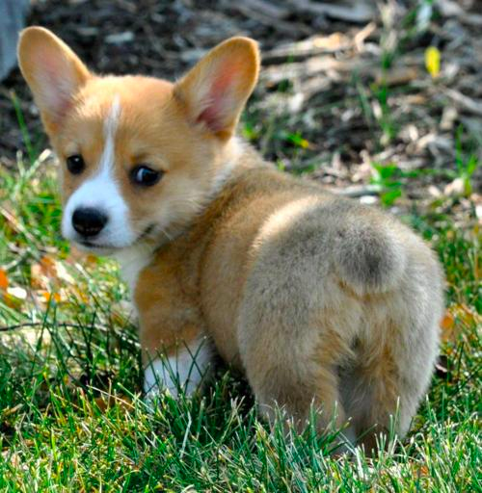
Pembroke Welsh Corgis
T Gene missense mutation
Alters T protein’s ability to bind to consensus DNA target
Homozygous lethal

Slide 7
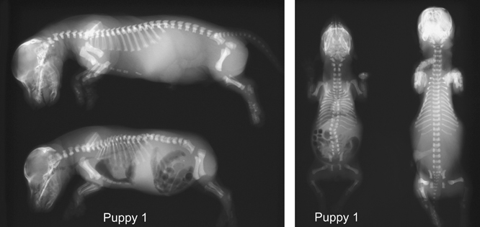
Pembroke Welsh Corgis
Malformations if homozygotes survive to birth

Slide 8
Other Dogs
T Box mutation present in many, not all short tailed dogs
Multiple genetic factors for tail phenotypes

Slide 9
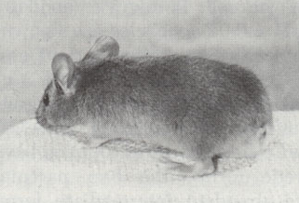
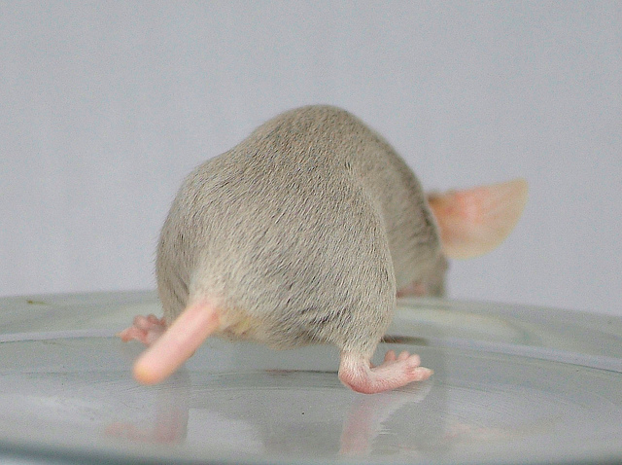
Mice
T Gene and Brachyury discovered in tailless mice
Two genes influence taillessness
One is dominant, the other recessive
Both present=tailless

Slide 10
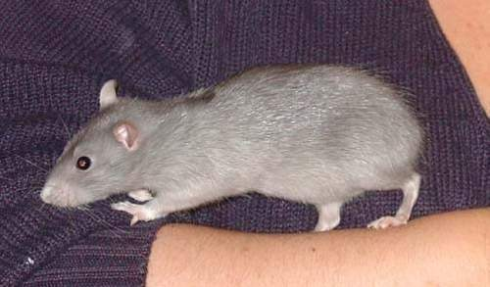
Mice
Selective fertilization for heterozygote during segregation/recombination
Homozygote lethal
Embryonic development
Differences from Day 10

Slide 11
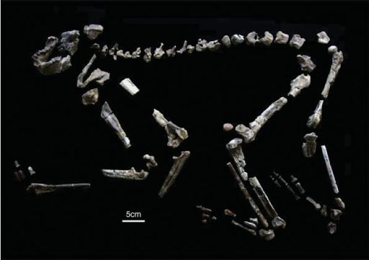
Hominoids
Bipedalism?
Influence of coccyx versus tail on sacrum
Grasping plus slow arboreal movements
Nacholapithecus

Slide 12
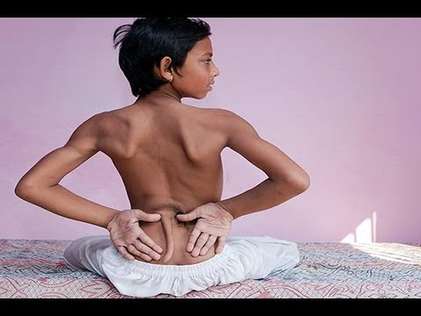
Humans
Human tails are now an anomaly
Little evidence for genetic basis
Disturbance in embryonic development

Slide 13
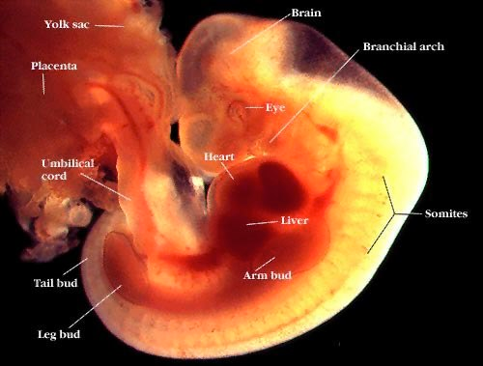
Humans
Tails present in embryo
Reach maximum length week 5
Starts to regress by week 6

Slide 14
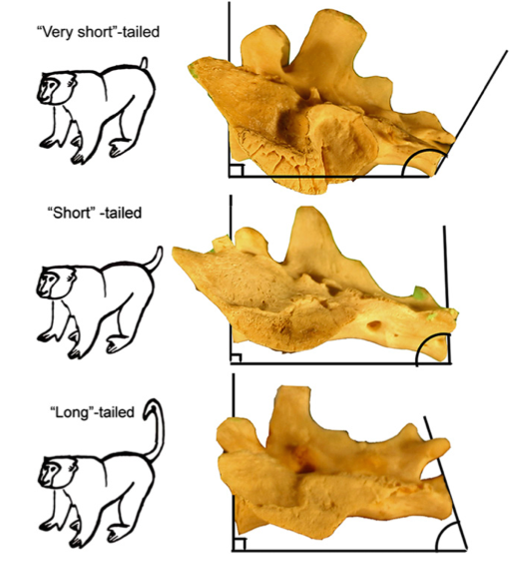
Overall Trends
T Gene/T-Box is really important
Multiple factors in tail phenotypes
Malformations with taillessness
Impact on the spinal cord

