Slide 1
Reversed Size Sexual Dimorphism (RSD)
In Birds of Prey
By: Angel Gosnell

Slide 2
What is RSD?
Reverse of the norm
  In normal size dimorphism, males are typically larger than females due to intrasexual selective pressures.
  In RSD, females are larger than males.
    How could this be advantageous to the male? To the female?

Slide 3
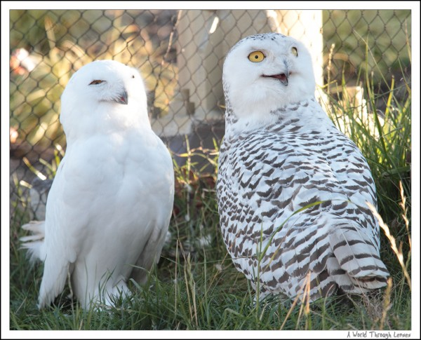
Our Subjects:
Strigiformes
  Owls
Snowy Owl
Nyctea scandiaca
Notes:
http://awtlblog.vitsco.com/2009/11/white-animal-in-the-zoo-snowy-owl/

Slide 4
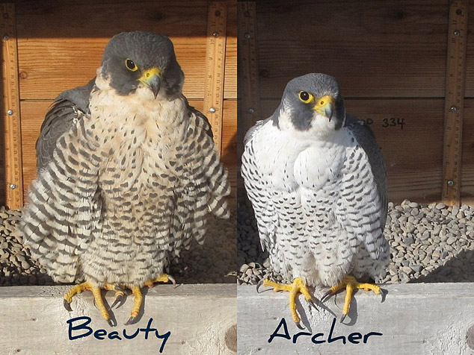
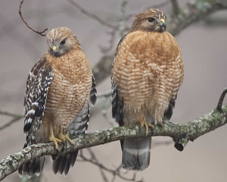
Our Subjects:
Falconiformes
  Falcons and Hawks
Red-shouldered Hawk
Buteo lineatus
Peregrine Falcon
Falco peregrinus
Notes:
http://birds.audubon.org/birds/red-shouldered-hawk
http://rfalconcam.com/rfc-main/physicalDescription.php

Slide 5
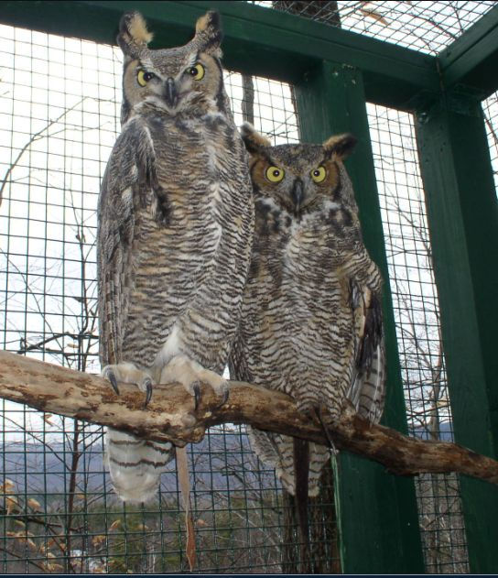
Hypotheses of Evolution and Maintenance
Small Male (retained female ancestral size)
Large Female (retained male ancestral size)
Selective pressures favoring large female and small male size
Great Horned Owl
Bubo virginianus
Notes:
http://www.adirondackwildlife.org/GreatHornedOwls.html

Slide 6
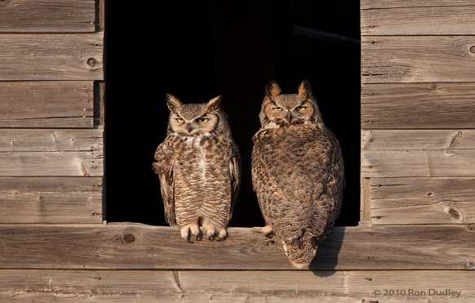
Ecological Hypothesis
Niche partitioning
  Lessens prey competition between the sexes
  Dimorphism allows for better exploitation of the available prey base and lessens survival competition between the sexes(Krueger 2005;Ydenberg RC, Forbes LS. 1991).
  Doesn’t predict which sex becomes larger (Krueger 2005; Ydenberg RC, Forbes LS. 1991).
Great Horned Owl
Bubo virginianus
Notes:
http://www.adirondackwildlife.org/GreatHornedOwls.html

Slide 7
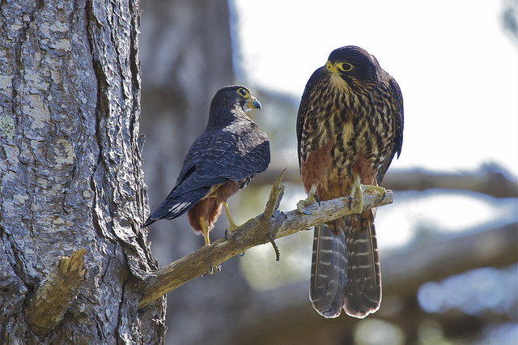
Role Differentiation Hypothesis
Males and females have divided work load in raising fledglings
Large female: Role
  Larger energy base
    to produce a larger egg size, larger clutch size, and shorter incubation periods. (Krueger 2005; Ydenberg RC, Forbes LS. 1991).
Small male: Role/Energy Saving
  Increased foraging efficient or territory defense due to an increase in flight efficiently
  Fast-prey specialization
  Hunting strategies
  Food provisioning
  Territorial defense
  Saves energy
New Zealand Falcon
Falco novaeseelandiae

Slide 8
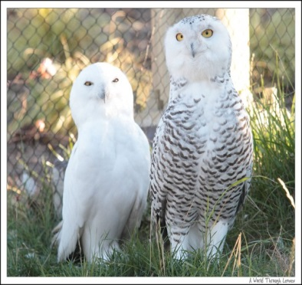
Behavioral Hypothesis
3 pathways
Large female
  Increased female dominance
    higher food provisioning/reproductive rate
  Decreased cannibalism (Smith 1982), increased safety
Large Female
  Intrasexual competition for males; where females compete for males
  Increases sexual dimorphism: plumage and size.
  Doesn’t correspond with Jones (1997) model…..
Small Male:
  Mate Selection
  Increased agility and flight maneuvers
  Intersexual competition for females
  Showing off ‘good genes’ and hunting ability
Snowy Owl
Nyctea scandiaca

Slide 9
Some Evidence
Pleasants and Pleasants (1998)
  Falconiformes
    Female increased in size due to change in hunting strategies of females or the male….most likely the male
    Male retained original size
  Strigiformes
    Males decreased in size
    Females and egg size either did not change from their plesiomorphic state or as female size increased egg size changed proportionately.
    Female retained original size

Slide 10
RSD’s Evolution
Krueger’s (2005) comparative analysis
Falconiformes
  Strong correlates between foraging
  Fits with the small male hypothesis in that males evolved to become smaller in response to increased foraging efficiency.
  RSD evolved via a change in hunting strategies resulting in higher reproduction.
Strigiformes
  Evolutionary analysis suggests that RSD evolved due to natural selection rather than sexual selection in owls because RSD evolved before specialization on more agile prey (Krueger 2005).

Slide 11
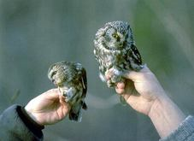
Tengmalm’s Owls:
Natural Selection over Sexual Selection?
Difference in good vs bad prey years
No significant difference in male reproductive output in good vole years
Small males: higher reproductive success in low vole years
  Increased reproductive output through out life compared with large males
  Females benefit from good nutrition…. female body size directly proportional to egg size in both years
  (Hakkarainen H, Korpimaeki E. 1991, 1993).
Tengmalm’s Owl
Aegolius funereus
Notes:
http://www.biokids.umich.edu/critters/Aegolius_funereus/

Slide 12
Suggestions
McDonald, Oslen, and Cockburn (2004)
  many researchers have failed to look at specific environmental factors that affect raptor RSD in specific species and/or specific populations
Arak (1988) suggests that a single selective pressure on one sex without considering other forces does not explain sexual dimorphism. Sexual dimorphism must arise from differing selectional pressures on body size for each sex.

Slide 13
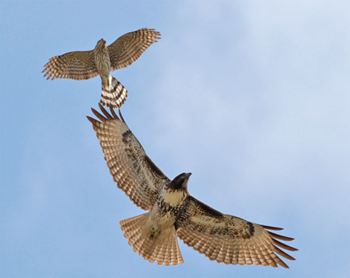
Conclusions
No conclusive evidence to the evolution of RSD
To study one sex over the other is bias
Determination of ancestral body size and reproductive characters, such as egg size and clutch size, provides crucial evidence to support or debunk any hypothesis
Logistical problems in determining pleiotropic characters impede proving either hypothesis.
Red-shouldered Hawk
Buteo lineatus

Slide 14
Bibliography
Arak A. 1988. Sexual dimorphism in body size: a model and atest. Evolution. 42:820-825.
Bateman AJ. 1948. Intrasexual selection in Drosophila. Heredity. 2:349-363.
Darwin C. 1871. The descent of man and selection in relation to sex. London: Murray.
Hakkarainen H, Korpimaeki E. 1991. Reversed sexual size dimorphism in Tengmalm's owl: Is small male size adaptive? Oikos. 61(3):337-346.
Hakkarainen H, Korpimaeki E. 1993. The effect of female body size on clutch volume of Tengmalm's owls (Aegolius funereus) in varying food conditions. Ornis Fennica. 70(4):189-195.
Jones AG, Avise JC. 1997. Microsatellite analysis of maternity and the mating system in the Gulf pipefish (Syngnathus scovelli), a species with male pregnancy and sex-role reversal. Mol Ecol. 6:203-213.
Krueger O. 2005.The Evolution of Reversed Sexual Size Dimorphism in Hawks, Falcons and Owls: A Comparative Study. Evol Ecol. 19(5): 467-486.
McDonald PG, Olsen PD, Cockburn A. 2005. Selection on body size in a raptor with pronounced reversed sexual size dimorphism: are bigger females better? Behav Ecol. 16(1):48- 56.
Trivers, RL. 1972. Parental investment and sexual selection. In: B. Campell, editor. Sexual selection and the descent of man. Aldine Press: Chicago, p. 136-179.
Ydenberg RC, Forbes LS. 1991.The survival-reproduction selection equilibrium and reversed size dimorphism in raptors. Oikos. 60(1): 115-120.

