Slide 1
Sexual Selection
- Recognized as a deviation from predictions offered by a strict selection model. In this case, there are different selective pressures on each SEX.

Slide 2
Sexual Selection
- Recognized as a deviation from predictions offered by a strict selection model.
1. The Basics

Slide 3
Sexual Selection
1. The Basics
- many species show sexual dimorphism (morph or behav)

Slide 4
Sexual Selection
- not really a level, but recognized in the same way - as a deviation from predictions offered by a strict selection model.
1. The Basics
- many species show sexual dimorphism (morph or behav)
- WHY? If adaptive (must be tested), then selective pressures differ

Slide 5
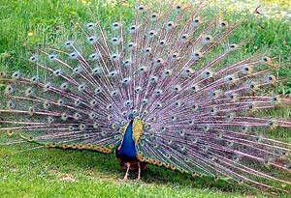
Sexual Selection
- not really a level, but recognized in the same way - as a deviation from predictions offered by a strict selection model.
1. The Basics
- many species show sexual dimorphism (morph or behav)
- WHY? If adaptive (must be tested), then selective pressures differ
- Some traits appear COSTLY to survival. Darwin (1871) described how showy plumage in birds should decrease survival. In order for it to be ADAPTIVE (increase reproductive success), this COST must be OFFSET by a disproportionate increase in one of the other components of fitness - most likely NUMBER of offspring.

Slide 6
Sexual Selection
- not really a level, but recognized in the same way - as a deviation from predictions offered by a strict selection model.
1. The Basics
- many species show sexual dimorphism (morph or behav)
- WHY? If adaptive (must be tested), then selective pressures differ
- Some traits appear COSTLY to survival. Darwin (1871) described how showy plumage in birds should decrease survival. In order for it to be ADAPTIVE (increase reproductive success), this COST must be OFFSET by a disproportionate increase in one of the other components of fitness - most likely NUMBER of offspring.
- This is affected by access to mates, number of mates, number of offspring, and quality of offspring.

Slide 7
Sexual Selection
- not really a level, but recognized in the same way - as a deviation from predictions offered by a strict selection model.
1. The Basics
- many species show sexual dimorphism (morph or behav)
- WHY? If adaptive (must be tested), then selective pressures differ
- Some traits appear COSTLY to survival. Darwin (1871) described how showy plumage in birds should decrease survival. In order for it to be ADAPTIVE (increase reproductive success), this COST must be OFFSET by a disproportionate increase in one of the other components of fitness - most likely NUMBER of offspring.
- This is affected by access to mates, number of mates, number of offspring, and quality of offspring.
- These diffs have to vary BETWEEN SEXES to account for dimorphism... so access to mates must vary, etc.

Slide 8
Sexual Selection
- not really a level, but recognized in the same way - as a deviation from predictions offered by a strict selection model.
1. The Basics
- many species show sexual dimorphism (morph or behav)
- WHY? If adaptive (must be tested), then selective pressures differ
- Some traits appear COSTLY to survival. Darwin (1871) described how showy plumage in birds should decrease survival. In order for it to be ADAPTIVE (increase reproductive success), this COST must be OFFSET by a disproportionate increase in one of the other components of fitness - most likely NUMBER of offspring.
- This is affected by access to mates, number of mates, number of offspring, and quality of offspring.
- These diffs have to vary BETWEEN SEXES to account for dimorphism... so access to mates must vary, etc.
- Darwin (1871) though of two patterns:

Slide 9
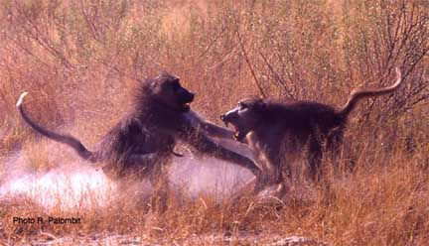
- Darwin (1871) though of two patterns:
Male Contest Female Choice

Slide 10
Sexual Selection
- not really a level, but recognized in the same way - as a deviation from predictions offered by a strict selection model.
1. The Basics
2. Hypothesis of Parental Investment (Bateman 1948, Trivers 1972)

Slide 11
Sexual Selection
- not really a level, but recognized in the same way - as a deviation from predictions offered by a strict selection model.
1. The Basics
2. Hypothesis of Parental Investment (Bateman 1948, Trivers 1972)
- what is a fundamental difference between most sexes? gamete size

Slide 12
Sexual Selection
- not really a level, but recognized in the same way - as a deviation from predictions offered by a strict selection model.
1. The Basics
2. Hypothesis of Parental Investment (Bateman 1948, Trivers 1972)
- what is a fundamental difference between most sexes? gamete size
- in anisogamous species (different sized gametes), the female produces a few large gametes, and the male produces lots of small ones.

Slide 13
Sexual Selection
- not really a level, but recognized in the same way - as a deviation from predictions offered by a strict selection model.
1. The Basics
2. Hypothesis of Parental Investment (Bateman 1948, Trivers 1972)
- what is a fundamental difference between most sexes? gamete size
- in anisogamous species (different sized gametes), the female produces a few large gametes, and the male produces lots of small ones.
- Thus, the female invests more energy in each gamete, and that may be the tip of the iceberg (fruit, seed, yolk, uterine development, care...)

Slide 14
Sexual Selection
- not really a level, but recognized in the same way - as a deviation from predictions offered by a strict selection model.
1. The Basics
2. Hypothesis of Parental Investment (Bateman 1948, Trivers 1972)
- what is a fundamental difference between most sexes? gamete size
- in anisogamous species (different sized gametes), the female produces a few large gametes, and the male produces lots of small ones.
- Thus, the female invests more energy in each gamete, and that may be the tip of the iceberg (fruit, seed, yolk, uterine development, care...)
- So: Female success is limited by number of offspring she can make
Male success is limited by access to/number of mates

Slide 15
Sexual Selection
- not really a level, but recognized in the same way - as a deviation from predictions offered by a strict selection model.
1. The Basics
2. Hypothesis of Parental Investment (Bateman 1948, Trivers 1972)
- what is a fundamental difference between most sexes? gamete size
- in anisogamous species (different sized gametes), the female produces a few large gametes, and the male produces lots of small ones.
- Thus, the female invests more energy in each gamete, and that may be the tip of the iceberg (fruit, seed, yolk, uterine development, care...)
- So: Female success is limited by number of offspring she can raise
Male success is limited by access to/number of mates
- There should be greater VARIANCE among males in success, so selection for mate acquisition should be stronger in males.

Slide 16
Sexual Selection
- not really a level, but recognized in the same way - as a deviation from predictions offered by a strict selection model.
1. The Basics
2. Hypothesis of Parental Investment (Bateman 1948, Trivers 1972)
C. Tests (Jones 2002)
- Newts: # offspring correlates with number of mates in males, not females
male
# offspring
female
# mates

Slide 17
Sexual Selection
- not really a level, but recognized in the same way - as a deviation from predictions offered by a strict selection model.
1. The Basics
2. Hypothesis of Parental Investment (Bateman 1948, Trivers 1972)
3. Tests (Jones 2002)
- Pipefish where males incubate young, the pattern is reversed...
# offspring
female
male
# mates

Slide 18
Sexual Selection
- not really a level, but recognized in the same way - as a deviation from predictions offered by a strict selection model.
1. The Basics
2. Hypothesis of Parental Investment (Bateman 1948, Trivers 1972)
3. Tests (Jones 2002)
- Pipefish where males incubate young, the pattern is reversed...
- SO: reproductive strategy correlates better with INVESTMENT than SEX, per se.
# offspring
female
male
# mates

Slide 19
Sexual Selection
- not really a level, but recognized in the same way - as a deviation from predictions offered by a strict selection model.
1. The Basics
2. Hypothesis of Parental Investment (Bateman 1948, Trivers 1972)
3. Tests (Jones 2002)
4. Conclusions

Slide 20
Sexual Selection
- not really a level, but recognized in the same way - as a deviation from predictions offered by a strict selection model.
1. The Basics
2. Hypothesis of Parental Investment (Bateman 1948, Trivers 1972)
3. Tests (Jones 2002)
4. Conclusions
- Darwin and Bateman said males are competitive, and the only recourse left to females is to be choosy.

Slide 21
Sexual Selection
- not really a level, but recognized in the same way - as a deviation from predictions offered by a strict selection model.
1. The Basics
2. Hypothesis of Parental Investment (Bateman 1948, Trivers 1972)
3. Tests (Jones 2002)
4. Conclusions
- Darwin and Bateman said males are competitive, and the only recourse left to females is to be choosy.
- Things are more complex (pipefish, monogamy)

Slide 22
Sexual Selection
- not really a level, but recognized in the same way - as a deviation from predictions offered by a strict selection model.
1. The Basics
2. Hypothesis of Parental Investment (Bateman 1948, Trivers 1972)
3. Tests (Jones 2002)
4. Conclusions
- Darwin and Bateman said males are competitive, and the only recourse left to females is to be choosy.
- Things are more complex (pipefish, monogamy)
- If one sex is limited by access, that sex should compete.

Slide 23
Sexual Selection
- not really a level, but recognized in the same way - as a deviation from predictions offered by a strict selection model.
1. The Basics
2. Hypothesis of Parental Investment (Bateman 1948, Trivers 1972)
3. Tests (Jones 2002)
4. Conclusions
- Darwin and Bateman said males are competitive, and the only recourse left to females is to be choosy.
- Things are more complex (pipefish, monogamy)
- If one sex is limited by access, that sex should compete.
- The sex NOT limited by access can then be choosey and select mates of the highest QUALITY.

Slide 24
Sexual Selection
5. INTRAsexual Competition (for access)

Slide 25
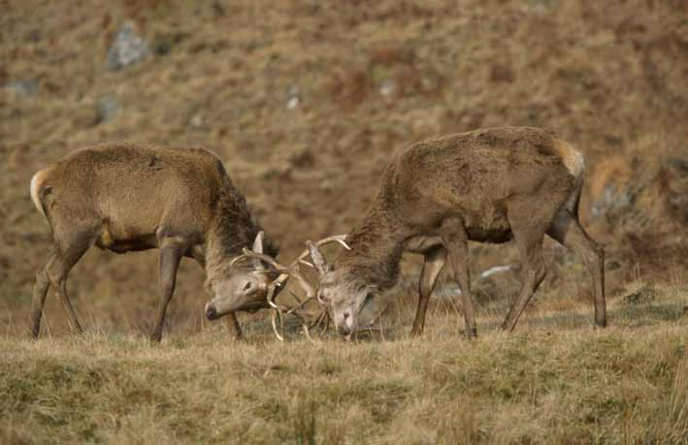
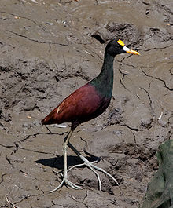
Sexual Selection
5. INTRAsexual Competition (for access)
- competition for harems, territories

Slide 26
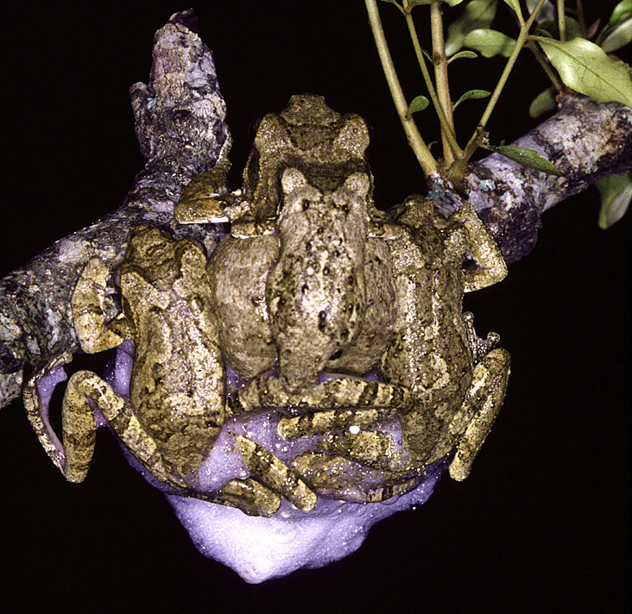
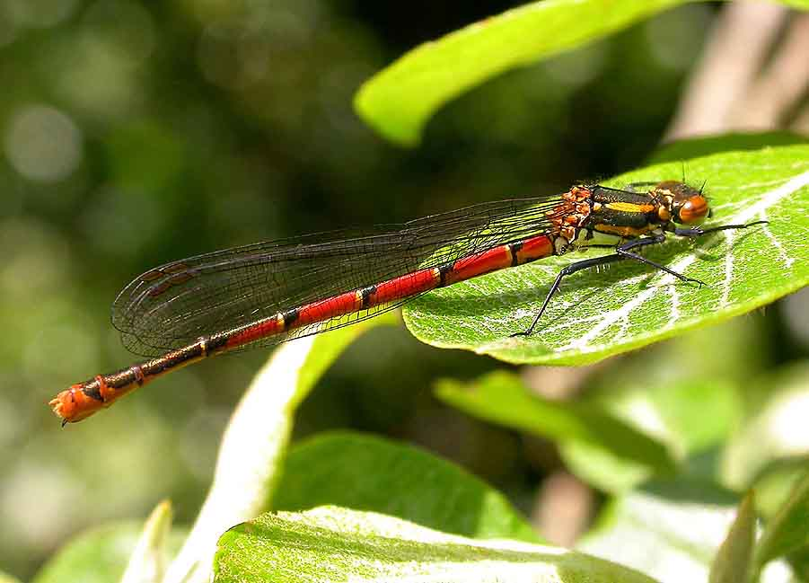
Sexual Selection
5. INTRAsexual Competition (for access)
- competition for harems, territories
- sperm competition

Slide 27
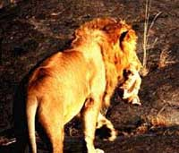
Sexual Selection
5. INTRAsexual Competition (for access)
- competition for harems, territories
- sperm competition
- infanticide

Slide 28
Sexual Selection
5. INTRAsexual Competition (for access)
- competition for harems, territories
- sperm competition
- infanticide
- female mimicry in male subadults and "stealth matings"

Slide 29
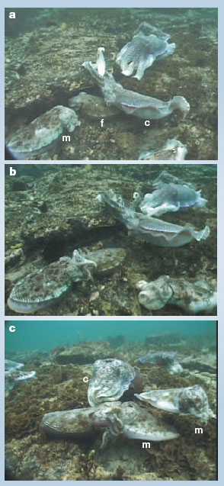
"sneaker males"
FEMALE
"Sneaker" male
This and other examples

Slide 30
Sexual Selection
6. INTERsexual Selection (Mate Preference)
- A behavior or morphology that is only performed during the reproductive season, which increases risk and must then be offset by mating

Slide 31
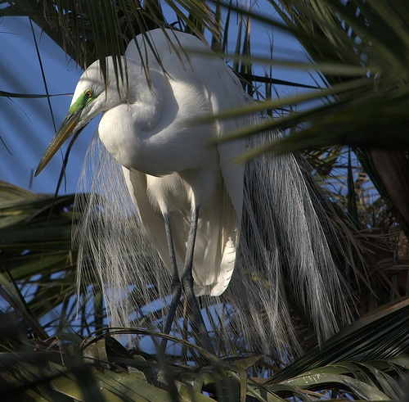
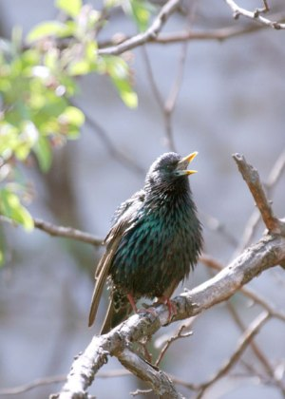
Sexual Selection
6. INTERsexual Selection (Mate Preference)
- A behavior or morphology that is only performed during the reproductive season, which increases risk and must then be offset by mating
showy breeding plumage
calling displays

Slide 32
Sexual Selection
6. INTERsexual Selection (Mate Preference)
- A behavior or morphology that is only performed during the reproductive season, which increases risk and must then be offset by mating
- WHY is it ADAPTIVE for the FEMALE to choose a SHOWY MALE??

Slide 33
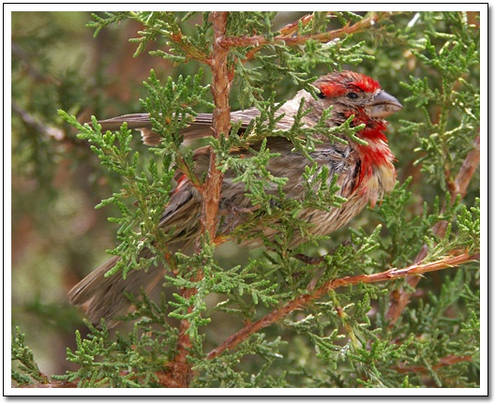
6. INTERsexual Selection (Mate Preference)
- A behavior or morphology that is only performed during the reproductive season, which increases risk and must then be offset by mating
- WHY is it ADAPTIVE for the FEMALE to choose a SHOWY MALE??
1. Direct Benefit
- healthy males are better fathers - the redder the male house finch, the healthier it is, and the more food it brings to the nest.

Slide 34
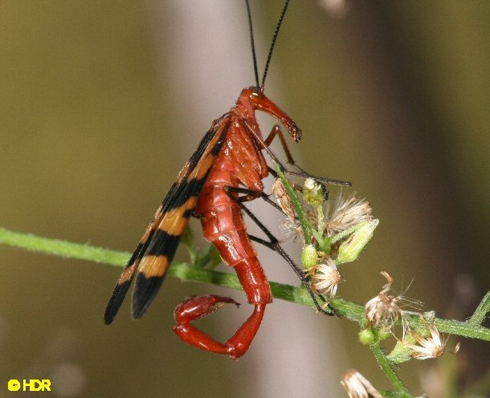
6. INTERsexual Selection (Mate Preference)
- A behavior or morphology that is only performed during the reproductive season, which increases risk and must then be offset by mating
- WHY is it ADAPTIVE for the FEMALE to choose a SHOWY MALE??
1. Direct Benefit
- Scorpion fly males bring a 'nuptual gift'... the one with the biggest gift is accepted by the female (who gets this extra energy to make eggs).

Slide 35
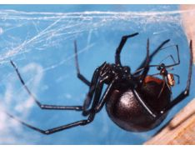
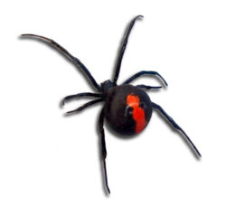
6. INTERsexual Selection (Mate Preference)
- A behavior or morphology that is only performed during the reproductive season, which increases risk and must then be offset by mating
- WHY is it ADAPTIVE for the FEMALE to choose a SHOWY MALE??
1. Direct Benefit
- Redback spiders - males that give themselves up as meal leave more offspring than those that don't

Slide 36
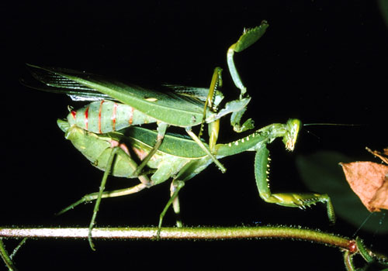
Male mantids eaten during copulation mate longer and transfer more sperm, and females lay more eggs.

Slide 37
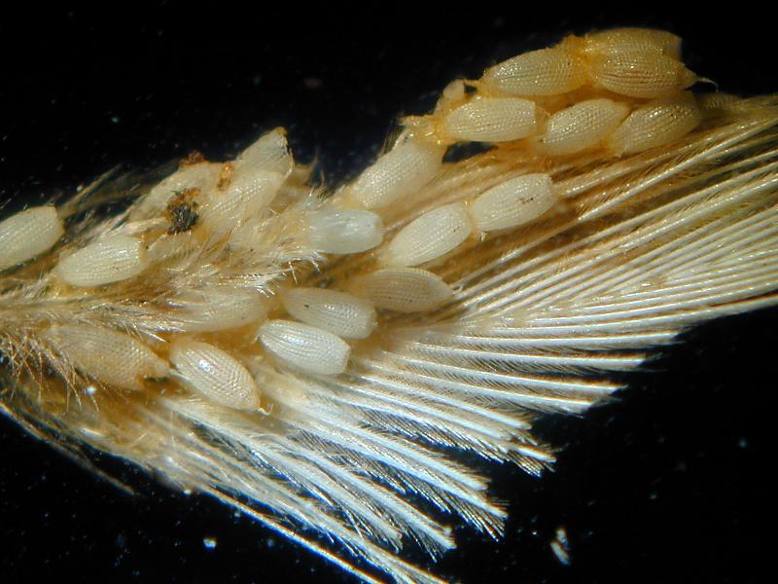
6. INTERsexual Selection (Mate Preference)
- A behavior or morphology that is only performed during the reproductive season, which increases risk and must then be offset by mating
- WHY is it ADAPTIVE for the FEMALE to choose a SHOWY MALE??
1. Direct Benefit
2. Indirect Benefit - "Good Genes"
"GOOD GENES"
- Bright Plumage means low parasite load
- Resistance to parasites has a genetic component
- Bright Males - low parasites - offspring with low parasites - increased probability of survival.

Slide 38
6. INTERsexual Selection (Mate Preference)
- A behavior or morphology that is only performed during the reproductive season, which increases risk and must then be offset by mating
- WHY is it ADAPTIVE for the FEMALE to choose a SHOWY MALE??
1. Direct Benefit
2. Indirect Benefit - "Good Genes" and Symmetry Theory"
"GOOD GENES"
"SYMMETRY THEORY"
- many organisms prefer the most symmetrical mates
- this might indicate co-adapted gene complexes that
work well together during development.
- Moeller demonstrated that offspring of symmetrical males molt earlier and develop sooner than offspring of other males.

Slide 39
6. INTERsexual Selection (Mate Preference)
- A behavior or morphology that is only performed during the reproductive season, which increases risk and must then be offset by mating
- WHY is it ADAPTIVE for the FEMALE to choose a SHOWY MALE??
1. Direct Benefit
2. Indirect Benefit - "Good Genes" and Symmetry Theory"
"GOOD GENES"
"SYMMETRY THEORY"
- many organisms prefer the most symmetrical mates
- this might indicate co-adapted gene complexes that
work well together during development.
- Moeller demonstrated that offspring of symmetrical males molt earlier and develop sooner than offspring of other males.
- And many human studies reveal the same things:
- preference for symmetrical mates

Slide 40
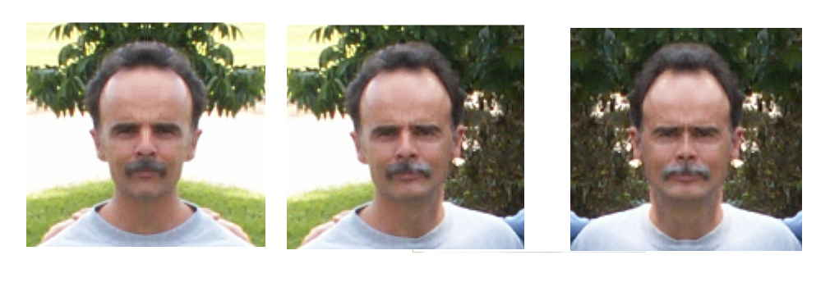
6. INTERsexual Selection (Mate Preference)
- A behavior or morphology that is only performed during the reproductive season, which increases risk and must then be offset by mating
- WHY is it ADAPTIVE for the FEMALE to choose a SHOWY MALE??
1. Direct Benefit
2. Indirect Benefit - "Good Genes"
"GOOD GENES"
"SYMMETRY THEORY"
- many organisms prefer the most symmetrical mates
- this might indicate co-adapted gene complexes that
work well together during development
Hmmm....

Slide 41
6. INTERsexual Selection (Mate Preference)
- A behavior or morphology that is only performed during the reproductive season, which increases risk and must then be offset by mating
- WHY is it ADAPTIVE for the FEMALE to choose a SHOWY MALE??
1. Direct Benefit
2. Indirect Benefit - "Good Genes"
"GOOD GENES"
"SYMMETRY THEORY"
- many organisms prefer the most symmetrical mates
- this might indicate co-adapted gene complexes that
work well together during development
Hmmm....

Slide 42
6. INTERsexual Selection (Mate Preference)
- A behavior or morphology that is only performed during the reproductive season, which increases risk and must then be offset by mating
- WHY is it ADAPTIVE for the FEMALE to choose a SHOWY MALE??
1. Direct Benefit
2. Indirect Benefit - "Good Genes"
"GOOD GENES"
"SYMMETRY THEORY"
- many organisms prefer the most symmetrical mates
- this might indicate co-adapted gene complexes that
work well together during development
Hmmm....
Hey, It Works!!

Slide 43
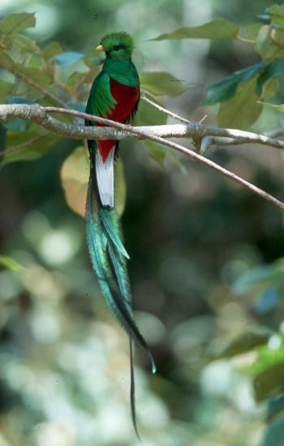
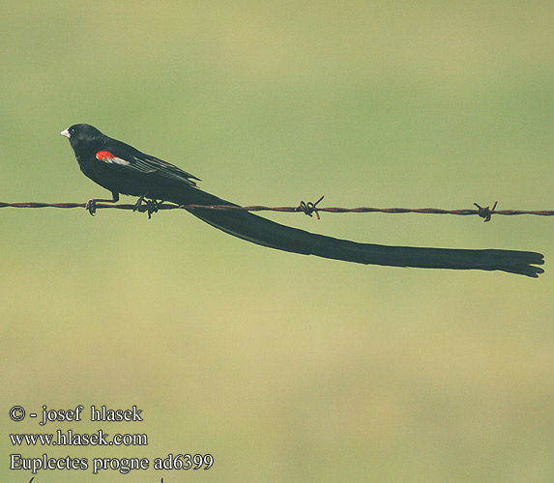
6. INTERsexual Selection (Mate Preference)
- A behavior or morphology that is only performed during the reproductive season, which increases risk and must then be offset by mating
- WHY is it ADAPTIVE for the FEMALE to choose a SHOWY MALE??
1. Direct Benefit
2. Indirect Benefit - "Handicap Theory"
- I'm alive, even WITH this HUGE TAIL!!!
- I must be awesome!!

Slide 44
6. INTERsexual Selection (Mate Preference)
- A behavior or morphology that is only performed during the reproductive season, which increases risk and must then be offset by mating
- WHY is it ADAPTIVE for the FEMALE to choose a SHOWY MALE??
1. Direct Benefit
2. Indirect Benefit - "Runaway Selection"
- Positive Feedback Loops

Slide 45
6. INTERsexual Selection (Mate Preference)
- A behavior or morphology that is only performed during the reproductive season, which increases risk and must then be offset by mating
- WHY is it ADAPTIVE for the FEMALE to choose a SHOWY MALE??
1. Direct Benefit
2. Indirect Benefit - "Runaway Selection"
- Positive Feedback Loops
If long tails are attractive to females for WHATEVER REASON, and they are heritable, then Females should continue to prefer males with long tails, because THEIR SONS will then have long tails and will mate.

Slide 46
6. INTERsexual Selection (Mate Preference)
- A behavior or morphology that is only performed during the reproductive season, which increases risk and must then be offset by mating
- WHY is it ADAPTIVE for the FEMALE to choose a SHOWY MALE??
1. Direct Benefit
2. Indirect Benefit - "Runaway Selection"
- Positive Feedback Loops
If long tails are attractive to most females for WHATEVER REASON, and they are heritable, then selection will reinforce this preference because females who select long-tailed males will produce sons with long tails, who will be preferred in the next generation… and daughters with a preference for long tails.

Slide 47
6. INTERsexual Selection (Mate Preference)
- A behavior or morphology that is only performed during the reproductive season, which increases risk and must then be offset by mating
- WHY is it ADAPTIVE for the FEMALE to choose a SHOWY MALE??
1. Direct Benefit
2. Indirect Benefit - "Runaway Selection"
- Positive Feedback Loops
If long tails are attractive to females for WHATEVER REASON, and they are heritable, then Females should continue to prefer males with long tails, because THEIR SONS will then have long tails and will mate.
Likewise, a female should produce daughters that are attracted to long tails, so that their grandsons will have long tails.
May result in SUPERNORMAL STIMULUS - if a long tail is good, a really long tail is GREAT!!!

Slide 48
6. INTERsexual Selection (Mate Preference)
- A behavior or morphology that is only performed during the reproductive season, which increases risk and must then be offset by mating
- WHY is it ADAPTIVE for the FEMALE to choose a SHOWY MALE??
1. Direct Benefit
2. Indirect Benefit - "Runaway Selection"
- Positive Feedback Loops
If long tails are attractive to females for WHATEVER REASON, and they are heritable, then Females should continue to prefer males with long tails, because THEIR SONS will then have long tails and will mate.
Likewise, a female should produce daughters that are attracted to long tails, so that their grandsons will have long tails.
May result in SUPERNORMAL STIMULUS - if a long tail is good, a really long tail is GREAT!!!
Why hasn't female choice driven male tail length to that extreme?

Slide 49
6. INTERsexual Selection (Mate Preference)
- A behavior or morphology that is only performed during the reproductive season, which increases risk and must then be offset by mating
- WHY is it ADAPTIVE for the FEMALE to choose a SHOWY MALE??
1. Direct Benefit
2. Indirect Benefit - "Runaway Selection"
- Positive Feedback Loops
If long tails are attractive to females for WHATEVER REASON, and they are heritable, then Females should continue to prefer males with long tails, because THEIR SONS will then have long tails and will mate.
Likewise, a female should produce daughters that are attracted to long tails, so that their grandsons will have long tails.
May result in SUPERNORMAL STIMULUS - if a long tail is good, a really long tail is GREAT!!! (see long-tailed widowbird example in book).
Why hasn't female choice driven male tail length to that extreme?
CONSTRAINTS (genetic) and
CONTRADICTORY SELECTIVE PRESSURES (energetic, survival, etc.)

