Slide 1
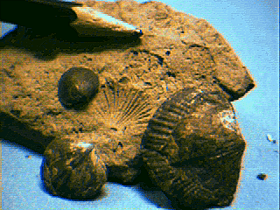
I. The Precambrian
- Vendian
II. Paleozoic
A. Cambrian (544-490 mya)
B. Ordovician (490-443 mya)
C. Silurian (443-417 mya)
- inverts
Brachipods begin to dominate; 80% of all individuals

Slide 2
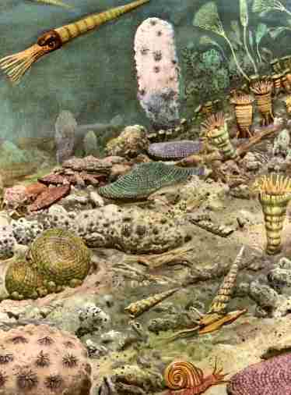
C. Silurian (443-417 mya)
- inverts
Brachipods begin to dominate; 80% of all individuals
Reef-building corals
radiate

Slide 3
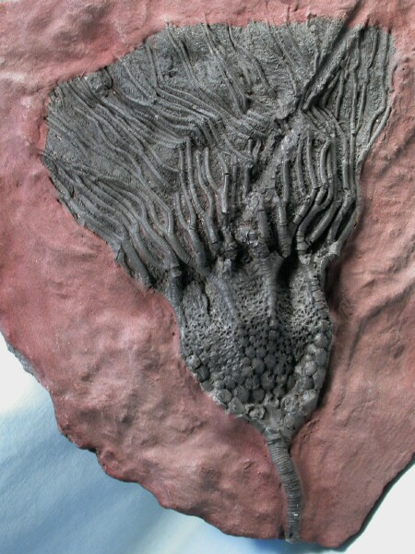
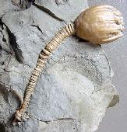
C. Silurian (443-417 mya)
- inverts
Brachipods begin to dominate; 80% of all individuals
Reef-building corals radiate
Crinoid echinoderms radiate

Slide 4
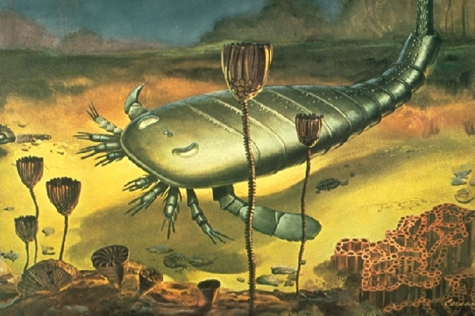
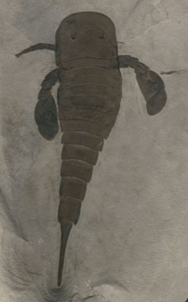
C. Silurian (443-417 mya)
- inverts
Brachipods begin to dominate; 80% of all individuals
Reef-building corals radiate
Crinoid echinoderms radiate
Eurypterids (sea scorpions) dominate (7 feet long)

Slide 5
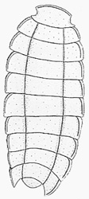
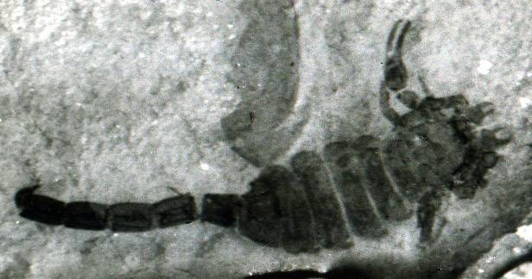
C. Silurian (443-417 mya)
- inverts
Brachipods begin to dominate; 80% of all individuals
Reef-building corals radiate
Crinoid echinoderms radiate
Eurypterids (sea scorpions) dominate; Horseshoe crabs
Semi-aquatic scorpions and terrestrial Chelicerata evolve
Millipedes first completely terrestrial animals

Slide 6
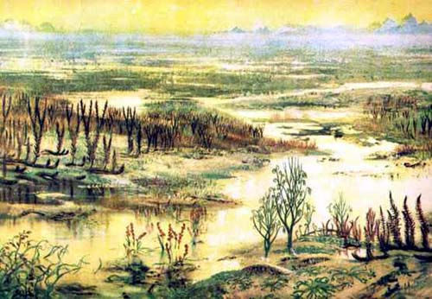
C. Silurian (443-417 mya)
- inverts
- plants

Slide 7
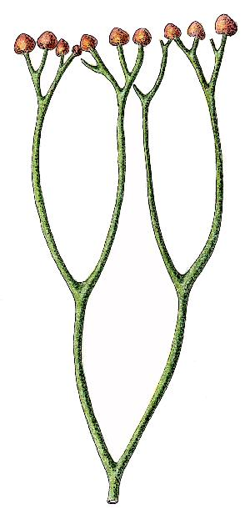
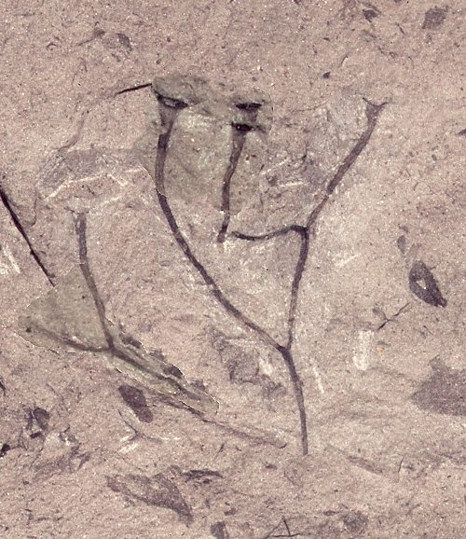
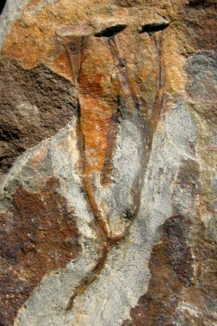
C. Silurian (443-417 mya)
- inverts
- plants
radiation of the first vascular plants
4 species of Cooksonia, including those representing the Rhyniophytes and Lycophytes

Slide 8
C. Silurian (443-417 mya)
- inverts
- plants
- verts

Slide 9
C. Silurian (443-417 mya)
- inverts
- plants
- verts
Radiation of Jawless fishes SILURIAN
Lampreys**
Heterostracans
Astraspids
"Ostracoderms"
Arandaspids
Osteostracans
**Tree of Life phylogeny; differs from Cowens.
JAWED FISHES

Slide 10
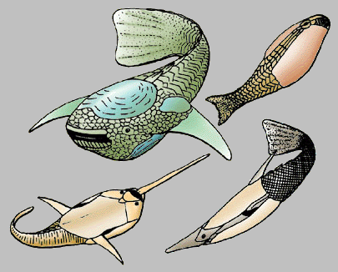
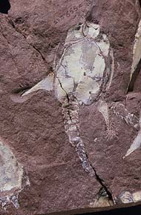
C. Silurian (443-417 mya)
- inverts
- plants
- verts
- Heterostracans - over 300 species; very abundant

Slide 11
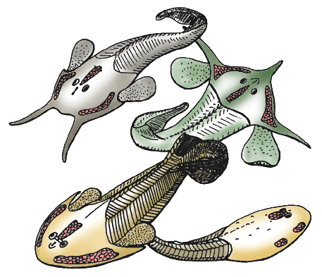
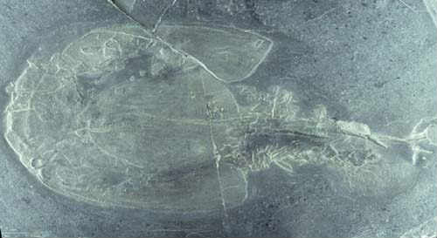
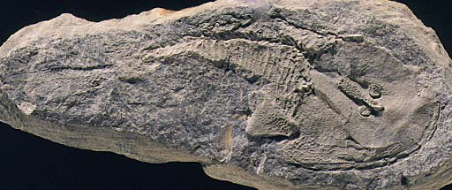
C. Silurian (443-417 mya)
- inverts
- plants
- verts
- Osteostracans
bottom-feeders, but with an important evolutionary advancement - paired fins

Slide 12
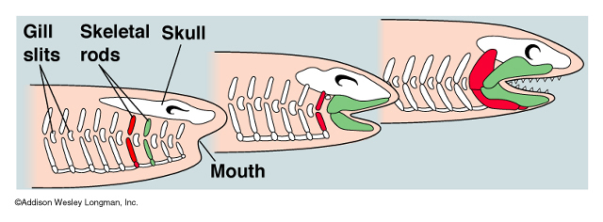
C. Silurian (443-417 mya)
- inverts
- plants
- verts
- Jawed Fishes (Gnathostomes)
- Acanthodians

Slide 13
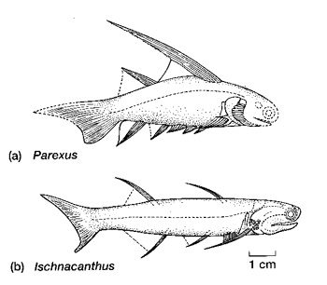
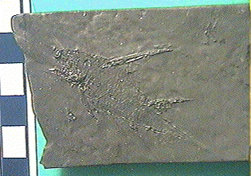
C. Silurian (443-417 mya)
- inverts
- plants
- verts
- Jawed Fishes (Gnathostomes)
the oldest jawed fish fossils are Acanthodians... however, they are a group of bony fishes and it is likely that they were preceded by the cartilaginous Placoderms (which radiate in the Devonian)

Slide 14
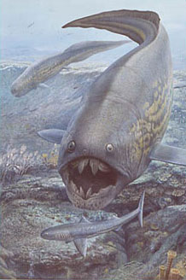
I. The Precambrian
- Vendian
II. Paleozoic
A. Cambrian (544-490 mya)
B. Ordovician (490-443 mya)
C. Silurian (443-417 mya)
D. Devonian (417-354 mya)
- "The Age of Fishes"

Slide 15
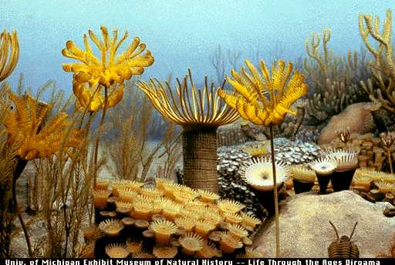
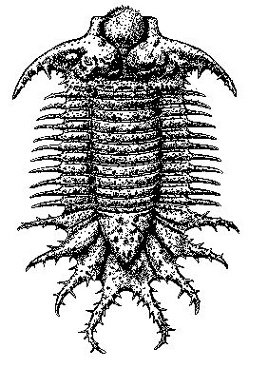
D. Devonian (417-354 mya)
- inverts
crazy trilobite 50cm long.... Terataspis grandis

Slide 16
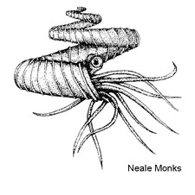
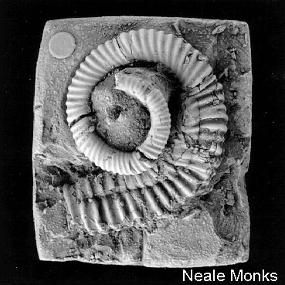
D. Devonian (417-354 mya)
- inverts:
- Ammonites

Slide 17
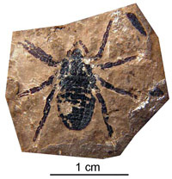
D. Devonian (417-354 mya)
- inverts:
- Ammonites
- Terrestrial Arthropods
- oldest spider - Attercopus
- mites
- trigonotarbids (no silk)

Slide 18
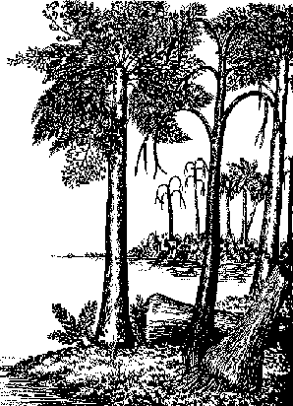
D. Devonian (417-354 mya)
- inverts:
- plants
Lycopod forests, then
Progymnosperm forests dominated by one genus, Archaeopteris 20m

Slide 19
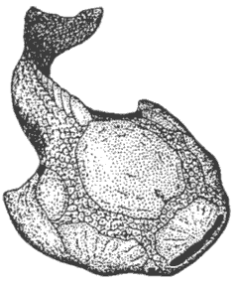
D. Devonian (417-354 mya)
- inverts:
- plants
- verts:
- last of the ostracoderms...
Psammolepis over 2m

Slide 20
D. Devonian (417-354 mya)
- inverts:
- plants
- verts:
- last of the ostracoderms...
- the major radiation of jawed fish groups
Arthrodires
Placoderms
Antiarchs
Chondrichthyes (Sharks, rays)
Acanthodians
Teleosts
Ray-finned Fishes
Bony Fish
Lobe-finned Fishes

Slide 21
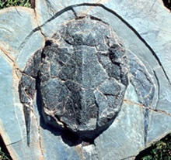
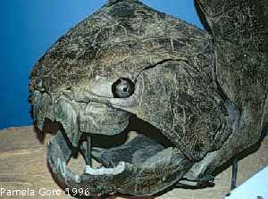
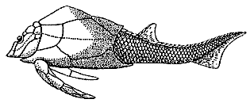
D. Devonian (417-354 mya)
- Placoderms
- very abundant
- head shields
- shearing or crushing tooth plates
Dunkleosteus - 6m
Arthrodire
Antiarch

Slide 22
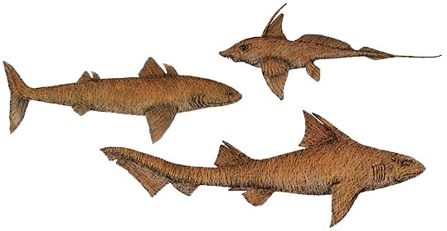
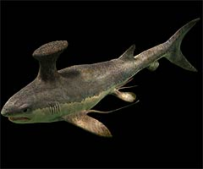
D. Devonian (417-354 mya)
- Placoderms
- Sharks
Stethacanthus - 2m

Slide 23
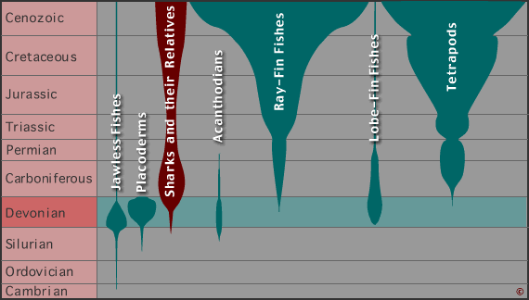
D. Devonian (417-354 mya)
- Placoderms
- Sharks

Slide 24
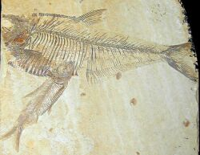
D. Devonian (417-354 mya)
- Placoderms
- Sharks
- Ray-finned Fishes

Slide 25
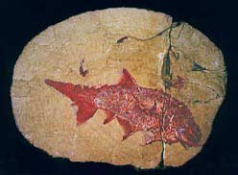
D. Devonian (417-354 mya)
- Placoderms
- Sharks
- Ray-finned Fishes

Slide 26
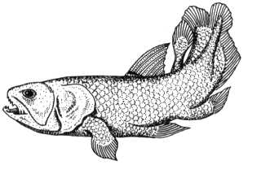
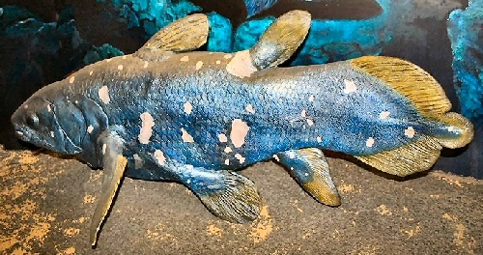
D. Devonian (417-354 mya)
- Placoderms
- Sharks
- Ray-finned Fishes
- Lobe-finned Fishes

Slide 27
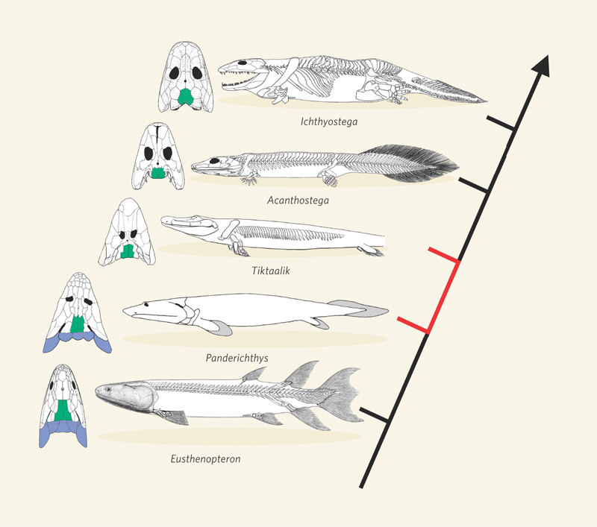
D. Devonian (417-354 mya)
- Placoderms
- Sharks
- Lobe-finned Fishes
365 mya
385 mya

Slide 28
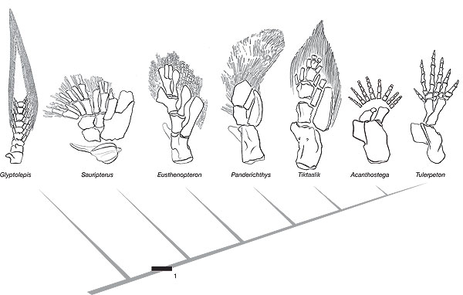

Slide 29
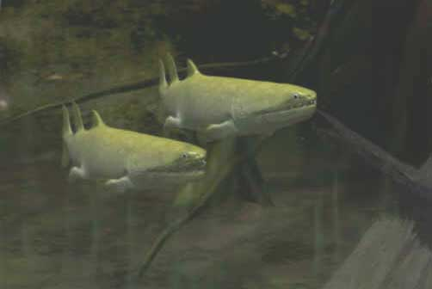
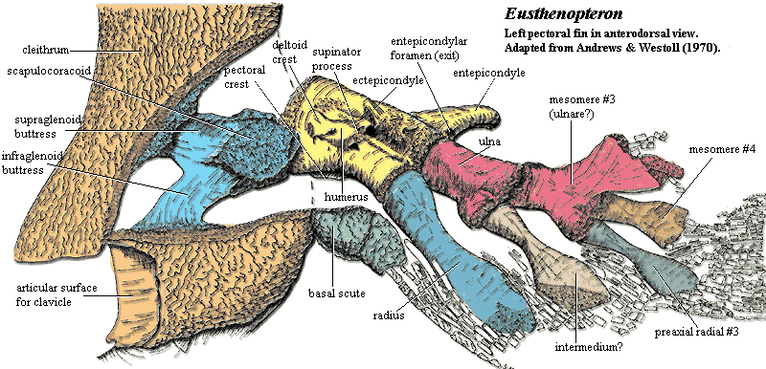
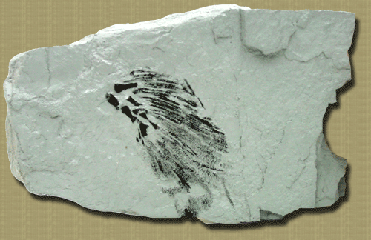
Eusthenopteron

Slide 30
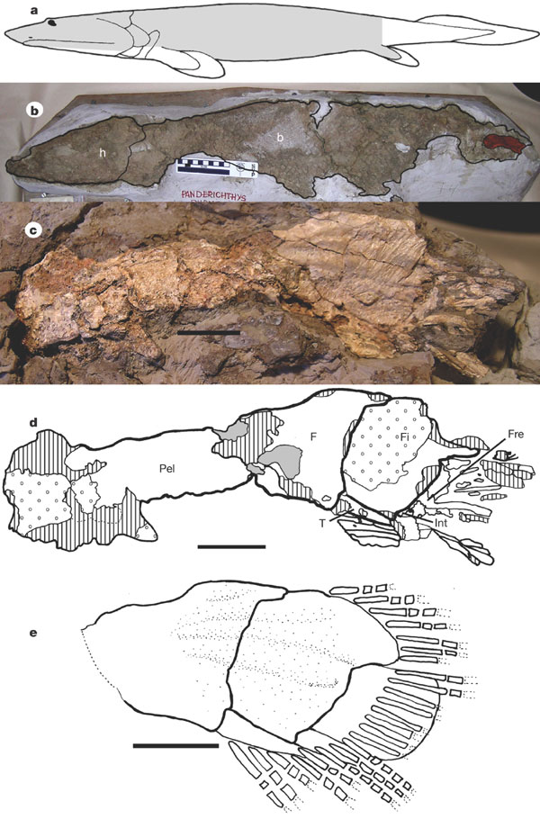
Panderichthys rhombolepis

Slide 31
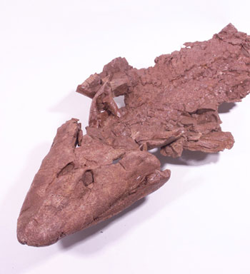
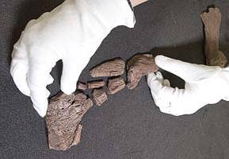
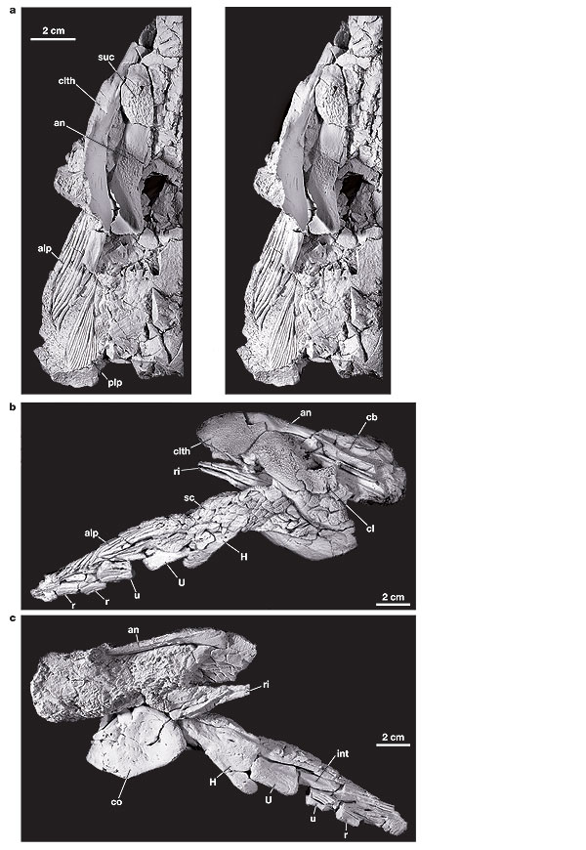
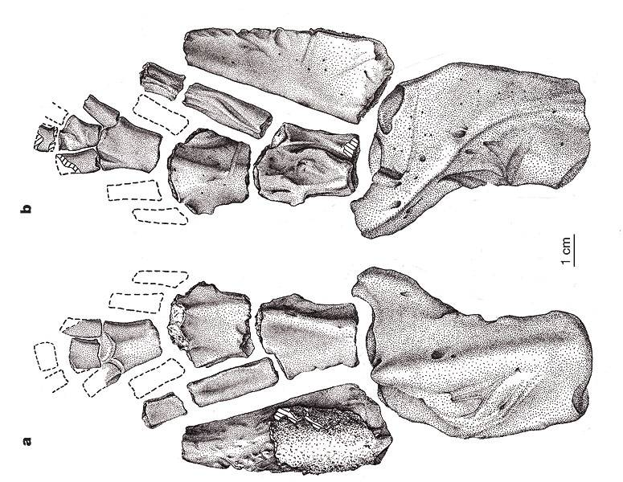
Tiktaalik roseae

Slide 32
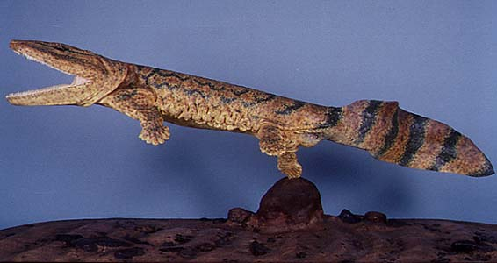
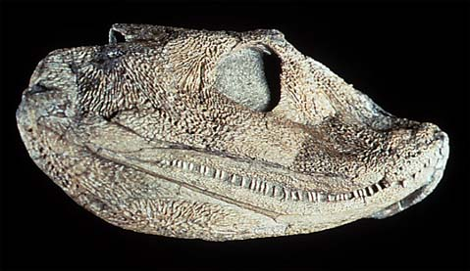
Acanthostega gunnari

Slide 33
Ichthyostega sp.

Slide 34
I. The Precambrian
- Vendian
II. Paleozoic
A. Cambrian (544-490 mya)
B. Ordovician (490-443 mya)
C. Silurian (443-417 mya)
D. Devonian (417-354 mya)
E. Carboniferous (359-300 mya)

Slide 35
E. Carboniferous (359-300 mya)
- inverts
Arthropleura -largest terrestrial arthropod - 2m

Slide 36
E. Carboniferous (359-300 mya)
- inverts
- radiation of insects
- evolution of flight
Meganeura monyi - largest insect ever
wingspan of 70 cm

Slide 37
E. Carboniferous (359-300 mya)
- inverts
- plants
The early Carboniferous saw a reduction in the Devonian forests and a dominance of small plants - lycopods and their kin.
Lepidodendron
Psaronius - fern
Lebachia - progymnosperm
Cordaites - progymnosperm

Slide 38
E. Carboniferous (359-300 mya)
- inverts
- plants
The early Carboniferous saw a reduction in the Devonian forests and a dominance of small plants - lycopods and their kin.
As the period proceeds, the giant lycopsid swamp forests evolve across the tropical continent of Euramerica.
There was lots of photosynthesis, but this was not balanced by decomposition (because much of the biomass was preserved in sediment, not broken down by decay). So, oxygen production by photosynthesis exceeded oxygen consumption by decomposition... and oxygen levels were probably very high...this may have allowed the enormous size of invertebrates.

Slide 39
E. Carboniferous (359-300 mya)
- inverts
- plants

Slide 40
E. Carboniferous (359-300 mya)
- inverts
- plants
Coal deposits in shallow tropical swamps

Slide 41
E. Carboniferous (359-300 mya)
- inverts
- plants
- vertebrates
sharks replace placoderms as dominant in oceans;

Slide 42
The golden age of sharks - 45 Families
(currently 21)

Slide 43
E. Carboniferous (359-300 mya)
- inverts
- plants
- vertebrates
sharks replace placoderms as dominant in oceans;
ray finned fishes dominate in fresh water

Slide 44
- vertebrates
radiation of stem tetrapods!!

Slide 45
- vertebrates
radiation of stem tetrapods!!

Slide 46
- vertebrates
radiation of stem tetrapods!!
"Anthracosaurs"

Slide 47
E. Carboniferous (359-300 mya)
- inverts
- plants
- vertebrates
sharks replace placoderms as dominant in oceans;
ray finned fishes dominate in fresh water
stem tetrapods radiate!
"crown" tetrapods
Seymouriamorpha
Temnospondyls
Ichthyostegans

Slide 48
E. Carboniferous (359-300 mya)
- inverts
- plants
- vertebrates
stem tetrapods
Temnospondyls
a very diverse radiation of tetrapods, from alligator-like salamanders to large, scaled, frog-like creatures. Cowens places these ancestral to Amphibia only, but recent analyses put them as a sister clade to all crown tetrapods.

Slide 49
Temnospondyls
a very diverse radiation of tetrapods, from alligator-like salamanders to large, scaled, frog-like creatures. Cowens places these ancestral to Amphibia only, but recent analyses put them as a sister clade to all crown tetrapods.

Slide 50
Seymouriamorpha
Radiate in Permian
but earliest fossils from the Carboniferous... larvae have external gills, which pulls them out of the amniota...

Slide 51
- vertebrates
radiation of stem tetrapods!!

Slide 52
The Amniote Divide
The amniotic egg was a big advance
- amnion protects the embryo - yolk sac provides nourishment - allantoic sac holds waste produced by embryo
Resist desiccation
Provision embryo
allows for colonization of dry habitats

Slide 53
Primitive Amniotes
Hylonomus lyelli – an early reptile
Carboniferous of Nova Scotia

Slide 54
E. Carboniferous
- The Amniote Radiations
SYNAPSID
Anapsid ancestor
Hylonomus
Casineria
ANAPSID (turtles?)
DIAPSID

Slide 55
I. The Precambrian
- Vendian
II. Paleozoic
A. Cambrian (544-490 mya)
B. Ordovician (490-443 mya)
C. Silurian (443-417 mya)
D. Devonian (417-354 mya)
E. Carboniferous (359-300 mya)
F. Permian (300-251 mya)

Slide 56
F. Permian (300-251 mya)
Pangaea forms
The fusion of land masses reduced the amount of humid coastline and increased the extent of dry inland areas. This favored the amniote radiations over "amphibian" clades.

Slide 57
F. Permian
- The Amniote Radiations Diversify
SYNAPSID
Anapsid ancestor
Hylonomus
ANAPSID (turtles)
DIAPSID

Slide 58
F. Permian (300-251 mya)
Synapsids dominate through the early Permian
Pelycosaurs
Dicynodonts
Gorgonopsids
Therapsids
Cynodonts
Mammals

Slide 59
F. Permian (300-251 mya)
Pelycosaurs dominate early
include the great sail-finned animals like Dimetrodon

Slide 60
F. Permian (300-251 mya)
Early Therapsids, like Gorgonopsids, dominate in the mid-late Permian
Moschops
Dinocephalians

Slide 61
F. Permian (300-251 mya)
Dicynodonts come to numerical dominance in the late Permian
abundant herbivores

Slide 62
F. Permian (300-251 mya)
and the first Cynodonts appear

Slide 63
F. Permian (300-251 mya)
large herbivorous anapsids were also present

Slide 64
F. Permian (300-251 mya)
Diapsids were small and lizard-like; the Synapsids ruled terrestrial communities

Slide 65
F. Permian (300-251 mya)
- Plants!!

Slide 66
F. Permian (300-251 mya)
- Plants!!
- the dry climate reduced the great Carboniferous swamp forests; lycopods shrink...
- Ferns, and gymnosperms ("seed ferns", Ginkos, Cycads, and Conifers) gain prominence...
- In particular Glossopteris - a seed fern - that produces seeds on its leaves like sori of ferns...
The evolution of gymnosperms introduced two important adaptive features:
- pollen (male gametophyte) - no more swimming sperm; reduced reliance on open water habitats
- seed - protective seed coat reduced desiccation of embryo, and nutritious endosperm provisioned the embryo with energy. (Like the amniote egg).

Slide 67
F. Permian (300-251 mya)
The great Permian extinction!!!!
A huge mantle plume rises towards the surface...

Slide 68
F. Permian (300-251 mya)
The great Permian extinction!!!!
then it pops like a zit!!

Slide 69
F. Permian (300-251 mya)
The great Permian extinction!!!!
A huge mantle plume rises towards the surface...
resulting in a great bubble of flowing lava... the Siberian flats (200,000 squ. mi)

Slide 70
F. Permian (300-251 mya)

Slide 71
F. Permian (300-251 mya)
- results:
90-95% of marine species go extinct...
trilobites
placoderms
acanthodians

Slide 72
F. Permian (300-251 mya)
- results:
90-95% of marine species go extinct...
trilobites
placoderms
acanthodians
70% of all land families
pelycosaurs

