Slide 1
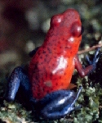
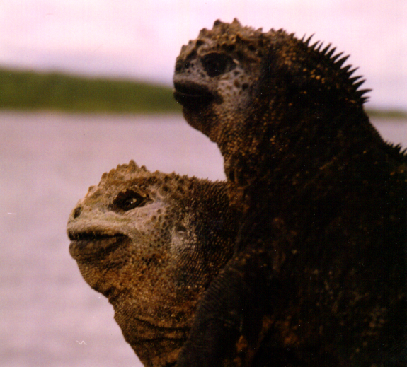
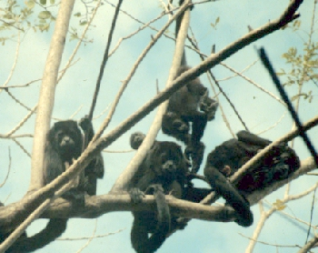
Why Preserve Biodiversity?

Slide 2
What diversity is…
What diversity does…

Slide 3
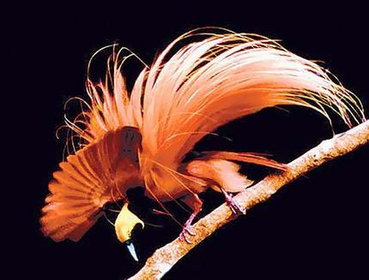
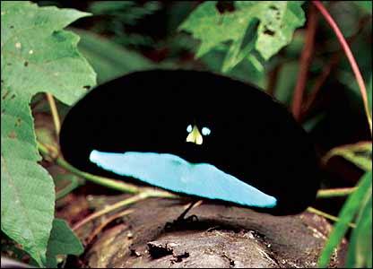
So, there sure are a lot of species… (= biodiversity)
WHY PRESERVE BIODIVERSITY?

Slide 4
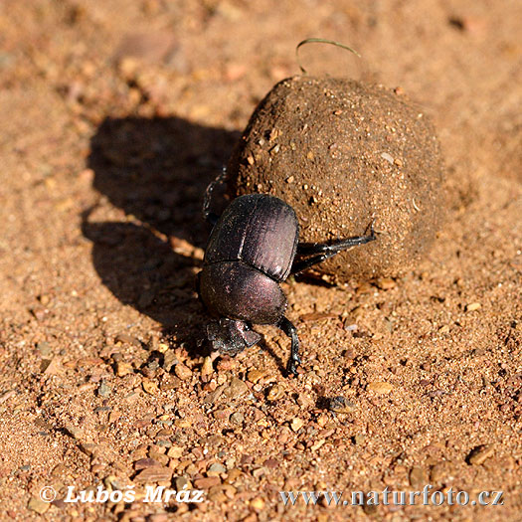
So, there sure are a lot of species… (= biodiversity)
WHY PRESERVE BIODIVERSITY?
Because it has value….
Functional

Slide 5

So, there sure are a lot of species… (= biodiversity)
WHY PRESERVE BIODIVERSITY?
Because it has value….
Functional
Aesthetic

Slide 6
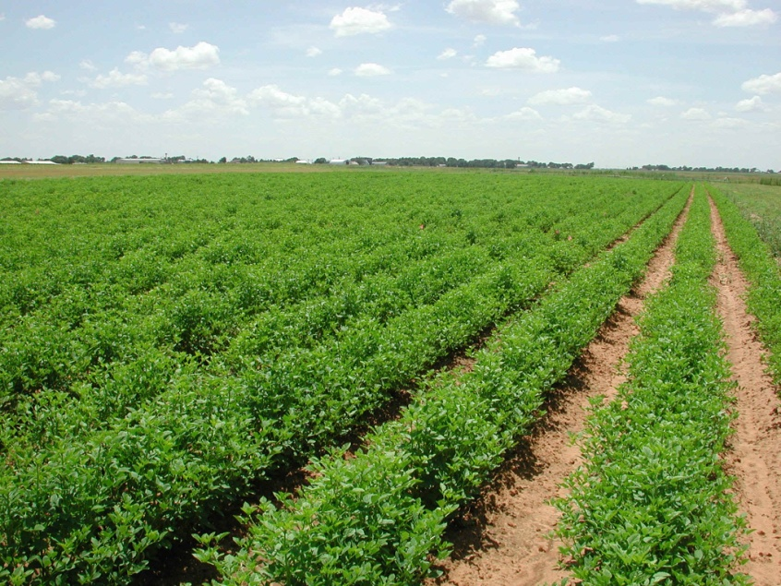
Functionally:
Productivity is the energy that an organism absorbs and stores as tissue – as biomass. (And not the energy that the organism spends to move or keep their cells alive…).
So, for humans, ecosystem productivity is food.

Slide 7
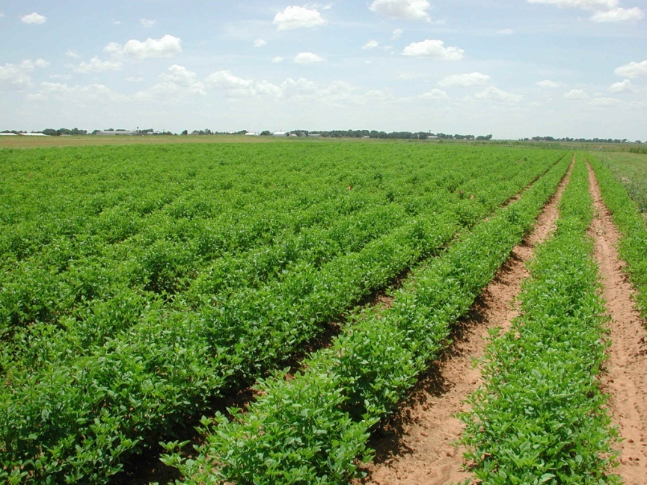
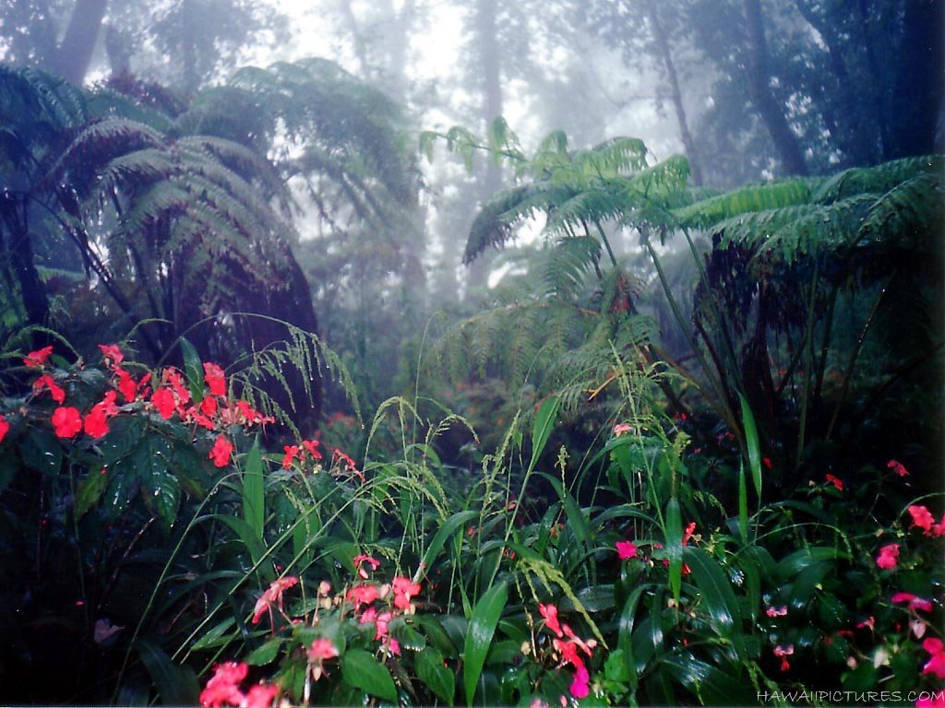
Functionally:
Diversity INCREASES productivity

Slide 8
Functionally:
Diversity INCREASES productivity
- Sampling Effects
More diverse communities are more likely to contain the most productive species, and thus raise the total productivity.

Slide 9
Functionally:
Diversity INCREASES productivity
- Sampling Effects
More diverse communities are more likely to contain the most productive species, and thus raise the total productivity.
- Niche Complementarity
More diverse communities are more likely to contain different types of species that use different types of energy... thus more efficiently harvesting the available energy

Slide 10
Monoculture
They all need the same things at the same concentrations; have to place them far apart to reduce competition.

Slide 11
Monoculture
Polyculture
They all need the same things at the same concentrations; have to place them far apart to reduce competition.
Combinations of different plants can be planted at higher density, and they use different "niches" and coexist. Even if abundance of "most productive" species, drops, this loss can be offset.

Slide 12
Functionally:
Diversity INCREASES productivity
- Sampling Effects
- Niche Complementarity
- Positive Interactions
More diverse communities may contain species that benefit other species, and thus increase the productivity of the whole community.

Slide 13
Monoculture
Polyculture
without beans
with beans
They all need the same things at the same concentrations; have to place them far apart to reduce competition.
Nitrogen fixing legumes (beans) nutrify the soil, increasing the growth of other plants

Slide 14
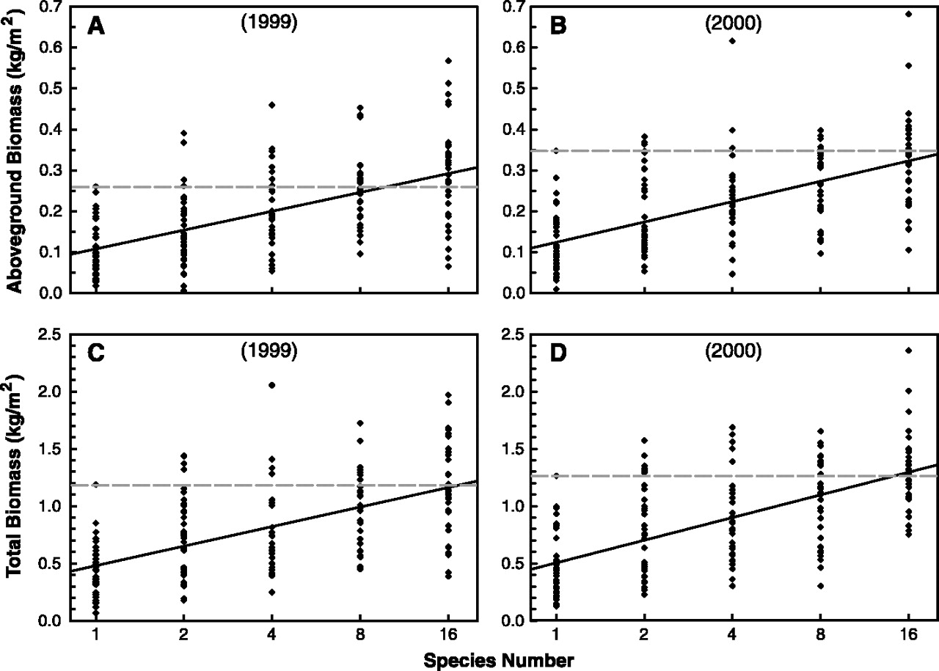
Diversity and Productivity in a Long-Term Grassland Experiment Tilman, et al. 2001. Science 294. 843 - 845
Dotted line is biomass in a monoculture of the most productive species. Higher productivity than this, at higher richness values, means niche complementarity or positive effects must be occurring.

Slide 15
Functionally:
Diversity INCREASES productivity
Diversity can increase stability

Slide 16
Functionally:
Diversity INCREASES productivity
Diversity can increase stability
types of stability:
resistance to change

Slide 17
Functionally:
Diversity INCREASES productivity
Diversity can increase stability
types of stability:
resistance to change
resilience after change (return to
initial state)

Slide 18
Functionally:
Diversity INCREASES productivity
Diversity can increase stability
types of stability:
relationships with diversity:
Diverse communities are less susceptible to one particular disturbance (like one species of pest, or fire, or flood), because multiple species are unlikely to be sensitive to the same thing.

Slide 19
Example 1: Bird Flu
Diverse communities are less susceptible to one particular disturbance (like one species of pest, or fire, or flood), because multiple species are unlikely to be sensitive to the same thing.

Slide 20
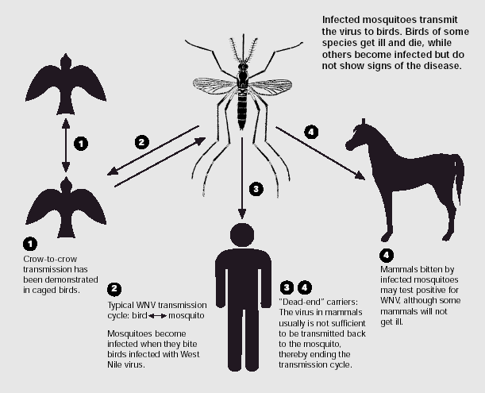
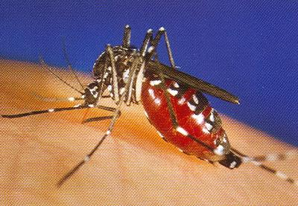
Example 1: Bird “Flu”
People can get a virus (West Nile Virus), carried by mosquitoes, from birds…

Slide 21
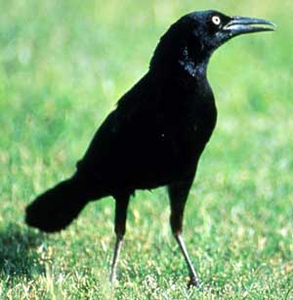
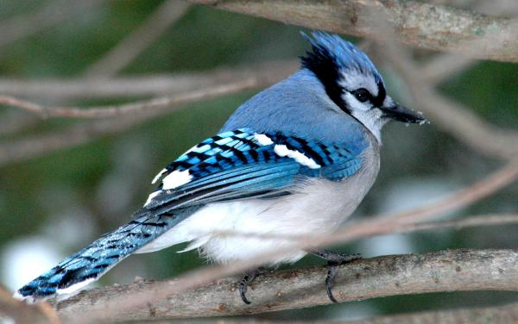
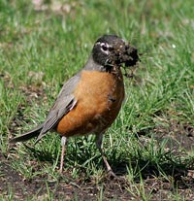
Example 1: Bird “Flu”
People can get a virus (West Nile Virus), carried by mosquitoes, from birds…
SOME birds are good reservoirs… Crows, Blue Jays, Sparrows, and Robins

Slide 22
Example 1: Bird “Flu”
So people in communities with low bird diversity, dominated by these species, have high rates of Bird Flu!
( because mosquitoes are likely to hit an infected bird and transmit to humans)

Slide 23
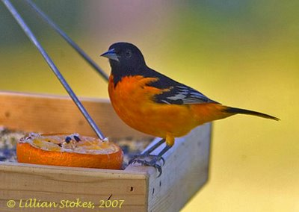
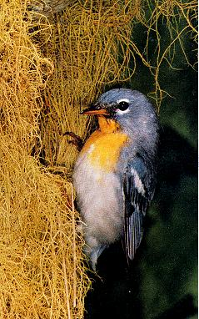
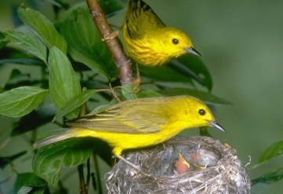
Example 1: Bird “Flu”
People in communities with high bird diversity means a lower percentage of these species, and mosquitoes are less likely to hit them and get infected because there are OTHER species to feed on!

Slide 24
Example 1: Bird “Flu”
People in communities with high bird diversity means a lower percentage of these species, and mosquitoes are less likely to hit them and get infected because there are OTHER species to feed on! And fewer people get sick!

Slide 25
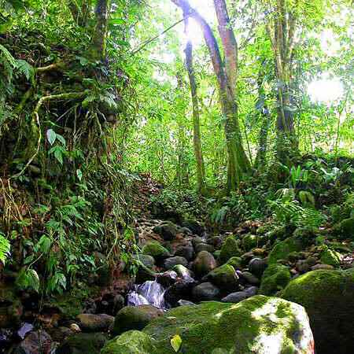
Example 2: Rainforest
Diverse communities are less susceptible to one particular disturbance (like one species of pest, or fire, or flood), because multiple species are unlikely to be sensitive to the same thing.

Slide 26
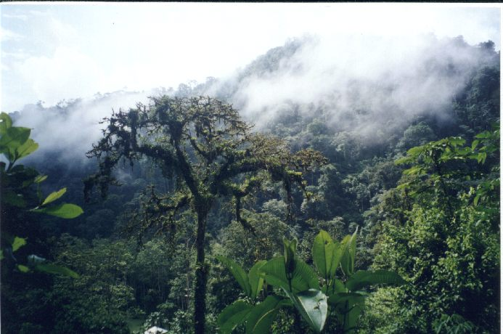
Example 2: Rainforests
Stimulate condensation and precipitation
Volatiles released
Rainforests feed themselves and water themselves.
Decomposition rapid
Absorption rapid

Slide 27
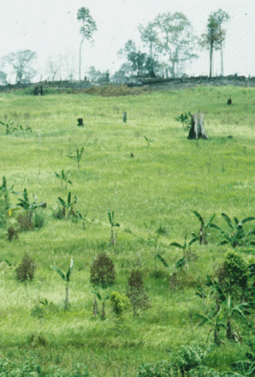
CUT FOREST DOWN
Select for fire-adapted grasses.... rainforest doesn't come back....
REDUCE RAINFALL... REDUCE NUTRIENTS
INCREASE FIRE

Slide 28
RAINFOREST
(wet, few fires)
"Multiple Stable States"
GRASSLAND
(dry, many fires)

Slide 29
We are dependent on the environment for food and resources. Ideally, we would like a STABLE, PRODUCTIVE supply of these resources.... right??
FEAST
FAMINE

Slide 30
(We don't want "boom and bust", "feast and famine" scenarios....)
FEAST
FAMINE

Slide 31
We are dependent on the environment for food and resources. Ideally, we would like a STABLE, PRODUCTIVE supply of these resources.... right??
(We don't want "boom and bust", "feast and famine" scenarios....)
STABILITY
?
PRODUCTIVITY

Slide 32
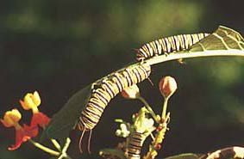
- Aesthetic reasons to preserve biodiversity:

Slide 33

nature is important to each person, even at an unconscious level.

Slide 34
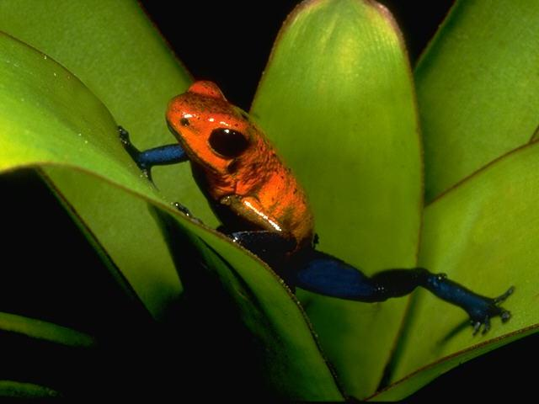
Biophilia:
We are interested in living things…

Slide 35
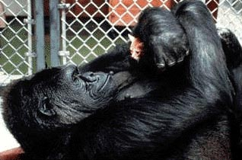
Biophilia:
There is an adaptive benefit to this interest that has been selected for over hominid evolution…

Slide 36
Evidence for Biophilia in the Humanities - Language
A ‘first alphabet’ book…..
‘A’ is for _____________.
‘B’ is for _____________.
‘C’ is for _____________.
‘D’ is for _____________.
‘E’ is for _____________.
‘F’ is for _____________.

Slide 37
Evidence for Biophilia in the Humanities - Language
A ‘first alphabet’ book…..
‘A’ is for _____________.
- antidisestablishmentarianism?

Slide 38

Evidence for Biophilia in the Humanities - Language
A ‘first alphabet’ book…..
‘A’ is for _____________.
- antidisestablishmentarianism?

Slide 39
Evidence for Biophilia in the Humanities - Language
A ‘first alphabet’ book…..
‘A’ is for _____________.
‘B’ is for _____________.
‘C’ is for _____________.
‘D’ is for _____________.
‘E’ is for _____________.
‘F’ is for _____________.

Slide 40
Evidence for Biophilia in the Humanities - Language
Adjectives and similes…..
Sly as _________

Slide 41
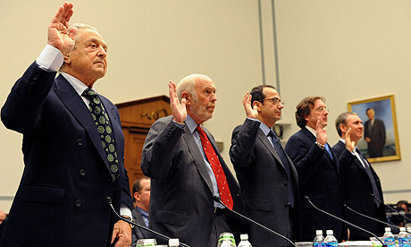
Evidence for Biophilia in the Humanities - Language
Adjectives and similes…..
Sly as _________ a hedge fund manager?

Slide 42
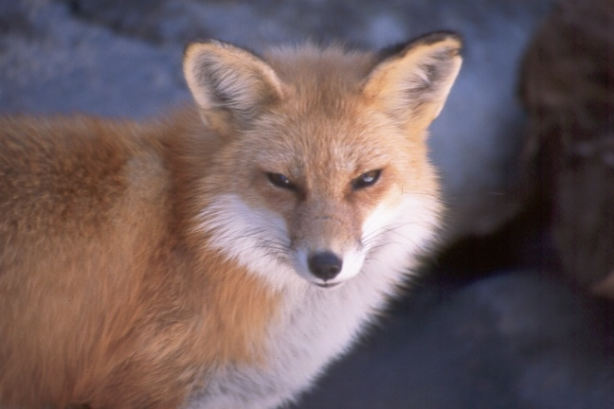
Evidence for Biophilia in the Humanities - Language
Adjectives and similes…..
Sly as _________

Slide 43
Evidence for Biophilia in the Humanities - Language
Adjectives and similes…..
busy as __________?
Strong as ________ ?
Weak as _________ ?

Slide 44
Evidence for Biophilia in the Humanities – Language
Verbs:
To ‘cow’ To ‘quail’
To ‘clam up’ To ‘weasel’
To ‘outfox’ To ‘hound’
To ‘hog’ To ‘grouse’
To ‘fawn’ To ‘buffalo’

Slide 45
Evidence for Biophilia in the Humanities – Language
Trivial examples or basic, fundamental examples?
Summary –
“Human intelligence is bound to the presence of animals. They are the means by which cognition takes shape and they are the instruments for imagining abstract ideas and qualities… they are basic to the development of speech and thought.”
-Shepard 1978

Slide 46

Evidence for Biophilia in the Humanities - Religion
Animals are central to the myths that give our lives meaning and our culture context.
In particular, the serpent figures
prominently as an icon of power,
knowledge, life, and death.
Egyptians – the Earth as an
Egg, grasped by a serpent

Slide 47
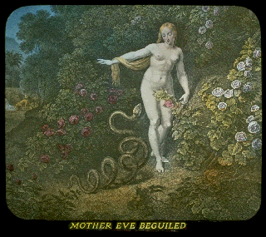
Evidence for Biophilia in the Humanities - Religion
Middle East – Judaism – Eve and the serpent

Slide 48
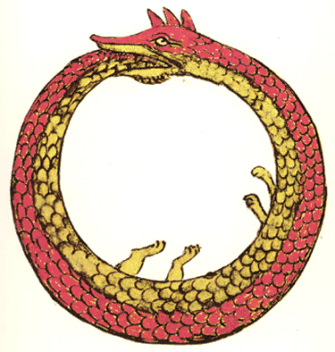
Evidence for Biophilia in the Humanities - Religion
Greeks – Gaia (Earth) was protected by her son, Python, who lived at the center of the world and held it together

Slide 49

Evidence for Biophilia in the Humanities - Religion
Australian aboriginal culture – the rainbow serpent – art dates from 6000 years ago

Slide 50

Evidence for Biophilia in the Humanities - Religion
Aztecs – Quetzalcoatl, the ‘bird-serpent’ or “feathered serpent”

Slide 51

Evidence for Biophilia in the Humanities –
Summary
"Animals are far more fundamental to our thinking than we supposed. They are not just a part of the fabric of thought: they are a part of the loom." (Peter Steinhart, 1989).
(Native American ouroboric image)

Slide 52

Evidence for Biophilia in the Social Sciences - Sociology
Animals are our cultural icons, we use them for tribal affiliation, both trivial….
NFL Football Team Mascots:
Cardinals Falcons Ravens Bills Panthers Bears Bengals Broncos Lions Colts Jaguars Dolphins Eagles Seahawks Rams
15 of 32 teams

Slide 53

Evidence for Biophilia in the Social Sciences - Sociology
And significant…

Slide 54
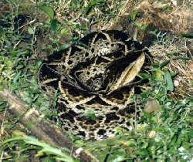
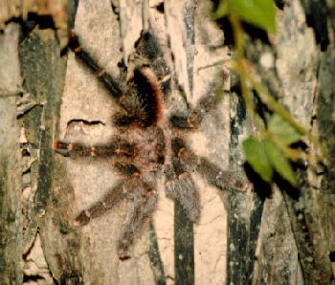
Evidence for Biophilia in the Social Sciences - Psychology
- phobias are usually related to natural cues: (snakes, spiders, water, closed spaces, heights)
(and other primates that encounter snakes are ophidophobes)

Slide 55
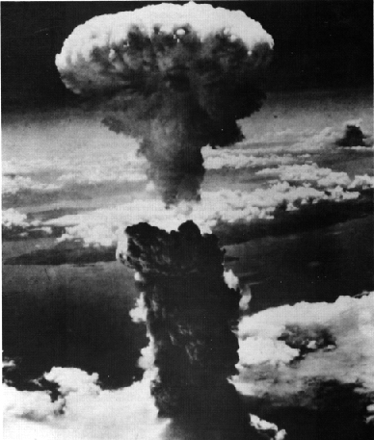

Evidence for Biophilia in the Social Sciences - Psychology
- even though cultures have produced more deadly risks

Slide 56
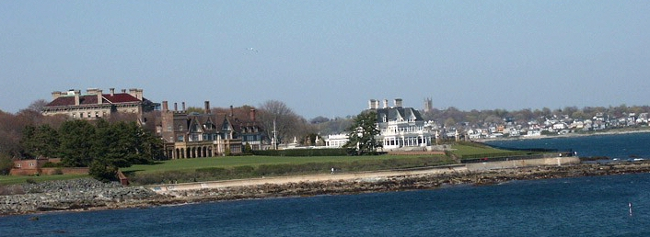
Evidence for Biophilia in the Social Sciences - Psychology
habitat selection – humans with the resources build homes on promontories near water, with a view
The Vanderbilt Estate, “The Breakers”, Newport, RI

Slide 57
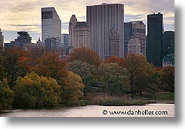
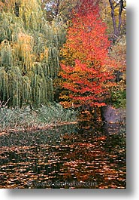
Evidence for Biophilia in the Social Sciences - Psychology
Societies construct gardens, parks, and green spaces in urban environments – like Central Park, NYC.

Slide 58
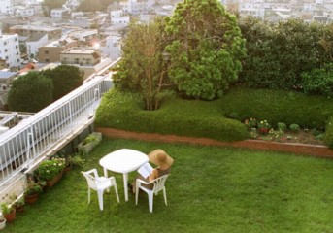
Evidence for Biophilia in the Social Sciences - Psychology
We need nature, and we take it with us into man-made environments; it is a part of what we are, and it has shaped who we are and how we identify ourselves, individually and collectively.
Rooftop Garden, Tokyo Tokyo

Slide 59
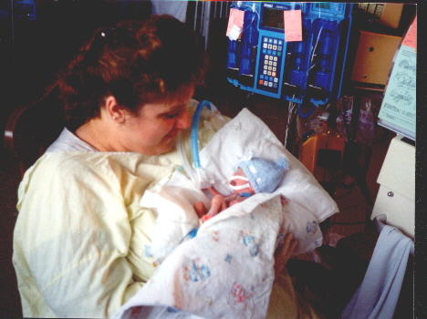
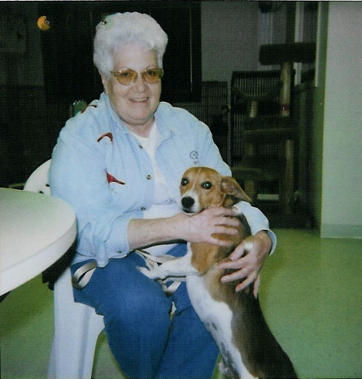
Evidence of Biophilia in the Natural Sciences - Physiology
- contact with people helps development and healing
- contact with animals helps stress and healing, and gives us someone who depends upon us.

Slide 60
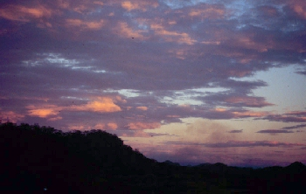
Evidence of Biophilia in the Natural Sciences - Physiology
- vistas - people with a natural view are less stressed and are more productive.
- inner city children with a view of a park are able to concentrate in school and are better learners.

Slide 61
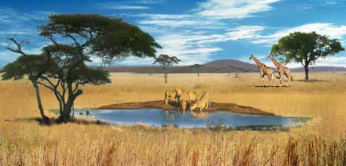
What are the ramifications of biophilia?
Humans need nature as a reference to completely express our humanity. It is at once the “other” and the “self”.
To lose it, or to simplify it, will profoundly affect what and who we are.

Slide 62
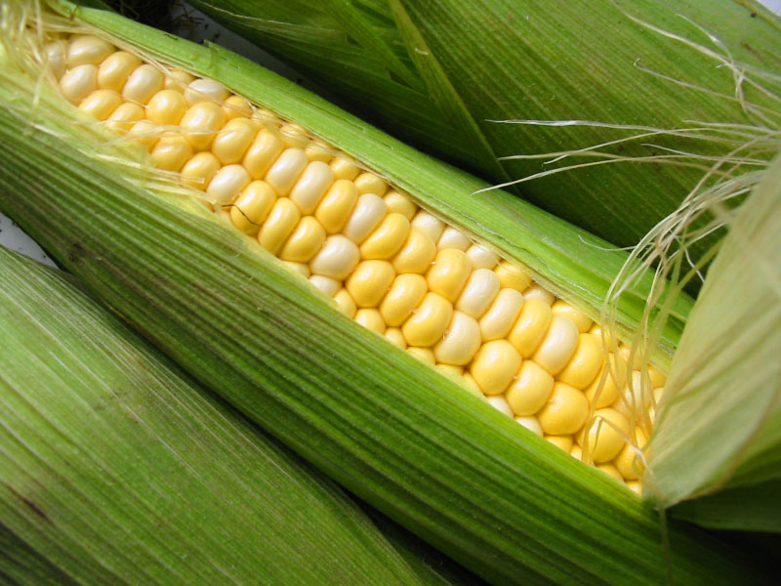
How is our biodiversity doing?
Genetic diversity within species
Species diversity in communities
Ecosystem diversity

Slide 63
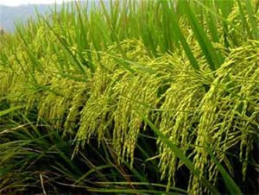
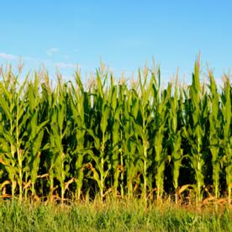
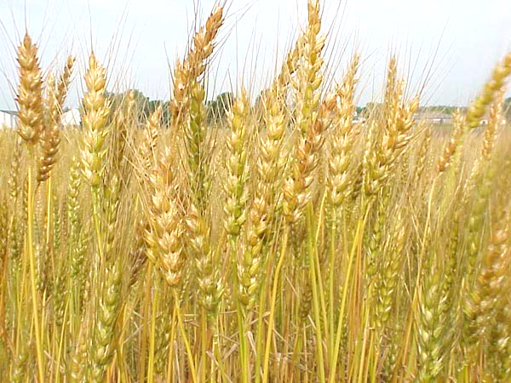
How is our biodiversity doing?
Humans used hundreds of crop species worldwide; now 3 species (rice, wheat, corn) provide 60% of our calories from crop plants.
According to the FAO of the UN, 70% of the genetic diversity of crop plants has been lost in the last 75 years as we’ve shifted to industrial farming and the use of GM strains.

Slide 64
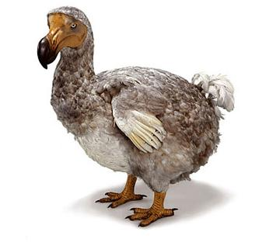
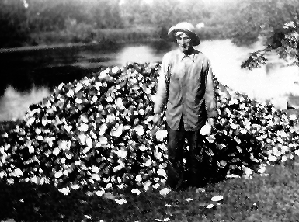
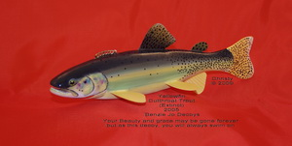
How is our biodiversity doing?
2000 Pacific Island bird species (15% of global total) have gone extinct after human colonization
20 of the 297 mussel species in N.A. have gone extinct in the last 100 years; 60% are endangered
40 of 950 fish species in N. A. have gone extinct in the last century; 35% are threatened or endangered
http://www.americanscientist.org/issues/pub/the-real-biodiversity-crisis/1
Yellow-finned cutthroat trout
http://www.fishdecoys.net/pages/LDC_Collection/BenzieJoDecoys.htm
http://www.nps.gov/sacn/planyourvisit/st-croix-currents.htm?customel_dataPageID_206517=289024

Slide 65
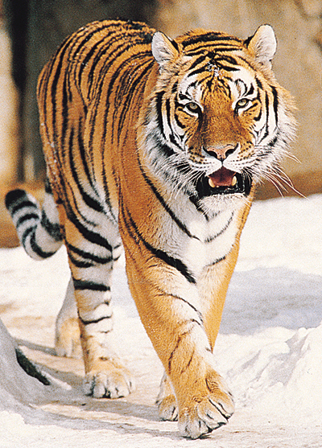
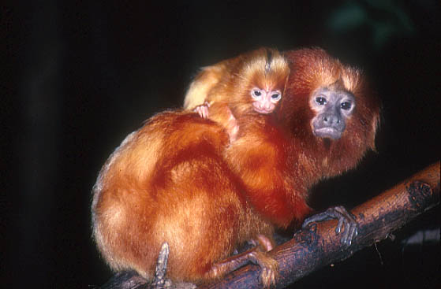
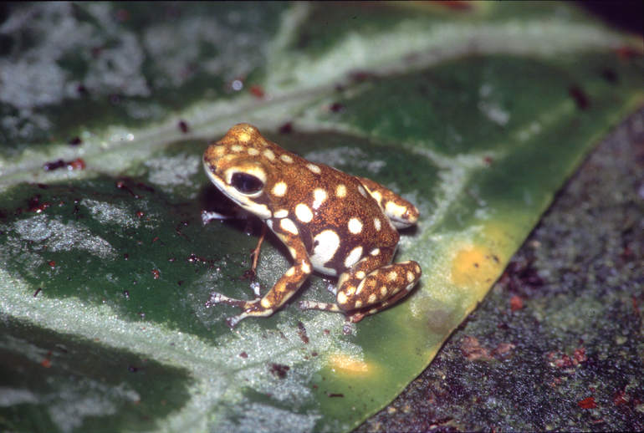
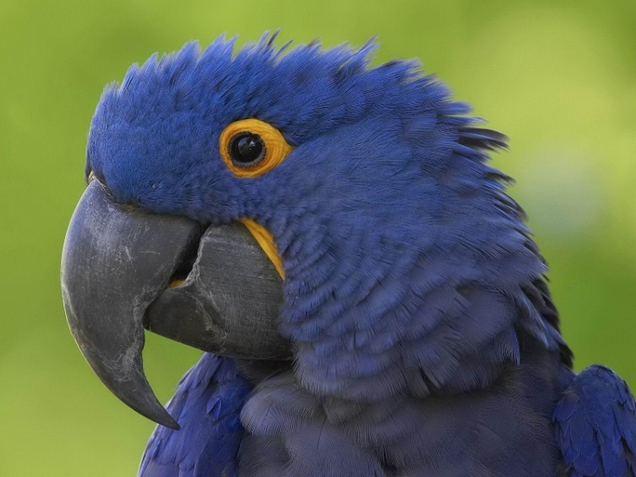
How is our biodiversity doing?
1 in 4 mammal species is endangered
1 in 8 bird species is endangered
1 in 3 amphibian species is endangered
48% of primate species are threatened
Data from: http://iucn.org/what/tpas/biodiversity/

Slide 66



How is our biodiversity doing?
35% of mangrove habitat has been lost in the last 20 years
In the Caribbean, hard coral cover has declined from 50% to 10% in the last 20 years
Since 2000, 232,000 sq miles of old growth forest have been lost (size of Texas).

Slide 67


Slide 68
WHY?

Slide 69


7 billion in 2011 (12 years later)

Slide 70

http://news.mongabay.com/2011/1009-amazon_deforestation_revised.html
13,000 sq kilometers is about the size of Connecticut

Slide 71

Extent of Virgin Forest, Contiguous U. S.
http://mvh.sr.unh.edu/mvhinvestigations/old_growth_forests.htm

Slide 72


Slide 73

Millenium Assessment 2006

Slide 74

Humans use/control 40% of the ‘food’ produced on the planet.
1
10 million?

Slide 75

Fragmentation

Slide 76
Fragmentation
Area Effects
CARNIVORES
HERBIVORES
PLANTS
LARGE AREA OF HABITAT
Notes:
1
1

Slide 77
Fragmentation
HABITAT FRAGMENTATION
Notes:
1
1

Slide 78
Fragmentation
Carnivores lost - (reduce diversity)
Herbivores compete – (reduce diversity)
Plants overgrazed – (reduce diversity)
HABITAT FRAGMENTATION
Notes:
1
1

Slide 79


We are a geological force, operating on an ecological timescale
Mountaintop removal in West Virginia

Slide 80

We are a geological force, operating on an ecological timescale
Gold mining in Peruvian Amazon

Slide 81


We are a geological force, operating on an ecological timescale

Slide 82

RESERVOIRS:
Most atmospheric carbon has been transferred to the hydrosphere (dissolved CO₂) and lithosphere (limestone and fossil deposits).
Dead and dissolved organic matter are other large reservoirs
The atmosphere and biosphere have some, too.
reservoirs in gigatons and exchanges in GT/year

Slide 83

Decrease due to terrestrial plant evolution and Carboniferous storage

Slide 84

- last 160,000 years (ice cores)
401
280

Slide 85

- Since 1000: up 43% (all since 1830 – industrial revolution)

Slide 86

- Since 1955: 318 to 407 (June 6, 2016) – 26%

Slide 87

- Ocean absorption and acidification

Slide 88


Slide 89


Slide 90


Slide 91

Reductions in Polar Ice
(area covered)
1979
Nasa.gov
2003

Slide 92

Summer 2012 – Record low summer sea ice

Slide 93


Slide 94


Slide 95


Reductions in polar ice
Reductions in glacial ice
B-15 is the size of Connecticutt (2000)

Slide 96

Reductions in polar ice
Reductions in glacial ice

Slide 97

- Increases in Sea Level

Slide 98

Reductions in polar ice
Reductions in glacial ice
Sea level rise

Slide 99

Reductions in polar ice
Reductions in glacial ice
Sea level rise
Melting of Permafrost
14% of the world’s organic carbon is stored in permafrost. As the poles warm (and they are warming faster than anywhere else), this carbon may be mobilized as decomposing bacteria gear up….
This is a type of threshold response (not a gradual response), and would involve positive feedback loops…

Slide 100


Slide 101

- More big storms: March 24, 2004 – Atlantic Cyclone off Brazil.

Slide 102
- More big storms
“Natural disasters caused by extreme weather claimed seven times as many victims in 2003 as in the previous year and the trend is set to continue, says the world's biggest reinsurance company. (They insure insurance companies.) Munich Re said global warming would cause increasing economic damage in the future. "It is to be feared that extreme events which can be traced to climate change will have increasingly grave consequences in the future," the report said, adding that insurance premiums would rise and that clear-cut indemnity limits would be needed.”
– Reuters New Service, Feb 27, 2004

Slide 103


Slide 104

1900-2010

Slide 105
Reductions in polar ice
Reductions in glacial ice
Sea level rise
Melting of Permafrost
Stronger Storms
Effects on the Biosphere
- Changes in Plant Growth:
Qualitative Effects:
Laurance et al. (March 2004, Nature):
- Pristine rainforests have changed composition in last 20 years, with an increase in fast-growing species and a decrease in slow growing species… probably as a result of increased CO₂ availability.

Slide 106
Reductions in polar ice
Reductions in glacial ice
Sea level rise
Melting of Permafrost
Stronger Storms
Effects on the Biosphere
Changes in Reef Communities:
“Almost 15% of the world's reefs are already beyond repair thanks to global warming. Another 30% may be lost over the next 30 years.”
– (Nature, February 2004)
- Reefs are home to 25% of all marine species
- Reefs are nursery areas for the larvae and fry of commercially important fish and crustacean species
- Reefs are important storm breaks for tropical coasts

Slide 107

Changes in Reef Communities:

Slide 108
Reductions in polar ice
Reductions in glacial ice
Sea level rise
Melting of Permafrost
Stronger Storms
Effects on the Biosphere
- Changes in Species Diversity
15-37% of terrestrial species may go extinct in the next 50 years, largely because of global warming. (Thomas et al. 2004)

Slide 109
“It is extremely likely that human influence on climate caused more than half of the observed increase in global average surface temperature from 1951 to 2010. There is high confidence that this has warmed the ocean, melted snow and ice, raised global mean sea level and changed some climate extremes in the second half of the 20th century.”

Slide 110

We are a geological force, operating on an ecological timescale

Slide 111

We are a geological force, operating on an ecological timescale
Hmmmm….

Slide 112

Sixth major mass extinction event - NOW
All genera
“well described” genera
The “big five” Mass Extinction Events
Thousands of Genera
Millions of Years Ago
http://en.wikipedia.org/wiki/File:Phanerozoic_biodiversity_blank_01.png

Slide 113

22 May 2010 –Secretary-General Ban Ki-moon:
“Biodiversity loss is moving ecological systems ever closer to a tipping point beyond which they will no longer be able to fulfill their vital functions.”

Slide 114


What Can We Do?
We need to protect and preserve large intact, biodiverse ecosystems.

Slide 115

This is great, but it ain’t gonna do it…

Slide 116


Slide 117
We need to rethink our model of community…
nature
nature
Development
Development
Development
Development

Slide 118



We need to find out what’s out there!

Slide 119
We need to appreciate the societal and economic value of biodiversity
Corporate Social Responsibility (CSR)
http://www.justmeans.com/Stop-Loss-CSR-Biodiversity/28856.html
“Protection of biodiversity should be the underlying reason for every CSR effort. Biodiversity loss is the most severe threat to human-wellbeing on the planet. It rates even higher than climate change and related problems….
The head of Deutsche Bank's Global Markets predicts that our current rate of biodiversity loss could see 6% of global GDP wiped out as early as 2050.
The Economics of Ecosystems and Biodiversity executive summary (2010) reports that “over 50% of CEOs surveyed in Latin America and 45% in Africa see declines in biodiversity as a challenge to business growth. In contrast, less than 20% of their counterparts in Western Europe share such concerns”

Slide 120



Slide 121

If we recognize the grandeur of life, we might appreciate it…

Slide 122

If we appreciate it, we might value it…

Slide 123

If we value it, we might sustain it…

Slide 124

If we sustain it, we might be able to sustain our societies and economies, as well.
ECONOMY
SOCIETY
ENVIRONMENT

Slide 125






If we don’t, we won’t…
Thylacine - 1936
Tecopa Pupfish - 1981
Quogga - 1883
Vietnamese Rhinoceros - 2010
Yangtze River Dolphin - 2006
Golden Toad - 1989
A few extinct animal species.

