Slide 1
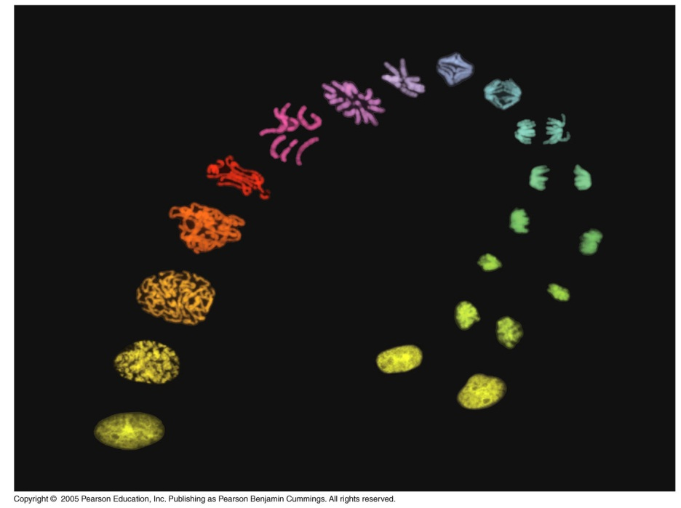
Lecture 5: Reproduction and Heredity

Slide 2
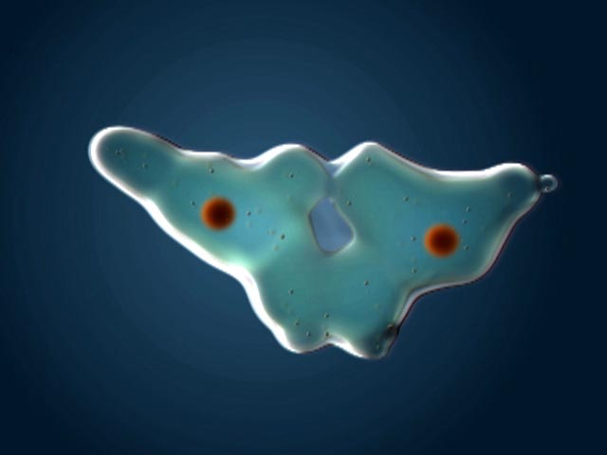
I. REPRODUCTION
A. Overview: Why Reproduce?

Slide 3
Reproduction is selected for, by definition.
X
X
X
X

Slide 4
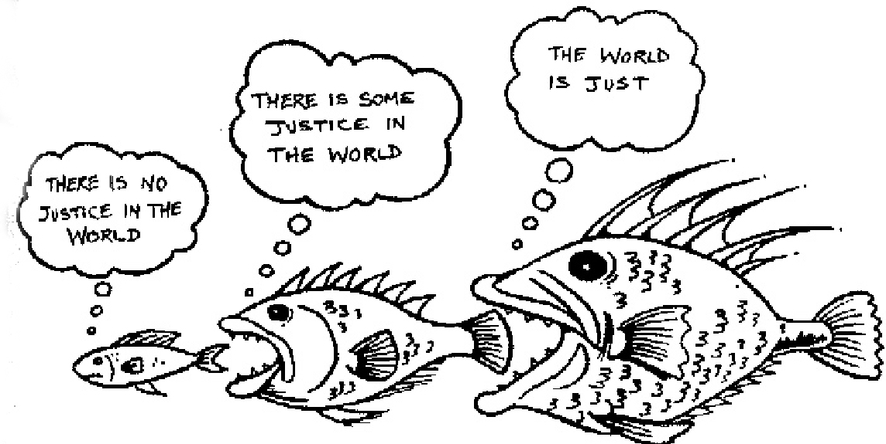
B. Cell Division
1. Why is cell division beneficial?
- persistence through time (selection by definition)
- efficiency
As cells increase in size, they decrease in efficiency.

Slide 5
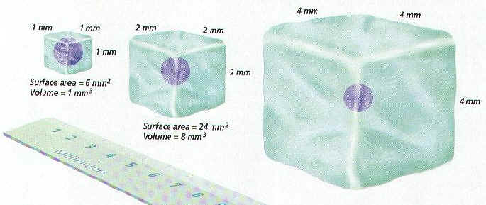
- WHY??
Bigger is better….
So selection favors growth…
But as cells increase in size, they decrease in efficiency.

Slide 6
SA/V = 6
SA/V = 3
SA/V = 1.5
The “surface area to volume ratio” decreases as something increases in size….

Slide 7
SA/V = 6
SA/V = 3
SA/V = 1.5
The “surface area to volume ratio” decreases as something increases in size….
The surface area – the membrane – limits the rate of supply of nutrients to the cell.
The volume – where all the enzymes are – represents potential production and ‘demand’ for nutrients.

Slide 8
SA/V = 6
SA/V = 3
SA/V = 1.5
So, as something gets larger, the volume increases more than the surface area… and the demand for nutrients (to meet peak productivity) grows faster than the rate at which the more slowly increasing SA can supply them. So, supply fails to meet demand, and the cell cannot meet peak productivity… it becomes less efficient.

Slide 9
- WHY??
Bigger is better….
So selection favors growth…
But as cells increase in size, they decrease in efficiency.
So, to get bigger, most organisms increase cell number, not cell size….

Slide 10
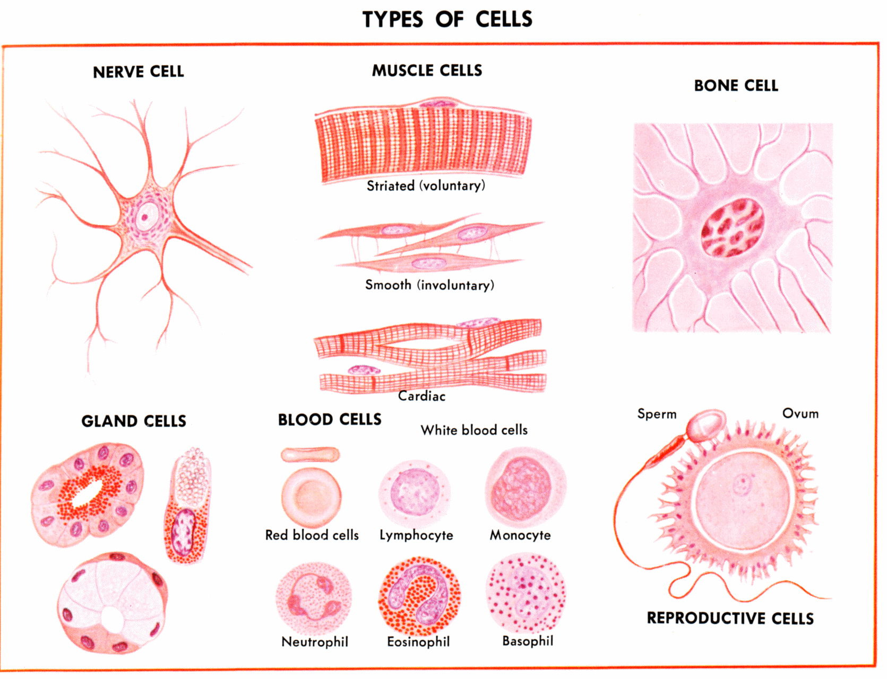
B. Cell Division
1. Why is cell division beneficial?
- persistence through time (selection by definition)
- efficiency
- multicellularity, division of labor (specialization)

Slide 11
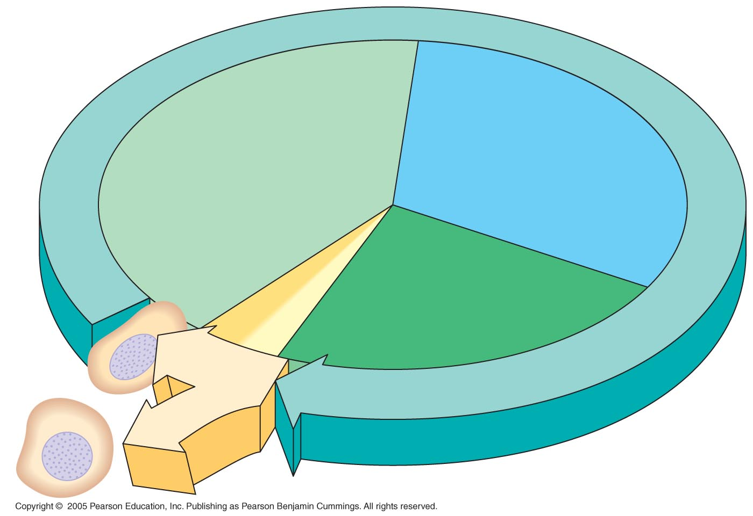
LE 12-5
2. How do cells divide?
- The Cell Cycle
INTERPHASE
G₁
S
(DNA synthesis)
Mitosis
Cytokinesis
G₂
MITOTIC
(M) PHASE

Slide 12
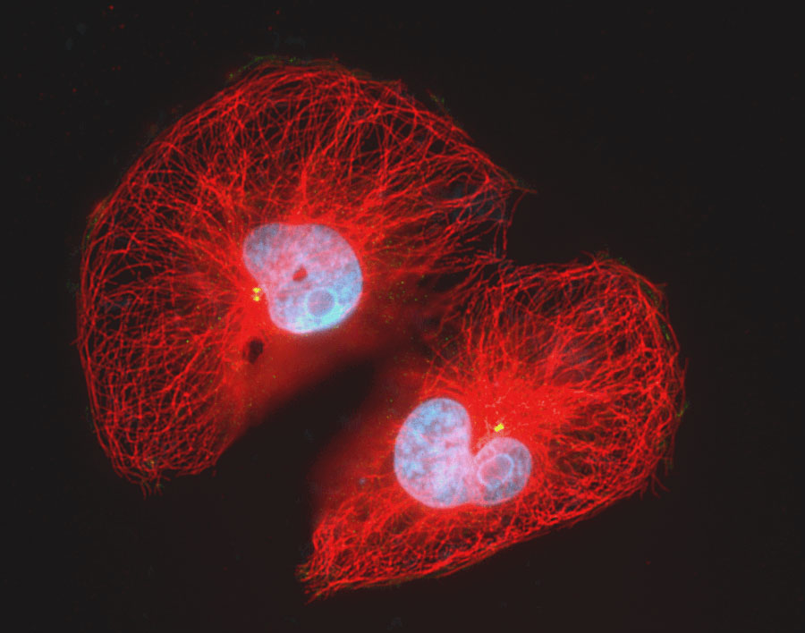
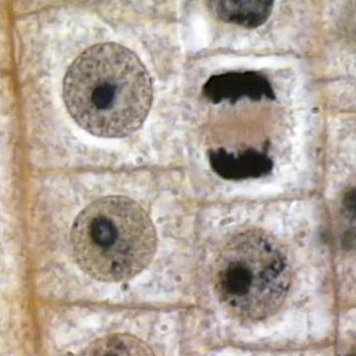
The Cell Cycle
1. Interphase: a. G1: high metabolic activity (protein synthesis) chromosomes diffuse; one DNA double helix per chromosome

Slide 13
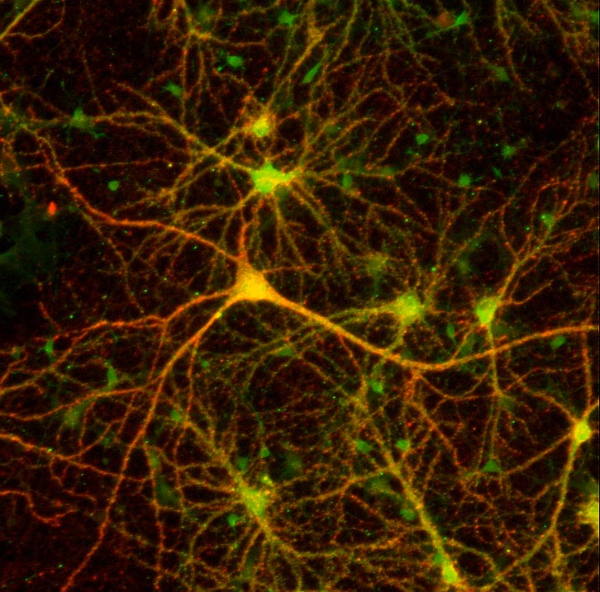
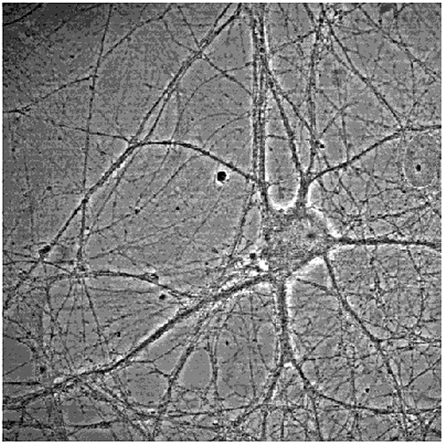
The Cell Cycle
1. Interphase:
Some cell types are "stuck" in this stage when they mature... it is only "stem cells" that keep dividing. In some tissues, all stem cells eventually mature, so the tissue can't regenerate (neurons)

Slide 14
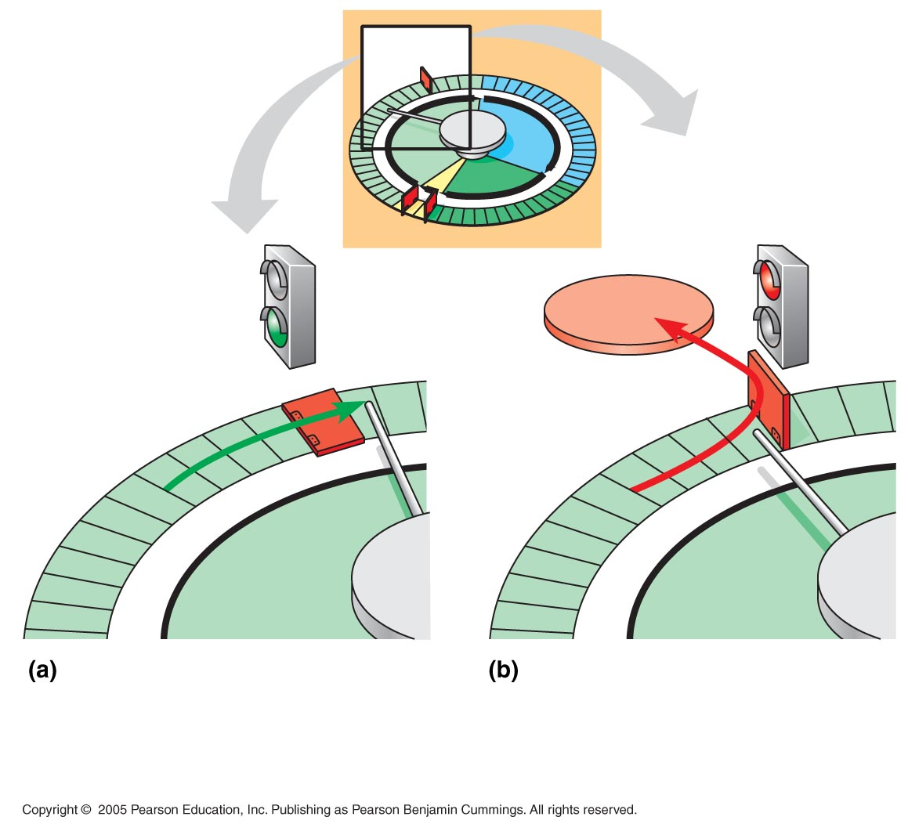
LE 12-15
G₀
G₁ checkpoint
G₁
G₁
If a cell receives a go-ahead signal at the G₁ checkpoint, the cell continues on in the cell cycle.
If a cell does not receive a go-ahead signal at the G₁ checkpoint, the cell exits the cell cycle and goes into G₀, a nondividing state.

Slide 15
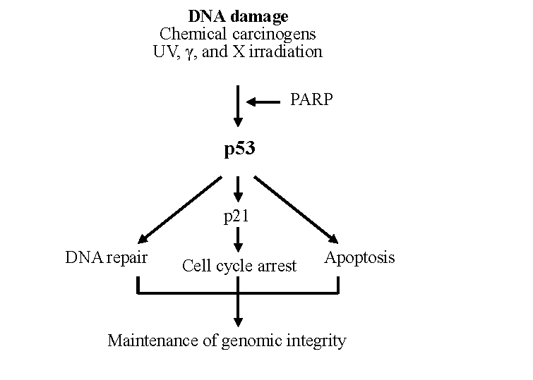

Slide 16
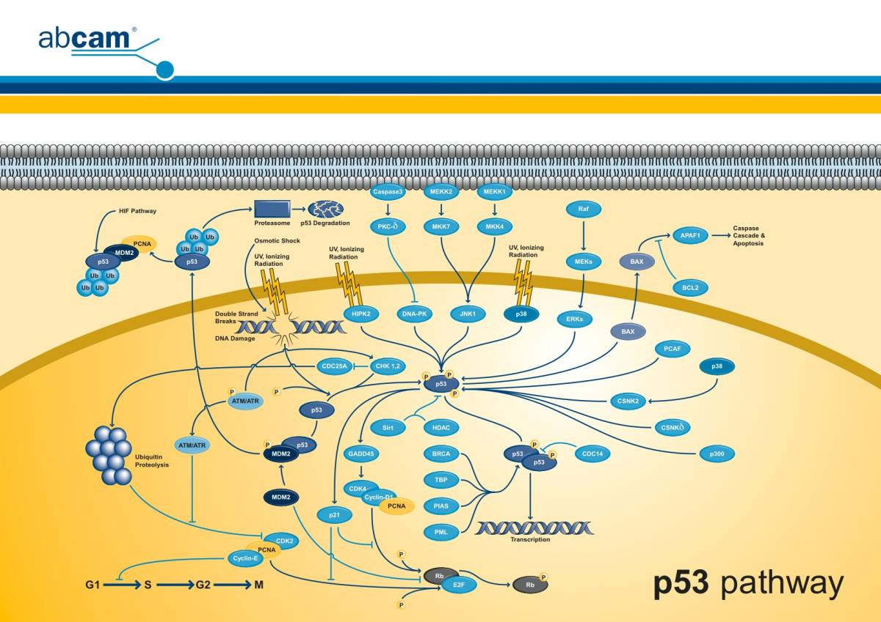

Slide 17
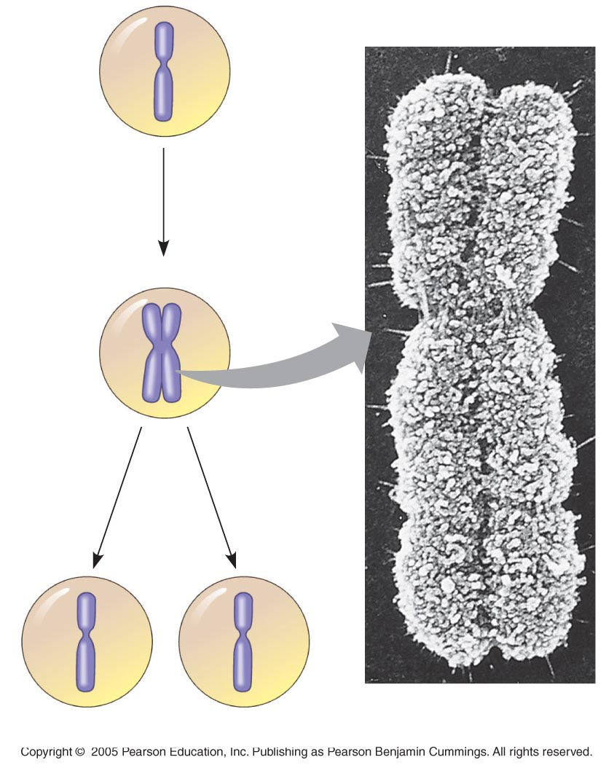
The Cell Cycle
1. Interphase
a. G1
b. S
Chromosome
duplication
(including DNA
synthesis)
Centromere
Sister chromatids

Slide 18
Semi-conservative replication

Slide 19
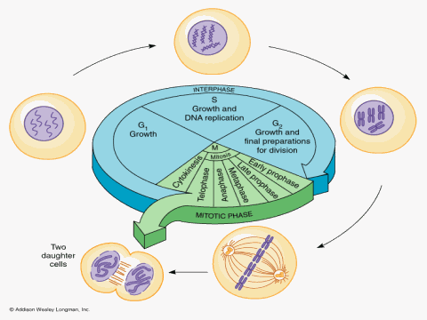
The Cell Cycle
1. Interphase
a. G1
b. S
c. G2

Slide 20
The Cell Cycle
1. Interphase
2. Mitosis

Slide 21
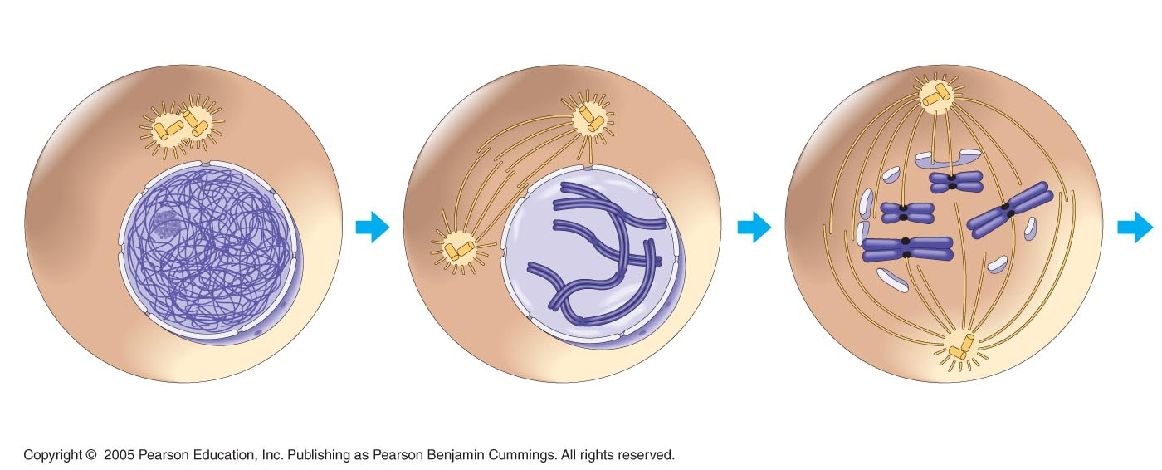
LE 12-6aa
INTERPHASE
PROPHASE
PROMETAPHASE
Centrosomes
(with centriole pairs
Chromatin
(duplicated)
Early mitotic
spindle
Aster
Fragments
of nuclear
envelope
Kinetochore
Centromere
Nonkinetochore
microtubules
Nucleus
Nuclear
envelope
Plasma
membrane
Chromosome, consisting
of two sister chromatids
Kinetochore
microtubule

Slide 22
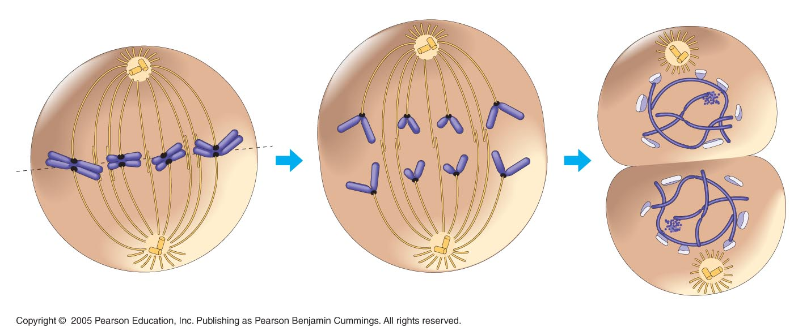
LE 12-6ba
METAPHASE
ANAPHASE
TELOPHASE
Metaphase
plate
Cleavage
furrow
Nucleolus
forming
Nuclear
envelope
forming
Spindle
Centrosome at
one spindle pole
Daughter
chromosomes

Slide 23
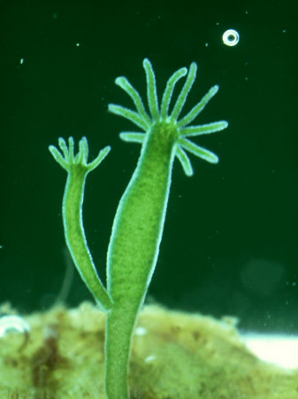
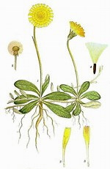
C. Sexual Reproduction and Meiosis
Why Sex?
- types of organismal reproduction – asexual reproduction (typically by mitosis)

Slide 24
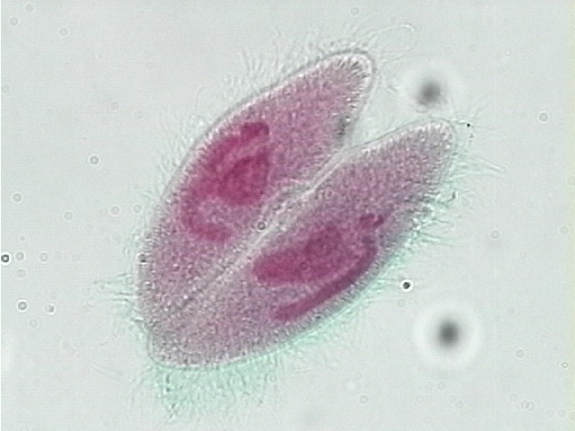
- types of organismal reproduction – sexual reproduction
- conjugation in bacteria and some protists – gene exchange.

Slide 25
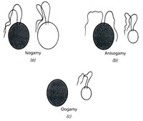
- types of organismal reproduction – sexual reproduction
- fusion of specialized cells - gametes
Multiple mating types (‘sexes’)
Usually just two types, but sometimes a range (Chlamydamonas)
isogamy
anisogamy
Males and females
oogamy

Slide 26
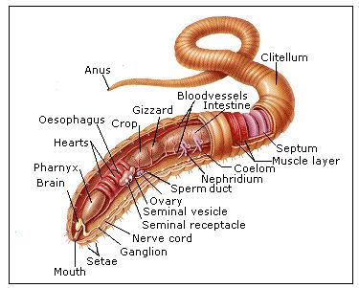
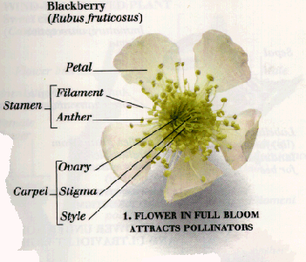
- types of organismal reproduction – sexual reproduction
- who produces these specialized reproductive cells?
Hermaphrodism

Slide 27
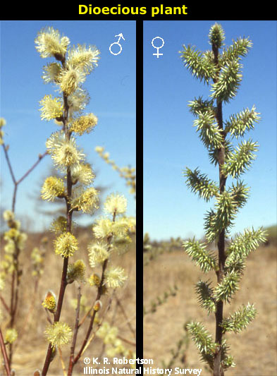
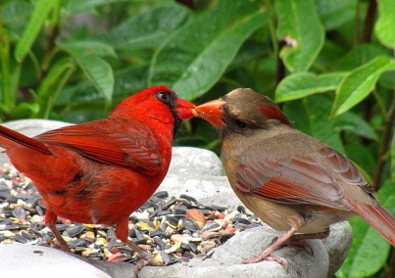
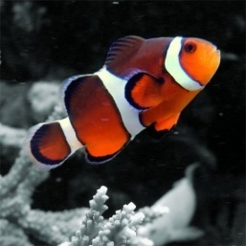
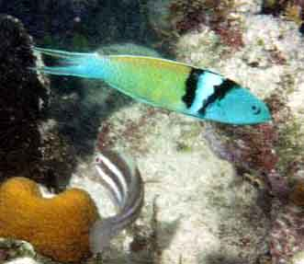
- types of organismal reproduction – sexual reproduction
- who produces these specialized reproductive cells?
Dioecious organisms: either male or female
Sexes permanent
Sex changes: Sequential hermaphrodism
Progyny: female then male
Protandry: male then female
Photoby icmoore: http://www.wunderground.com/blog/icmoore/comment.html?entrynum=9&tstamp=&page=9

Slide 28
C. Sexual Reproduction and Meiosis
Why Sex?
a. types of sexes
b. Costs and Benefits of Asexual and Sexual Reproduction
Asexual (copying existing genotype) | Sexual (making new genotype)
Benefits No mate need All genes transferred to every offspring Offspring survival high in same environment

Slide 29
C. Sexual Reproduction and Meiosis
Why Sex?
a. types of sexes
b. Costs and Benefits of Asexual and Sexual Reproduction
Asexual (copying existing genotype) | Sexual (making new genotype)
Benefits No mate need All genes transferred to every offspring Offspring survival high in same environment
Costs “Muller’s ratchet” Mutation (rare) only source of variation Offspring survival is “all or none” in a changing environment

Slide 30
C. Sexual Reproduction and Meiosis
Why Sex?
a. types of sexes
b. Costs and Benefits of Asexual and Sexual Reproduction
Asexual (copying existing genotype) | Sexual (making new genotype)
Benefits No mate need All genes transferred to every offspring Offspring survival high in same environment | Costs May need to find/acquire a mate Only ½ genes to each offspring Offspring variable – many combo’s bad
Costs “Muller’s ratchet” Mutation (rare) only source of variation Offspring survival is “all or none” in a changing environment

Slide 31
C. Sexual Reproduction and Meiosis
Why Sex?
a. types of sexes
b. Costs and Benefits of Asexual and Sexual Reproduction
Asexual (copying existing genotype) | Sexual (making new genotype)
Benefits No mate need All genes transferred to every offspring Offspring survival high in same environment | Costs May need to find/acquire a mate Only ½ genes to each offspring Offspring variable – many combo’s bad
Costs “Muller’s ratchet” Mutation (rare) only source of variation Offspring survival is “all or none” in a changing environment | Benefits Not all genes inherited – no ratchet MUCH more variation produced In a changing environment, producing variable offspring is very adaptive

Slide 32
C. Sexual Reproduction and Meiosis
Why Sex?
a. types of sexes
b. Costs and Benefits of Asexual and Sexual Reproduction
Asexual (copying existing genotype) | Sexual (making new genotype)
Benefits No mate need All genes transferred to every offspring Offspring survival high in same environment | Costs May need to find/acquire a mate Only ½ genes to each offspring Offspring variable – many combo’s bad
Costs “Muller’s ratchet” Mutation (rare) only source of variation Offspring survival is “all or none” in a changing environment | Benefits Not all genes inherited – no ratchet MUCH more variation produced In a changing environment, producing variable offspring is very adaptive
And because all environments on earth change, sex has been adaptive for all organisms. Even those that reproduce primarily by asexual means will reproduce sexually when the environment changes. This is an adaptive strategy – it produces lots of variation.

Slide 33
2. Meiosis
a. HOW?
- problem: fusing body cells doubles genetic information over generations
2n
4n
8n
2n
4n

Slide 34
2. Meiosis
a. HOW?
- problem: fusing body cells doubles genetic information over generations
- solution: alternate fusion of cells with the reduction of genetic information
Fusion (fertilization)
1n
2n
Reduction (meiosis)

Slide 35
REDUCTION
DIVISION
1n
1n
1n
2n
1n
1n
1n

Slide 36
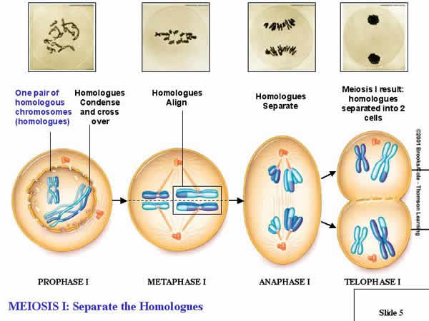
Meiosis I (Reduction)
There are four replicated chromosomes in the initial cell. Each chromosomes pairs with its homolog (that influences the same suite of traits), and pairs align on the metaphase plate. Pairs are separated in Anaphase I, and two cells, each with only two chromosomes, are produced. REDUCTION

Slide 37
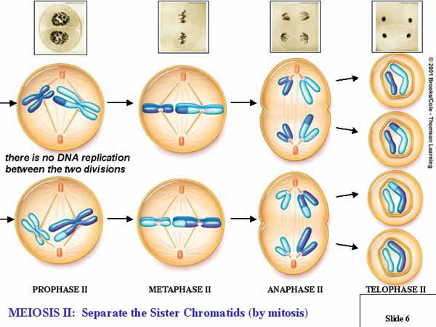
Transition
Meiosis II (Division)
Each cell with two chromosomes divides; sister chromatids are separated. There is no change in ploidy in this cycle; haploid cells divide to produce haploid cells.
DIVISION

Slide 38
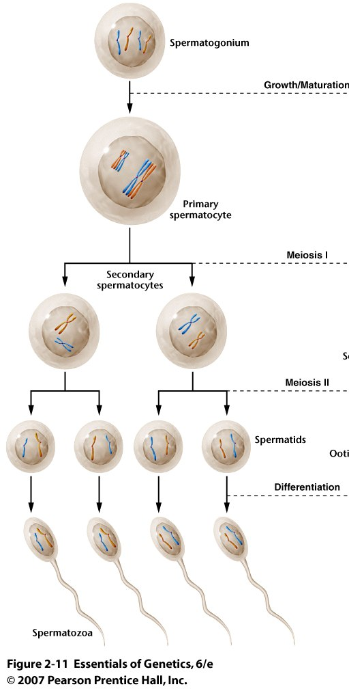
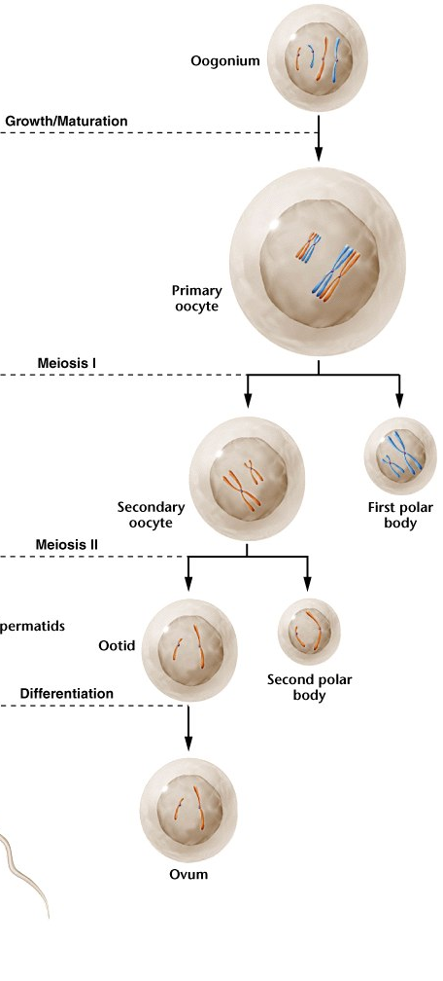
Modifications in anisogamous and oogamous species

Slide 39
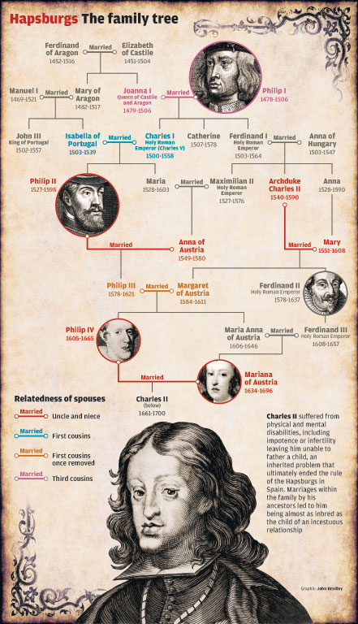
II. Heredity
A. Pre-Mendelian Ideas About Heredity
Traits run in families….

Slide 40
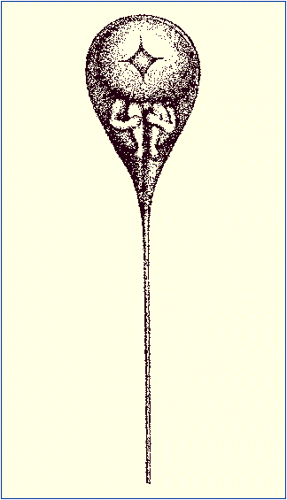
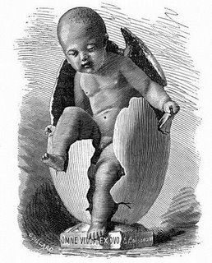
II. Heredity
A. Pre-Mendelian Ideas About Heredity
1. Preformationist Ideas

Slide 41
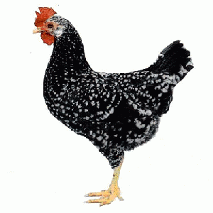
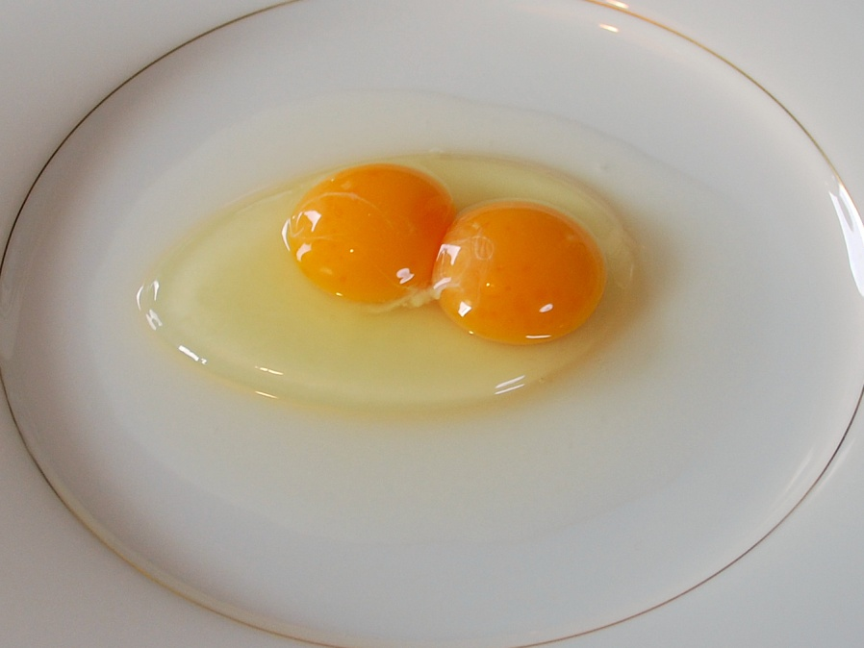
II. Heredity
A. Pre-Mendelian Ideas About Heredity
1. Preformationist Ideas
2. Epigenetic
?

Slide 42
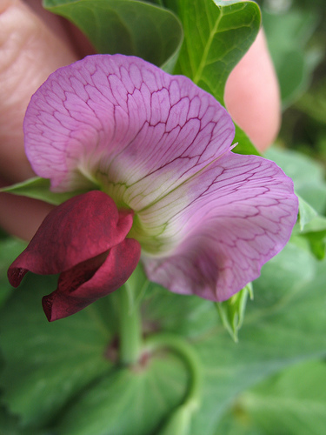
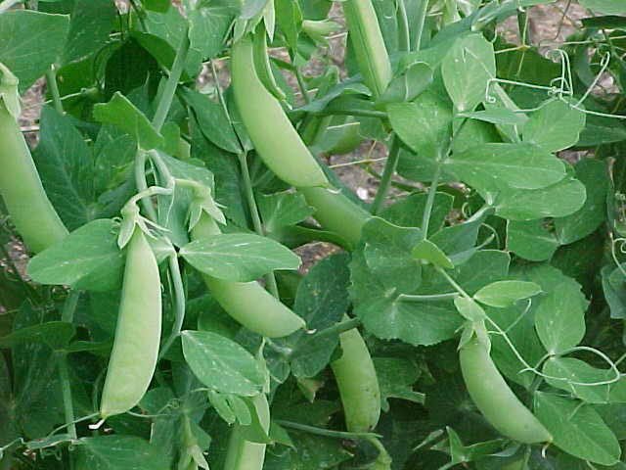
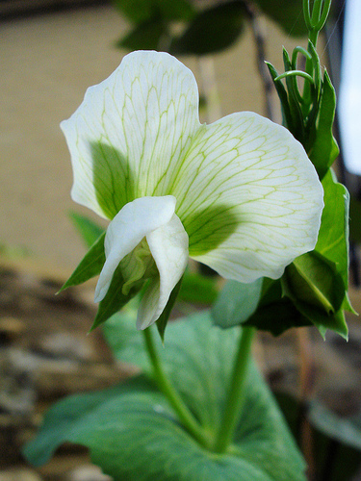
II. Heredity
A. Pre-Mendelian Ideas About Heredity
B. Mendel’s Experiments

Slide 43
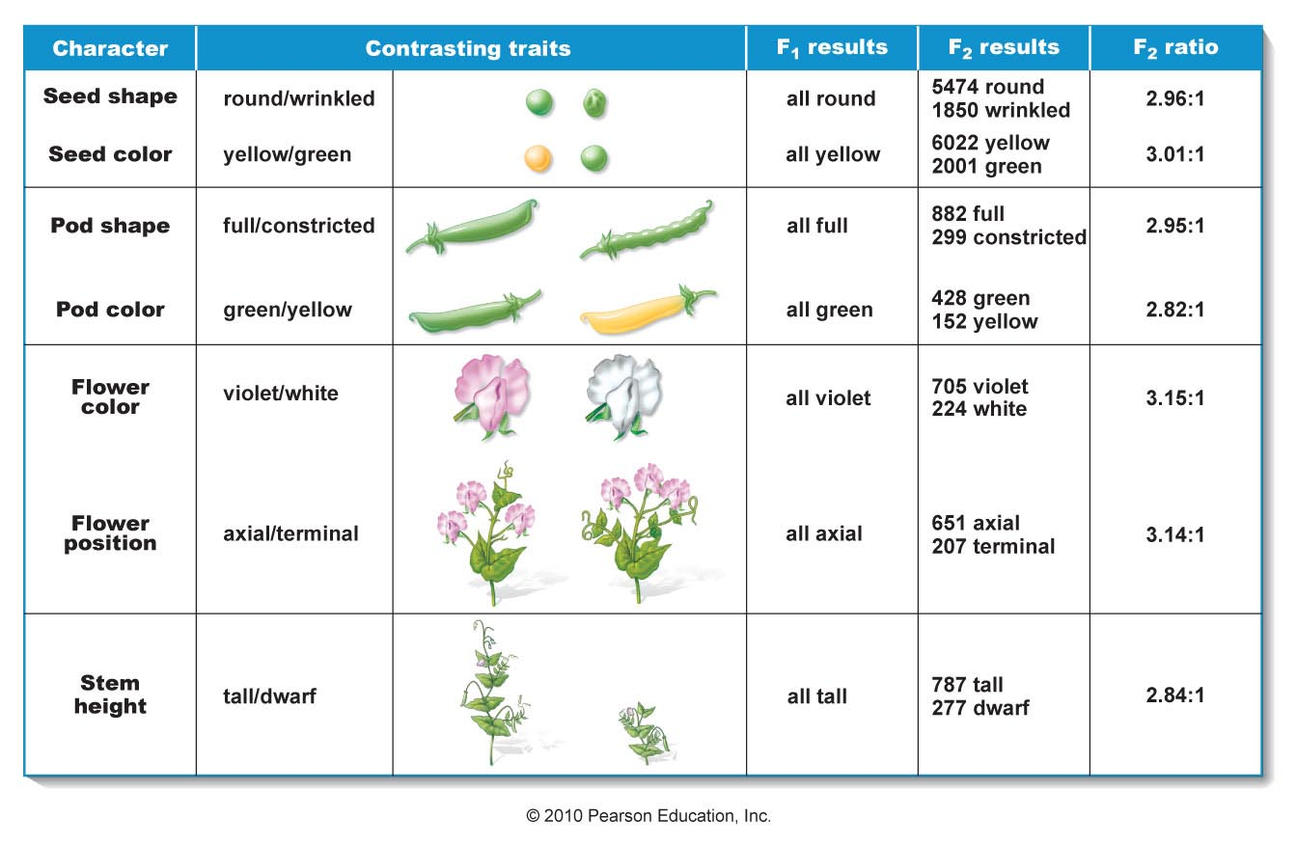
B. Mendel’s Experiments
1. Monohybrid Experiments

Slide 44
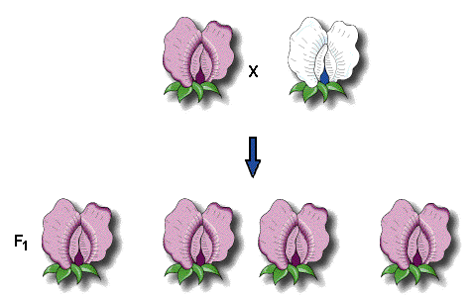
B. Mendel’s Experiments
1. Monohybrid Experiments
a. reciprocal crosses
Pollen (purple) Ovule (white)
Ovule (purple) Pollen (white)
WHY??

Slide 45
B. Mendel’s Experiments
1. Monohybrid Experiments
a. reciprocal crosses
PARENTAL CROSS
Pollen (purple) Ovule (white)
Ovule (purple) Pollen (white)
Results falsified both the ovist and homunculan schools – hereditary information must come from both parents….

Slide 46
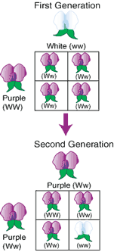
B. Mendel’s Experiments
1. Monohybrid Experiments
a. reciprocal crosses
b. crossing the F1 hybrids
Decided to cross the offspring in an F1 x F1 cross:
Got a 3:1 ratio of purple to white…. (705:224)
SO, the F1 Purple flowered plant had particles for white that were not expressed, but could be passed on.

Slide 47
- Proposed 4 ‘postulates’ (hypotheses) to explain his data:
1) hereditary material is “particulate”

Slide 48
- Proposed 4 ‘postulates’ (hypotheses) to explain his data:
1) hereditary material is “particulate”…. and each organism has 2 particles governing each trait

Slide 49
- Proposed 4 ‘postulates’ (hypotheses) to explain his data:
1) hereditary material is “particulate”…. and each organism has 2 particles governing each trait
2) if the particles differ, only one (‘dominant’) is expressed as the trait; the other is not expressed (‘recessive’).

Slide 50
- Proposed 4 ‘postulates’ (hypotheses) to explain his data:
1) hereditary material is “particulate”…. and each organism has 2 particles governing each trait
2) if the particles differ, only one (‘dominant’) is expressed as the trait; the other is not expressed (‘recessive’).
3) during gamete formation, the two particles governing a trait SEPARATE and go into DIFFERENT gametes…

Slide 51
- Proposed 4 ‘postulates’ (hypotheses) to explain his data:
1) hereditary material is “particulate”…. and each organism has 2 particles governing each trait
2) if the particles differ, only one (‘dominant’) is expressed as the trait; the other is not expressed (‘recessive’).
3) during gamete formation, the two particles governing a trait SEPARATE and go into DIFFERENT gametes. Subsequent fertilization is RANDOM (these gametes are equally likely to meet with either gamete type of the other parent…and vice-versa). This is Mendel’s Principle of Segregation

Slide 52
B. Mendel’s Experiments
1. Monohybrid Experiments
a. reciprocal crosses
b. crossing the F1 hybrids
c. Proposed four postulates
2. Monohybrid Test Cross
Mendel’s ideas rested on the hypothesis that the F1 plants were hiding a gene for ‘white’
Hypothesized Genotype = Ww

Slide 53
C. Mendel’s Experiments
1. Monohybrid Experiments
a. reciprocal crosses
b. crossing the F1 hybrids
c. Proposed four postulates
2. Monohybrid Test Cross
½ W
Based on his hypotheses (postulates), the plant should produce two types of gametes at equal frequency.
Ww
½ w
Mendel’s ideas rested on the hypothesis that the F1 plants were hiding a gene for ‘white’
Hypothesized Genotype = Ww
HOW can we see these frequencies, when we can only actually observe the phenotypes of the offspring?

Slide 54
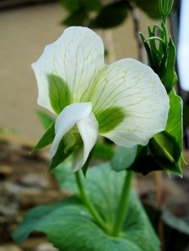
Mate with the recessive parent, which can only give recessive alleles to offspring
B. Mendel’s Experiments
1. Monohybrid Experiments
a. reciprocal crosses
b. crossing the F1 hybrids
c. Proposed four postulates
2. Monohybrid Test Cross
ww
w
½ W
Ww
½ w
Mendel’s ideas rested on the hypothesis that the F1 plants were hiding a gene for ‘white’
Hypothesized Genotype = Ww

Slide 55
Mate with the recessive parent, which can only give recessive alleles to offspring
B. Mendel’s Experiments
1. Monohybrid Experiments
a. reciprocal crosses
b. crossing the F1 hybrids
c. Proposed four postulates
2. Monohybrid Test Cross
ww
w
½ W
½ Ww
½ ww
Ww
½ w
Mendel’s ideas rested on the hypothesis that the F1 plants were hiding a gene for ‘white’
Hypothesized Genotype = Ww
Genotypic Ratio of offspring

Slide 56
Mate with the recessive parent, which can only give recessive alleles to offspring
B. Mendel’s Experiments
1. Monohybrid Experiments
a. reciprocal crosses
b. crossing the F1 hybrids
c. Proposed four postulates
2. Monohybrid Test Cross
ww
w
½ W
½ Ww
½ ww
½ W
½ w
Ww
½ w
Mendel’s ideas rested on the hypothesis that the F1 plants were hiding a gene for ‘white’
Hypothesized Genotype = Ww
Genotypic Ratio of offspring
Phenotypic Ratio of offspring

Slide 57
Mate with the recessive parent, which can only give recessive alleles to offspring
B. Mendel’s Experiments
1. Monohybrid Experiments
a. reciprocal crosses
b. crossing the F1 hybrids
c. Proposed four postulates
2. Monohybrid Test Cross
ww
Same as gamete frequencies of unknown parent
w
½ W
½ Ww
½ ww
½ W
½ w
Ww
½ w
Mendel’s ideas rested on the hypothesis that the F1 plants were hiding a gene for ‘white’
Hypothesized Genotype = Ww
Genotypic Ratio of offspring
Phenotypic Ratio of offspring

Slide 58
B. Mendel’s Experiments
1. Monohybrid Experiments
2. Monohybrid Test Cross
3. Dihybrid Experiments
a. Parental cross
Round and Yellow Peas Wrinkled and Green Peas

Slide 59
B. Mendel’s Experiments
1. Monohybrid Experiments
2. Monohybrid Test Cross
3. Dihybrid Experiments
a. Parental cross
Round and Yellow Peas Wrinkled and Green Peas
RRYY
rryy
RY
ry
100% F1 = RrYy

Slide 60
B. Mendel’s Experiments
1. Monohybrid Experiments
2. Monohybrid Test Cross
3. Dihybrid Experiments
a. Parental cross
b. F1 x F1 cross
X
RrYy
RrYy
315 round, yellow (~9/16)
108 round, green (~3/16)
101 wrinkled, yellow (~3/16)
32 wrinkled, green (~1/16)

Slide 61
B. Mendel’s Experiments
1. Monohybrid Experiments
2. Monohybrid Test Cross
3. Dihybrid Experiments
a. Parental cross
b. F1 x F1 cross
X
RrYy
RrYy
Monohybrid Ratios Preserved
315 round, yellow (~9/16)
423 Round (~3/4)
108 round, green (~3/16)
~ 3:1
101 wrinkled, yellow (~3/16)
133 wrinkled (~1/4)
32 wrinkled,green(~1/16)

Slide 62
B. Mendel’s Experiments
1. Monohybrid Experiments
2. Monohybrid Test Cross
3. Dihybrid Experiments
a. Parental cross
b. F1 x F1 cross
X
RrYy
RrYy
Monohybrid Ratios Preserved
315 round, yellow (~9/16)
416 Yellow (~3/4)
108 round, green (~3/16)
~ 3:1
101 wrinkled, yellow (~3/16)
140 Green (~1/4)
32 wrinkled, green (~1/16)

Slide 63
Mendel's Principle of Independent Assortment: During gamete formation, the way one pair of genes (governing one trait) segregates is not affected by (is independent of) the pattern of segregation of other genes; subsequent fertilization is random.
B. Mendel’s Experiments
1. Monohybrid Experiments
2. Monohybrid Test Cross
3. Dihybrid Experiments
a. Parental cross
b. F1 x F1 cross
c. His explanation
X
RrYy
RrYy
Monohybrid Ratios Preserved
Product Rule Predicts Combinations
¾ Round x ¾ Yellow =
315 round, yellow (~9/16)
¾ Round x ¼ Green =
108 round, green (~3/16)
¼ Wrinkled x ¾ Yellow =
101 wrinkled, yellow (~3/16)
¼ Wrinkled x ¼ Green =
32 wrinkled, green (~1/16)

Slide 64
F1: Round, Yellow: RrYy
Each gamete gets a gene for each trait:
R or r Y or y
RY Ry rY ry
R = ½, r = ½
Y = ½, y = ½
So, if R’s and Y’s are inherited independently,
THEN each combination should occur ¼ of time.
IF the genes for these traits are allocated to gametes independently of one another, then each F1 parent should produce four types of gametes, in equal frequencies

Slide 65
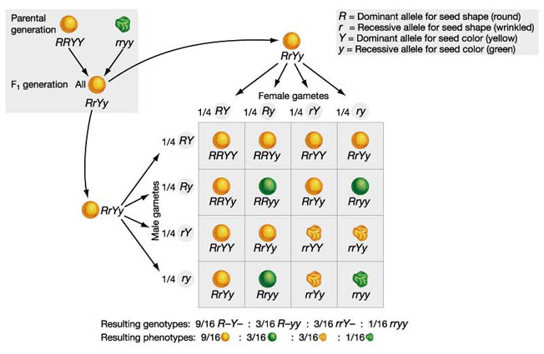
c. His explanation: (including patterns of dominance)
Independent Assortment occurs HERE

Slide 66
c. His explanation: (including patterns of dominance)
Independent Assortment occurs HERE
Round Yellow = 9/16

Slide 67
c. His explanation: (including patterns of dominance)
Independent Assortment occurs HERE
Round Yellow = 9/16
Round Green = 3/16

Slide 68
c. His explanation: (including patterns of dominance)
Independent Assortment occurs HERE
Round Yellow = 9/16
Round Green = 3/16
Wrinkled Yellow = 3/16

Slide 69
c. His explanation: (including patterns of dominance)
Independent Assortment occurs HERE
Round Yellow = 9/16
(3/4) x (3/4)
Round Green = 3/16
(3/4) x (1/4)
Wrinkled Yellow = 3/16
(1/4) x (3/4)
Wrinkled Green = 1/16
(1/4) x (1/4)

Slide 70
B. Mendel’s Experiments
1. Monohybrid Experiments
2. Monohybrid Test Cross
3. Dihybrid Experiments
4. Dihybrid Test Cross
The hypothesis rests on the gametes produced by the F1 individual.
How can we determine if they are produced in a 1 : 1 : 1 : 1 ratio?
¼ RY
¼ Ry
¼ rY
¼ ry
RrYy

Slide 71
B. Mendel’s Experiments
1. Monohybrid Experiments
2. Monohybrid Test Cross
3. Dihybrid Experiments
4. Dihybrid Test Cross
Cross with a recessive individual that can only give recessive alleles for both traits to all offspring
rryy
All gametes = ry
¼ RY
¼ Ry
¼ rY
¼ ry
¼ RrYy
¼ Rryy
¼ rrYy
¼ rryy
RrYy
Genotypic Frequencies in offspring

Slide 72
B. Mendel’s Experiments
1. Monohybrid Experiments
2. Monohybrid Test Cross
3. Dihybrid Experiments
4. Dihybrid Test Cross
Cross with a recessive individual that can only give recessive alleles for both traits to all offspring
rryy
All gametes = ry
¼ RY
¼ Ry
¼ rY
¼ ry
¼ RrYy
¼ Rryy
¼ rrYy
¼ rryy
¼ RY
¼ Ry
¼ rY
¼ ry
And the phenotypes of the offspring reflect the gametes donated by the RrYy parent.
RrYy
Genotypic Frequencies in offspring

Slide 73
B. Mendel’s Experiments
Summary
1) Hereditary information is unitary and ‘particulate’, not blending
2) First Principle – SEGREGATION: During gamete formation, the two particles governing a trait separate and go into different gametes; subsequent fertilization is random.
3) Second Principle – INDEPENDENT ASSORTMENT: The way genes for one trait separate and go into gametes does not affect the way other genes for other traits separate and go into gametes; so all gene combinations in gametes occur as probability dictates. Subsequent fertilization is random.

Slide 74
C. The Power of Independent Assortment
1. If you can assume that the genes assort independently, then you can calculate ‘single gene’ outcomes and multiply results together…
For Example: AaBb x Aabb
- what is the probability of an Aabb offspring?
- What is the probability of an offspring expressing Ab?
- How many genotypes are possible in the offspring?
- how many phenotypes are possible in the offspring?

Slide 75
C. The Power of Independent Assortment
1. If you can assume that the genes assort independently, then you can calculate ‘single gene’ outcomes and multiply results together…
For Example: AaBb x Aabb
- what is the probability of an Aabb offspring?
Do the Punnett Squares for each gene separately:
For A: For B:
 | A | a
A | AA | Aa
a | Aa | aa

Slide 76
C. The Power of Independent Assortment
1. If you can assume that the genes assort independently, then you can calculate ‘single gene’ outcomes and multiply results together…
For Example: AaBb x Aabb
- what is the probability of an Aabb offspring?
Do the Punnett Squares for each gene separately:
For A: For B:
 | A | a
A | AA | Aa
a | Aa | aa
 | b | b
B | Bb | Bb
b | bb | bb

Slide 77
C. The Power of Independent Assortment
1. If you can assume that the genes assort independently, then you can calculate ‘single gene’ outcomes and multiply results together…
For Example: AaBb x Aabb
- what is the probability of an Aabb offspring?
Do the Punnett Squares for each gene separately:
For A: For B:
Answer the question for each gene, then multiply:
P(Aa) = ½ x P(bb) = ½ = 1/4
 | A | a
A | AA | Aa
a | Aa | aa
 | b | b
B | Bb | Bb
b | bb | bb

Slide 78
C. The Power of Independent Assortment
1. If you can assume that the genes assort independently, then you can calculate ‘single gene’ outcomes and multiply results together…
For Example: AaBb x Aabb
- what is the probability of an Aabb offspring?
- What is the probability of an offspring expressing Ab?
For A: For B:
Answer the question for each gene, then multiply:
P(A) = 3/4 x P(b) = ½ = 3/8
 | A | a
A | AA | Aa
a | Aa | aa
 | b | b
B | Bb | Bb
b | bb | bb

Slide 79
C. The Power of Independent Assortment
1. If you can assume that the genes assort independently, then you can calculate ‘single gene’ outcomes and multiply results together…
For Example: AaBb x Aabb
- what is the probability of an Aabb offspring?
- What is the probability of an offspring expressing Ab?
- How many genotypes are possible in the offspring?
For A: For B:
Answer the question for each gene, then multiply:
(AA, Aa, aa) = 3 x (Bb, bb) = 2 = 6
 | A | a
A | AA | Aa
a | Aa | aa
 | b | b
B | Bb | Bb
b | bb | bb

Slide 80
C. The Power of Independent Assortment
1. If you can assume that the genes assort independently, then you can calculate ‘single gene’ outcomes and multiply results together…
For Example: AaBb x Aabb
- what is the probability of an Aabb offspring?
- What is the probability of an offspring expressing Ab?
- How many genotypes are possible in the offspring?
- how many phenotypes are possible in the offspring?
For A: For B:
Answer the question for each gene, then multiply:
(A, a) = 2 x (B, b) = 2 = 4
 | A | a
A | AA | Aa
a | Aa | aa
 | b | b
B | Bb | Bb
b | bb | bb

Slide 81
C. The Power of Independent Assortment
1. If you can assume that the genes assort independently, then you can calculate ‘single gene’ outcomes and multiply results together…
2. You can easily address more difficult multigene problems:
(female) AaBbCcdd x AABbccDD (male)

Slide 82
C. The Power of Independent Assortment
1. If you can assume that the genes assort independently, then you can calculate ‘single gene’ outcomes and multiply results together…
2. You can easily address more difficult multigene problems:
(female) AaBbCcdd x AABbccDD (male)
- how many types of gametes can each parent produce?
- What is the probability of an offspring expressing ABCD?
- How many genotypes are possible in the offspring?
- how many phenotypes are possible in the offspring?

Slide 83
C. The Power of Independent Assortment
1. If you can assume that the genes assort independently, then you can calculate ‘single gene’ outcomes and multiply results together…
2. You can easily address more difficult multigene problems:
(female) AaBbCcdd x AABbccDD (male)
- how many types of gametes can each parent produce?
For Female: For Male:
2 x 2 x 2 x 1 = 8 1 x 2 x 1 x 1 = 2
 | Aa | Bb | Cc | dd
 | A, a | B, b | C, c | d
 | 2 | 2 | 2 | 1
 | AA | Bb | cc | DD
 | A | B, b | c | D
 | 1 | 2 | 1 | 1

Slide 84
C. The Power of Independent Assortment
1. If you can assume that the genes assort independently, then you can calculate ‘single gene’ outcomes and multiply results together…
2. You can easily address more difficult multigene problems:
(female) AaBbCcdd x AABbccDD (male)
- how many types of gametes can each parent produce?
- What is the probability of an offspring expressing ABCD?
At A: At B: At C: At D:
P(A) = 1 x p(B) = ¾ x p(C) = ½ x p(D) = 1 = 3/8
 | A | A
A | AA | AA
a | Aa | Aa
 | B | b
B | BB | Bb
b | Bb | bb
 | c
C | Cc
c | cc
 | D
d | Dd

Slide 85
C. The Power of Independent Assortment
1. If you can assume that the genes assort independently, then you can calculate ‘single gene’ outcomes and multiply results together…
2. You can easily address more difficult multigene problems:
(female) AaBbCcdd x AABbccDD (male)
- how many types of gametes can each parent produce?
- What is the probability of an offspring expressing ABCD?
- How many genotypes are possible in the offspring?
- how many phenotypes are possible in the offspring?
At A: At B: At C: At D:
 | A | A
A | AA | AA
a | Aa | Aa
 | B | b
B | BB | Bb
b | Bb | bb
 | c
C | Cc
c | cc
 | D
d | Dd

Slide 86
C. The Power of Independent Assortment
1. If you can assume that the genes assort independently, then you can calculate ‘single gene’ outcomes and multiply results together…
2. You can easily address more difficult multigene problems:
(female) AaBbCcdd x AABbccDD (male)
- how many types of gametes can each parent produce?
- What is the probability of an offspring expressing ABCD?
- How many genotypes are possible in the offspring? 2 x 3 x 2 x 1= 12
- how many phenotypes are possible in the offspring? 1 x 2 x 2 x 1 = 4
At A: At B: At C: At D:
 | A | A
A | AA | AA
a | Aa | Aa
 | B | b
B | BB | Bb
b | Bb | bb
 | c
C | Cc
c | cc
 | D
d | Dd

Slide 87
C. The Power of Independent Assortment
1. If you can assume that the genes assort independently, then you can calculate ‘single gene’ outcomes and multiply results together…
2. You can easily address more difficult multigene problems.
As you can see, IA produces lots of variation, because of the multiplicative effect of combining genes from different loci together in gametes, and then combining them together during fertilization.

Slide 88
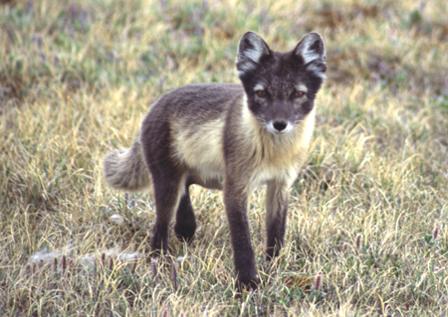
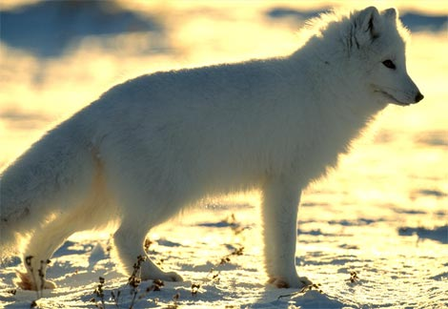
D. Allelic, Genic, and Environmental Interactions

Slide 89
D. Allelic, Genic, and Environmental Interactions
1. Overview:
The effect of a gene is influenced at three levels:
- Intralocular (effects of other alleles at this locus)
- Interlocular (effects of other genes at other loci)
- Environmental (the effect of the environment on
determining the effect of a gene on the phenotype)
Environment
GENOME
A a
PHENOTYPE

Slide 90
D. Allelic, Genic, and Environmental Interactions
1. Overview:
2. Intralocular Interactions
A a

Slide 91
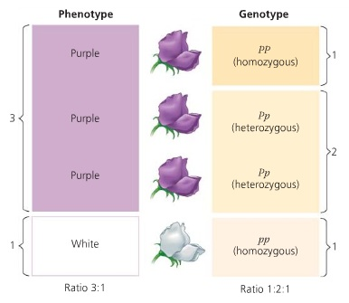
D. Allelic, Genic, and Environmental Interactions
1. Overview:
2. Intralocular Interactions
a. Complete Dominance:
- The presence of one allele is enough to cause the complete expression of a given phenotype.

Slide 92
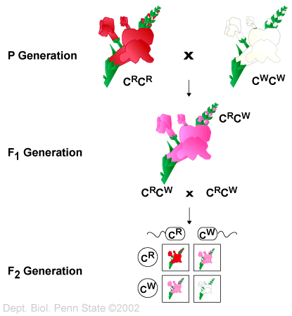
D. Allelic, Genic, and Environmental Interactions
1. Overview:
2. Intralocular Interactions
a. Complete Dominance:
b. Incomplete Dominance:
- The heterozygote expresses a phenotype between or intermediate to the phenotypes of the homozygotes.

Slide 93
D. Allelic, Genic, and Environmental Interactions
1. Overview:
2. Intralocular Interactions
a. Complete Dominance:
b. Incomplete Dominance:
c. Codominance:
- Both alleles are expressed completely; the heterozygote does not have an intermediate phenotype, it has BOTH phenotypes.
ABO Blood Type:
A = ‘A’ surface antigens
B = ‘B’ surface antigens
O = no surface antigen from this locus
Phenotype Genotypes
A AA, AO
B BB, BO
O OO
AB AB
codominance
AB Phenotype

Slide 94
D. Allelic, Genic, and Environmental Interactions
1. Overview:
2. Intralocular Interactions
a. Complete Dominance:
b. Incomplete Dominance:
c. Codominance:
d. Overdominance :
– the heterozygote expresses a phenotype MORE EXTREME than either homozygote
“T”
Enzyme Activity
TEMP
“t”
Enzyme Activity
TT = tall (grows best in warm conditions)
tt = short (grows best in cool conditions)
Tt = Very Tall (has both alleles and so grows optimally in cool and warm conditions)
TEMP

Slide 95
D. Allelic, Genic, and Environmental Interactions
1. Overview:
2. Intralocular Interactions
a. Complete Dominance:
b. Incomplete Dominance:
c. Codominance:
d. Overdominance :
e. Multiple Alleles:
- not really an interaction, but a departure from simple Mendelian postulates.
- and VERY important as a source of variation
# Alleles at the Locus | # Genotypes Possible
1 (A) | 1 (AA)
2 (A, a) | 3 (AA, Aa, aa)
3 (A, a, A’) | 6 (AA, Aa, aa, A’A’, A’A, A’a)
4 | 10
5 | 15

Slide 96
D. Allelic, Genic, and Environmental Interactions
1. Overview:
2. Intralocular Interactions
- Summary and Implications:
populations can harbor extraordinary genetic variation at each locus, and these alleles can interact in myriad ways to produce complex and variable phenotypes.
Consider this cross: AaBbCcDd x AABbCcDD
Assume:
The genes assort independently A and a are codominant
B is incompletely dominant to b
C is incompletely dominant to c
D is completely dominant to d
How many phenotypes are possible in the offspring?

Slide 97
D. Allelic, Genic, and Environmental Interactions
1. Overview:
2. Intralocular Interactions
- Summary and Implications:
populations can harbor extraordinary genetic variation at each locus, and these alleles can interact in myriad ways to produce complex and variable phenotypes.
Consider this cross: AaBbCcDd x AABbCcDD
Assume:
The genes assort independently A and a are codominant
B is incompletely dominant to b
C is incompletely dominant to c
D is completely dominant to d
How many phenotypes are possible in the offspring?
A B C D
x 3 x 3 x 1 = 18
If they had all exhibited complete dominance, there would have been only:
x 2 x 2 x 1 = 4
So the variety of allelic interactions that are possible increases phenotypic variation multiplicatively. In a population with many alleles at each locus, there is an nearly limitless amount of phenotypic variability.

Slide 98
D. Allelic, Genic, and Environmental Interactions
1. Overview:
2. Intralocular Interactions
3. Interlocular/Genic Interactions
The genotype at one locus can influence how the genes at other loci are expressed.

Slide 99
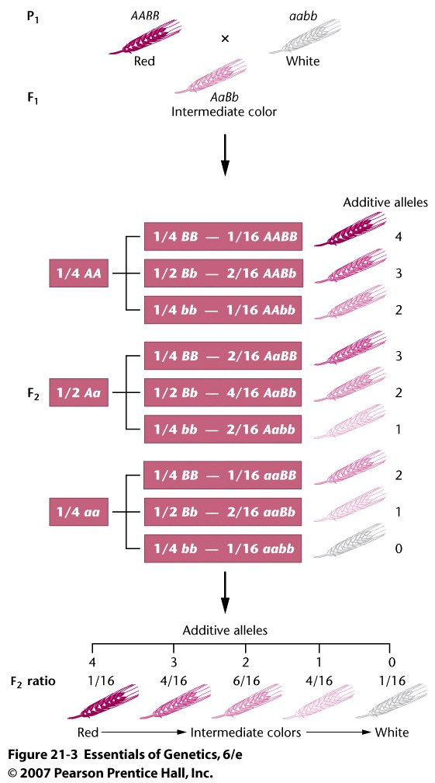
D. Allelic, Genic, and Environmental Interactions
1. Overview:
2. Intralocular Interactions
3. Interlocular/Genic Interactions
a. Quantitative (Polygenic) Traits:
There may be several genes that produce the same protein product; and the phenotype is the ADDITIVE sum of these multiple genes.
Creates continuously variable traits.
So here, both genes A and B produce the same pigment. The double homozygote AABB produces 4 ‘doses’ of pigment and is very dark. It also means that there are more ‘intermediate gradations’ that are possible.

Slide 100
Genotype at H | Genotype at A,B,O | Phenotype
H- | A- | A
H- | B- | B
H- | OO | O
H- | AB | AB
hh | A- | O
hh | B- | O
hh | OO | O
hh | AB | O
D. Allelic, Genic, and Environmental Interactions
1. Overview:
2. Intralocular Interactions
3. Interlocular/Genic Interactions
a. Quantitative (Polygenic) Traits:
b. Epistasis:
one gene curtails the expression at another locus; the phenotype in the A,B,O blood group system can be affected by the genotype at the fucosyl transferase locus.
This locus makes the ‘H substance’ to which the sugar groups are added to make the A and B surface antigens.
A non-function ‘h’ gene makes a non-functional foundation and sugar groups can’t be added – resulting in O blood regardless of the genotype at the A,B,O locus

Slide 101
D. Allelic, Genic, and Environmental Interactions
1. Overview:
2. Intralocular Interactions
3. Interlocular/Genic Interactions
a. Quantitative (Polygenic) Traits:
b. Epistasis:
one gene curtails the expression at another locus; the phenotype in the A,B,O blood group system can be affected by the genotype at the fucosyl transferase locus.
This locus makes the ‘H substance’ to which the sugar groups are added to make the A and B surface antigens.
A non-function ‘h’ gene makes a non-functional foundation and sugar groups can’t be added – resulting in O blood regardless of the genotype at the A,B,O locus
So, what are the phenotypic ratios from this cross:
HhAO x HhBO?

Slide 102
D. Allelic, Genic, and Environmental Interactions
1. Overview:
2. Intralocular Interactions
3. Interlocular/Genic Interactions
a. Quantitative (Polygenic) Traits:
b. Epistasis:
one gene curtails the expression at another locus; the phenotype in the A,B,O blood group system can be affected by the genotype at the fucosyl transferase locus.
This locus makes the ‘H substance’ to which the sugar groups are added to make the A and B surface antigens.
A non-function ‘h’ gene makes a non-functional foundation and sugar groups can’t be added – resulting in O blood regardless of the genotype at the A,B,O locus
So, what are the phenotypic ratios from this cross:
HhAO x HhBO?
Well, assume they are inherited independently.
AT H: ¾ H: ¼ h
At A,B,O: ¼ A : ¼ O: ¼ B : ¼ AB
So, the ¼ that is h is O type blood, regardless.
Then, we have:
¾ H x ¼ A = 3/16 A
¾ H x ¼ O = 3/16 O (+ 4/16 above)
¾ B x ¼ B = 3/16 B
¾ H x ¼ AB = 3/16 AB
Phenotypic Ratios: 3/16 A : 3/16 B : 3/16 AB : 7/16 O = 16/16 (check!)

Slide 103
D. Allelic, Genic, and Environmental Interactions
1. Overview:
2. Intralocular Interactions
3. Interlocular/Genic Interactions
a. Quantitative (Polygenic) Traits:
b. Epistasis:
-example #2: in a enzymatic process, all enzymes may be needed to produce a given phenotype. Absence of either may produce the same alternative ‘null’.
Process:
enzyme 1 enzyme 2
Precursor 1 precursor2 product
(pigment)

Slide 104
D. Allelic, Genic, and Environmental Interactions
1. Overview:
2. Intralocular Interactions
3. Interlocular/Genic Interactions
a. Quantitative (Polygenic) Traits:
b. Epistasis:
-example #2: in a enzymatic process, all enzymes may be needed to produce a given phenotype. Absence of either may produce the same alternative ‘null’.
For example, two strains of white flowers may be white for different reasons; each lacking a different necessary enzyme to make color.
Process:
enzyme 1 enzyme 2
Precursor 1 precursor2 product
(pigment)
Strain 1:
enzyme 1 enzyme 2
Precursor 1 precursor2 no product
(white)
Strain 2:
enzyme 1 enzyme 2
Precursor 1 precursor2 no product
(white)

Slide 105
D. Allelic, Genic, and Environmental Interactions
1. Overview:
2. Intralocular Interactions
3. Interlocular/Genic Interactions
a. Quantitative (Polygenic) Traits:
b. Epistasis:
-example #2: in a enzymatic process, all enzymes may be needed to produce a given phenotype. Absence of either may produce the same alternative ‘null’.
For example, two strains of white flowers may be white for different reasons; each lacking a different necessary enzyme to make color.
So there must be a dominant gene at both loci to produce color.
Genotype Phenotype
aaB- white
aabb white
A-bb white
A-B- pigment
So, what’s the phenotypic ratio from a cross:
AaBb x AaBb ?

Slide 106
D. Allelic, Genic, and Environmental Interactions
1. Overview:
2. Intralocular Interactions
3. Interlocular/Genic Interactions
a. Quantitative (Polygenic) Traits:
b. Epistasis:
-example #2: in a enzymatic process, all enzymes may be needed to produce a given phenotype. Absence of either may produce the same alternative ‘null’.
For example, two strains of white flowers may be white for different reasons; each lacking a different necessary enzyme to make color.
So there must be a dominant gene at both loci to produce color.
Genotype Phenotype
aaB- white
aabb white
A-bb white
A-B- pigment
So, what’s the phenotypic ratio from a cross:
AaBb x AaBb ?
9/16 pigment (A-B-), 7/16 white

Slide 107
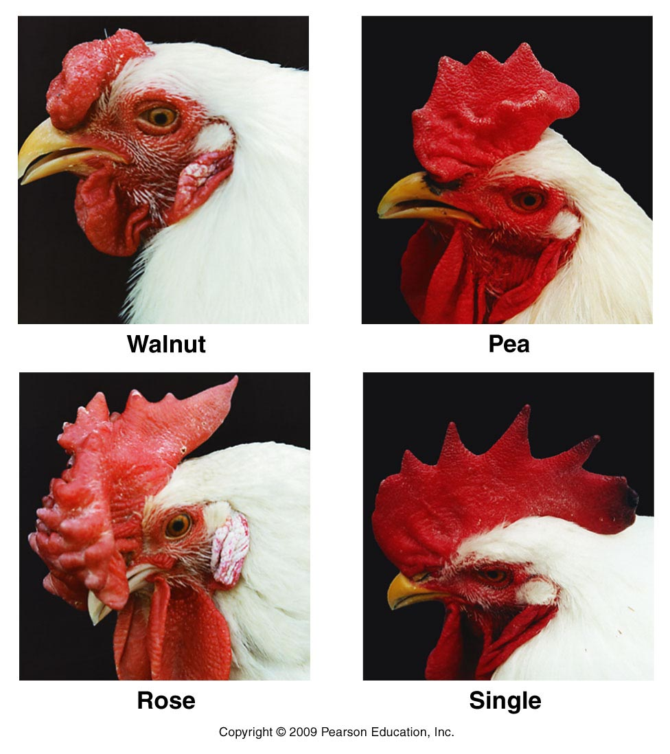
Genotype Phenotype
rrpp single
R-pp rose
rrP- pea
A-B- Walnut
D. Allelic, Genic, and Environmental Interactions
1. Overview:
2. Intralocular Interactions
3. Interlocular/Genic Interactions
a. Quantitative (Polygenic) Traits:
b. Epistasis:
-example #2: in a enzymatic process, all enzymes may be needed to produce a given phenotype. Absence of either may produce the same alternative ‘null’.
-example #3: Novel Phenotypes.
Comb shape in chickens is governed by 2 interacting genes that independently produce “Rose” or “Pea” combs, but together produce something completely different (walnut).

Slide 108
D. Allelic, Genic, and Environmental Interactions
1. Overview:
2. Intralocular Interactions
3. Interlocular/Genic Interactions
4. Environmental Effects
The environment can influence whether and how an allele is expressed ,and the effect it has.

Slide 109
4. Environmental Effects:
a. TEMPERATURE
- Siamese cats and Himalayan rabbits – dark feet and ears, where temps are slightly cooler. Their pigment enzymes function at cool temps.
- Arctic fox, hares – their pigment genes function at high temps and are responsible for a change in coat color in spring and fall, and a change back to white in fall and winter.

Slide 110
4. Environmental Effects:
a. TEMPERATURE
b. TOXINS
- people have genetically different sensitivities to different toxins. Certain genes are associated with higher rates of certain types of cancer, for example. However, they are not ‘deterministic’… their effects must be activated by some environmental variable.
PKU = phenylketonuria… genetic inability to convert phenylalanine to tyrosine. Phenylalanine can build up and is toxic to nerve cells. Single gene recessive disorder.
But if a homozygote recessive eats a diet low in phenylalanine, no negative consequences develop. So, the genetic predisposition to express the disorder is influenced by the environment.

Slide 111
D. Allelic, Genic, and Environmental Interactions
1. Overview:
2. Intralocular Interactions
3. Interlocular/Genic Interactions
4. Environmental Effects
5. The “value” of an allele
1. There are obvious cases where genes are bad – lethal alleles
2. But there are also ‘conditional lethals’ that are only lethal under certain conditions – like temperature-sensitive lethals.
3. And for most genes, the relative value of one allele over another is determined by the relative effects of those genes in a particular environment. And these relative effects may be different in different environments.

Slide 112
D. Allelic, Genic, and Environmental Interactions
1. Overview:
2. Intralocular Interactions
3. Interlocular/Genic Interactions
4. Environmental Effects
5. The “value” of an allele
Survivorship in U.S., sickle-cell anemia
(incomplete dominance, one gene ‘bad’,
two ‘worse’)
SS Ss ss

Slide 113
D. Allelic, Genic, and Environmental Interactions
1. Overview:
2. Intralocular Interactions
3. Interlocular/Genic Interactions
4. Environmental Effects
5. The “value” of an allele
Survivorship in U.S., sickle-cell anemia Survivorship in tropical Africa
(incomplete dominance, one gene ‘bad’, (one gene ‘good’, two ‘bad’)
two ‘worse’)
SS Ss ss
SS Ss ss

Slide 114
Malaria is still a primary cause of death in tropical Africa (with AIDS). The malarial parasite can’t complete development in RBC’s with sickle cell hemoglobin… so one SC gene confers a resistance to malaria without the totally debilitating effects of sickle cell.
D. Allelic, Genic, and Environmental Interactions
1. Overview:
2. Intralocular Interactions
3. Interlocular/Genic Interactions
4. Environmental Effects
5. The “value” of an allele
Survivorship in U.S., sickle-cell anemia Survivorship in tropical Africa
(incomplete dominance, one gene ‘bad’, (one gene ‘good’, two ‘bad’)
two ‘worse’)
Survival in U. S.
Survival in Tropics
SS Ss ss
SS Ss ss

Slide 115
As Darwin realized, selection will favor different organisms in different environments, causing populations to become genetically different over time.
D. Allelic, Genic, and Environmental Interactions
1. Overview:
2. Intralocular Interactions
3. Interlocular/Genic Interactions
4. Environmental Effects
5. The “value” of an allele
Survivorship in U.S., sickle-cell anemia Survivorship in tropical Africa
(incomplete dominance, one gene ‘bad’, (one gene ‘good’, two ‘bad’)
two ‘worse’)
SS Ss ss
SS Ss ss

Slide 116
Each organism is more than simply the sum of their genes; this is why identical twins, who have the same genes, are not actually identical.
Their genes act in different ways in response to differences in their environments.
Environment
GENOME
A a
PHENOTYPE

