Slide 1
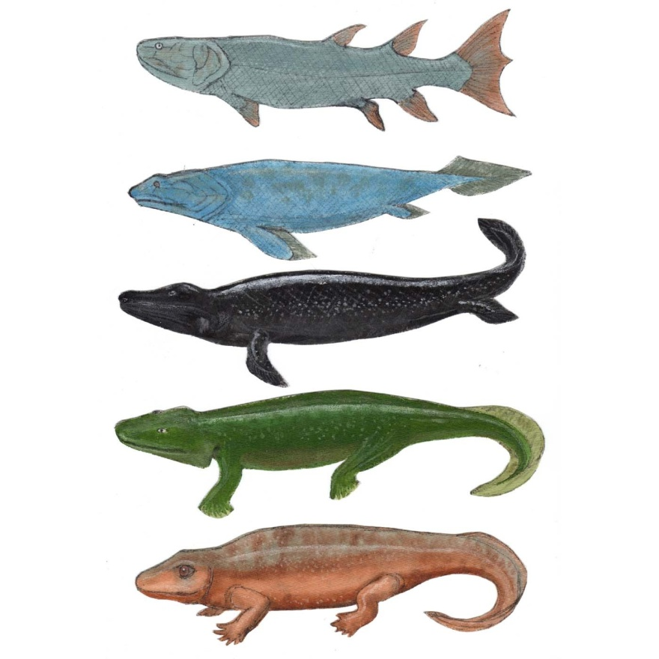
Modern Evolutionary Biology
I. Population Genetics
II. Genes and Development: "Evo-Devo"
A. Overview
Can changes like this….
…explain changes like this?

Slide 2
Modern Evolutionary Biology
I. Population Genetics
II. Genes and Development: "Evo-Devo"
A. Overview
…explain changes like this?
Can changes like this….
Differences correlate with what they make (different proteins make them different colors)
Differences don’t correlate with what they make; they are pretty much the same stuff, just in a different shape.

Slide 3
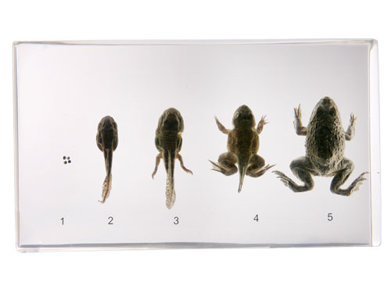
Modern Evolutionary Biology
I. Population Genetics
II. Genes and Development: "Evo-Devo"
A. Overview
- the importance of embryology and development:
In embryological development, we see structures emerging where they did not exist before. Maybe the evolution of new structures during the history of life ‘emerged’ in the same way, through the evolution and regulation of developmental pathways that gave rise to new structures.

Slide 4
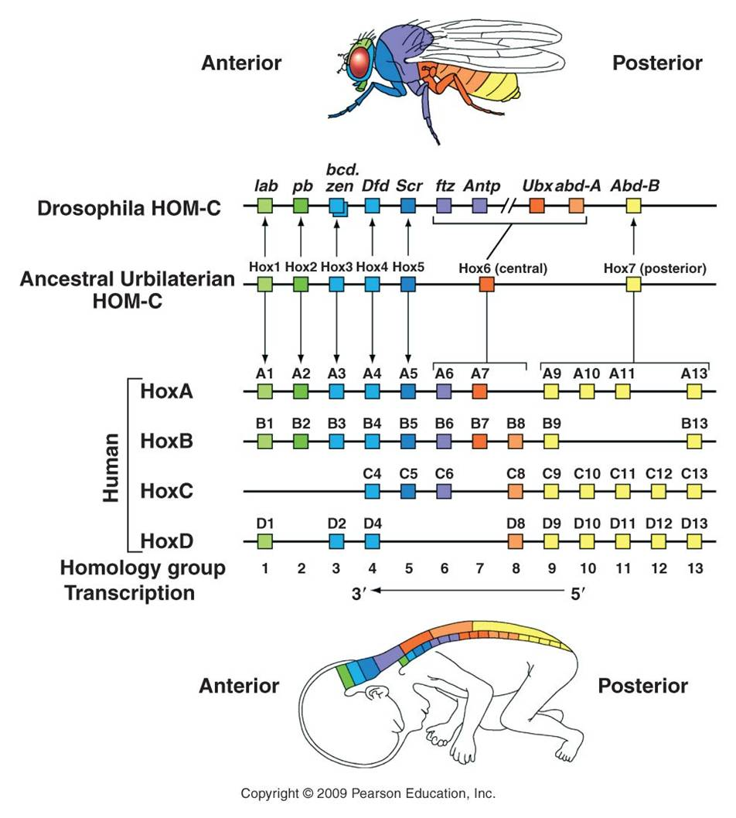
Modern Evolutionary Biology
I. Population Genetics
II. Genes and Development: "Evo-Devo"
A. Overview
B. Homeotic Genes

Slide 5
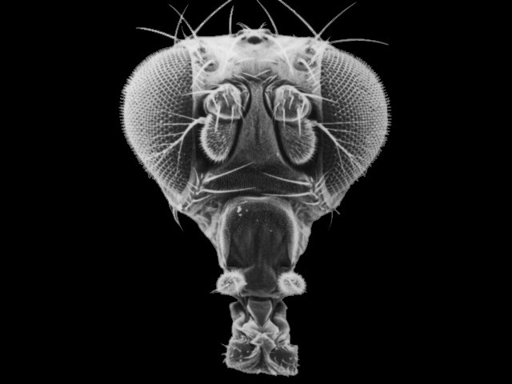
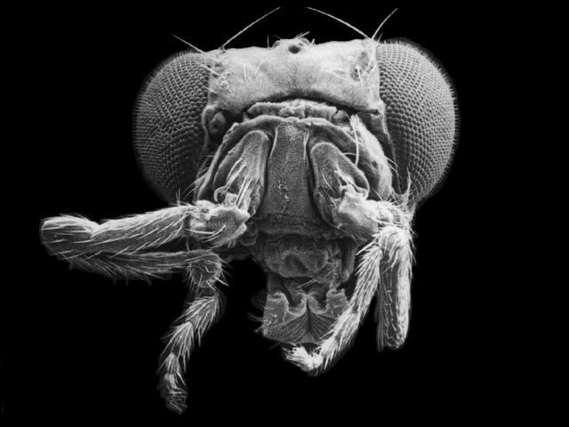
Modern Evolutionary Biology
I. Population Genetics
II. Genes and Development: "Evo-Devo"
A. Overview
B. Homeotic Genes
Normal antennae
“antennapedia mutant

Slide 6
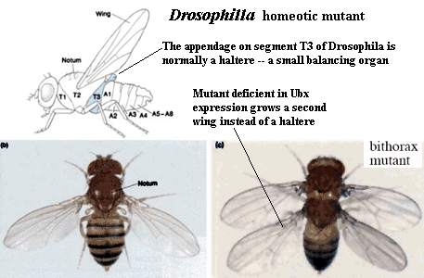
Modern Evolutionary Biology
I. Population Genetics
II. Genes and Development: "Evo-Devo"
A. Overview
B. Homeotic Genes

Slide 7
Modern Evolutionary Biology
I. Population Genetics
II. Genes and Development: "Evo-Devo"
A. Overview
B. Homeotic Genes

Slide 8
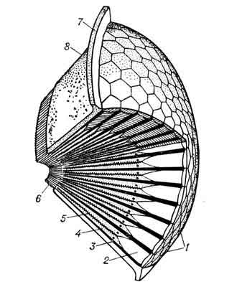
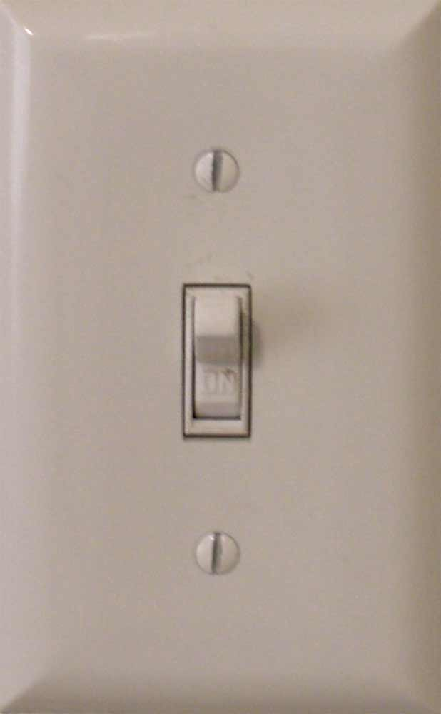
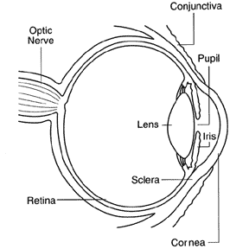
Modern Evolutionary Biology
I. Population Genetics
II. Genes and Development: "Evo-Devo"
A. Overview
B. Homeotic Genes

Slide 9
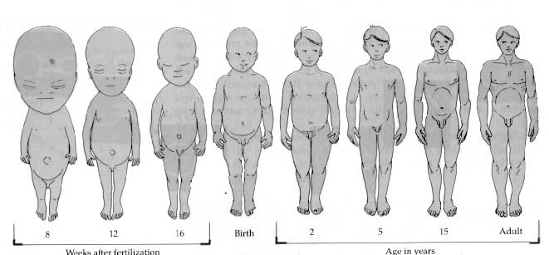
Modern Evolutionary Biology
I. Population Genetics
II. Genes and Development: "Evo-Devo"
A. Overview
B. Homeotic Genes
C. Environmental Effects and Phenotypic Plasticity
D. Regulation and Selection
E. Allometry and Speciation
Allometry – difference in growth rates of different body parts – causes change in body proportionality

Slide 10
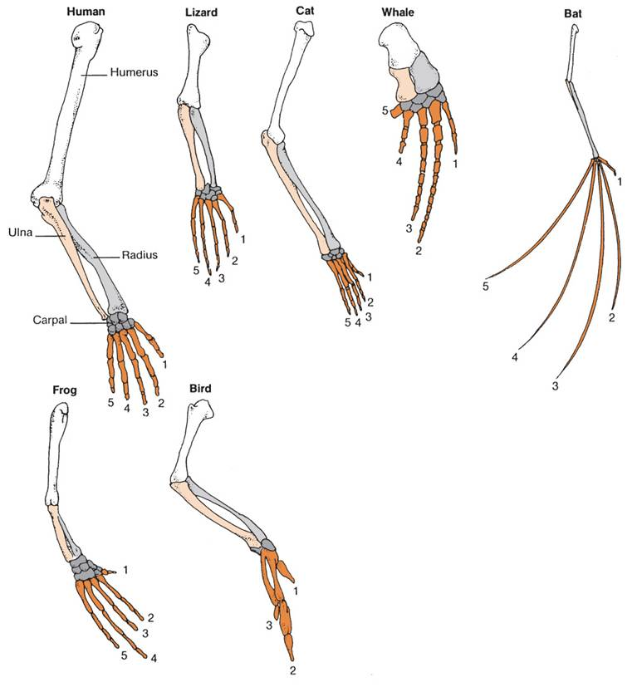
Modern Evolutionary Biology
I. Population Genetics
II. Genes and Development: "Evo-Devo"
A. Overview
B. Homeotic Genes
C. Environmental Effects and Phenotypic Plasticity
D. Regulation and Selection
E. Allometry and Speciation
Allometry – difference in growth rates of different body parts – causes change in body proportionality

Slide 11
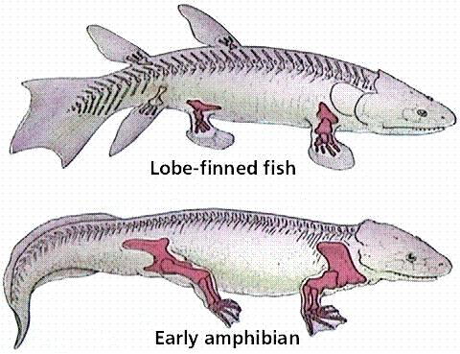
II. Genes and Development: "Evo-Devo"
A. Overview
B. Homeotic Genes
C. Environmental Effects and Phenotypic Plasticity
D. Allometry and Speciation

Slide 12
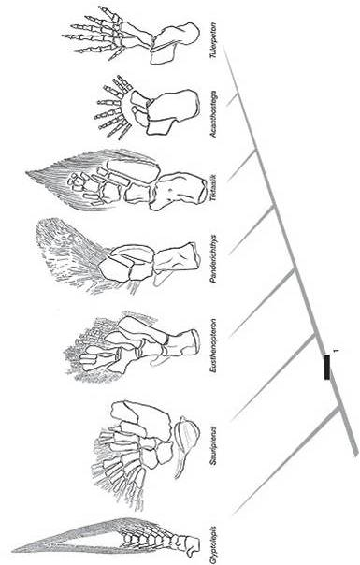
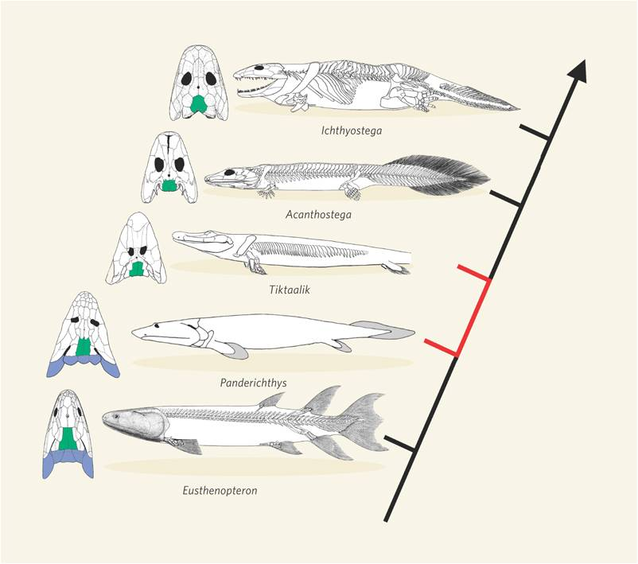
II. Genes and Development: "Evo-Devo"
A. Overview
B. Homeotic Genes
C. Environmental Effects and Phenotypic Plasticity
D. Allometry and Speciation

Slide 13
II. Genes and Development: "Evo-Devo"
A. Overview
B. Homeotic Genes
C. Environmental Effects and Phenotypic Plasticity
D. Allometry and Speciation
Sources of Variation
Agents of Change
Selection
Drift
Mutation
Migration
Non-Random Mating
Mutation
Recombination
PHYSIOLOGY
DEVELOPMENT
VARIATION

Slide 14
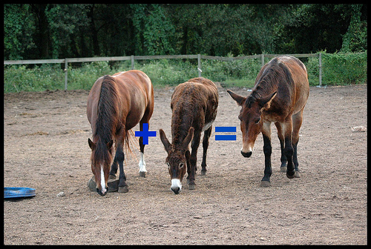
Modern Evolutionary Biology
I. Population Genetics
II. Genes and Development: "Evo-Devo"
III. Species
A. Overview

Slide 15
Modern Evolutionary Biology
I. Population Genetics
II. Genes and Development: "Evo-Devo"
III. Species and Phylogenies
Overview
What is a Species?
1. Morphological species concept:
“a species is what a professional taxonomist says it is”

Slide 16
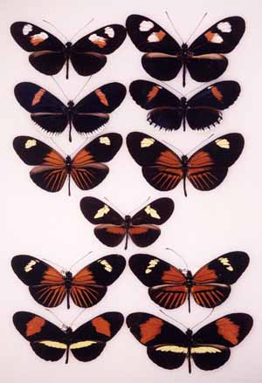
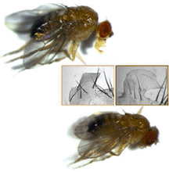
B. What is a Species?
1. Morphological species concept:
Problems…
Polymorphism
Sibling species
H. erato
H. melpomene

Slide 17
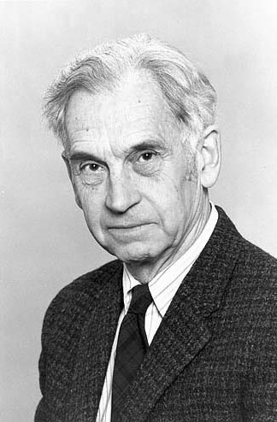
B. What is a Species?
1. Morphological species concept:
2. Biological species concept:
“a group of interbreeding organisms that are reproductively isolated from other such groups” – Ernst Mayr

Slide 18
B. What is a Species?
1. Morphological species concept:
2. Biological species concept:
“a group of interbreeding organisms that are reproductively isolated from other such groups”
Problems:
Asexual species?
Fossils?
The process of divergence…

Slide 19
B. What is a Species?
C. How Does Speciation Occur?
Pre-zygotic Isolating Mechanisms | Post-zygotic Isolating Mechanisms
Geographic isolation | Genome Incompatibility
Temporal Isolation | Hybrid Sterility
Behavioral Isolation | Low Hybrid Fitness
Mechanical Isolation
Chemical Isolation

Slide 20
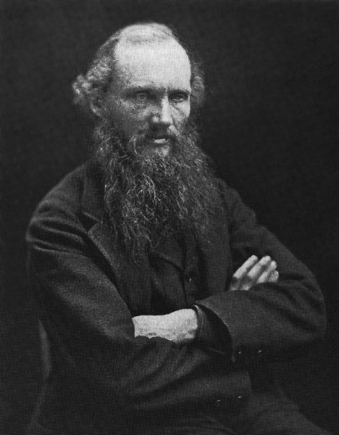
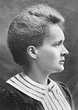
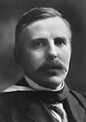
IV. Reconstructing Phylogenies
A. Fossil Evidence
1. Radioactive Decay and Geological Clocks
1862 – “Lord Kelvin”
1903 – Marie Curie
1904 - Ernst Rutherford
"The discovery of the radio-active elements, which in their disintegration liberate enormous amounts of energy, thus increases the possible limit of the duration of life on this planet, and allows the time claimed by the geologist and biologist for the process of evolution.“ - Rutherford

Slide 21
IV. Reconstructing Phylogenies
A. Fossil Evidence
1. Radioactive Decay and Geological Clocks
- measure amt of parent and daughter isotopes = total initial parental
- with the measureable1/2 life, determine time needed to decay this fraction
- K40-Ar40 suppose 1/2 of total is Ar40 = 1.3by
(Now, you might say "be real"! How can we measure something that is this slow?)
Well, 40 grams of Potassium (K) contains:
6.0 x 10²³ atoms (Avogadro's number, remember that little chemistry tid-bit?).
So, For 1/2 of them to change, that would be:
3.0 x 10²³ atoms in 1.3 billion years (1.3 x 10⁹)
So, divide 3.0 x 10²³ by 1.3 x 10⁹ = 2.3 X 10¹⁴ atoms/year.
Then, divide 2.3 x 10¹⁴ by 365 (3.65 x 10²) days per year = 0.62 x 10¹² atoms per day ( shift decimal = 6.2 x 10¹¹)
Then, divide 6.2 x 10¹¹ by 24*60*60 = 86,400 seconds/day: (= 8.64 x 10⁴) = 0.7 x 10⁷ atoms per second
0.7 x 10⁷ = 7 x 10⁶ = 7 million atoms changing from Potassium to Argon every second!!!

Slide 22
IV. Reconstructing Phylogenies
A. Fossil Evidence
1. Radioactive Decay and Geological Clocks
2. Transitional Fossils
a. Ichthyostega and the fish-amphibian transition
FISH AMPHIBIANS
Ichthyostega
- Struts in the tailfin (FISH)
- Feet (AMPHIBIANS)
- After fish, before amphibians (just where evolution predicts it should be)
XXX

Slide 23
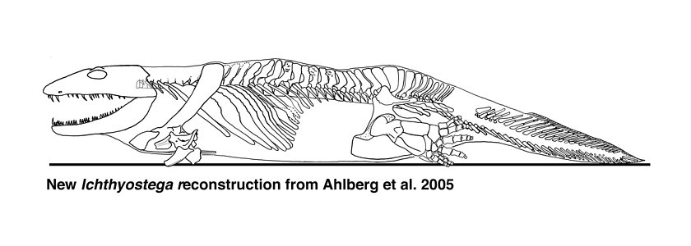
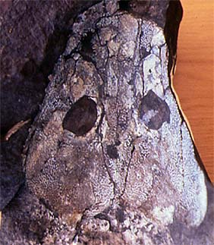
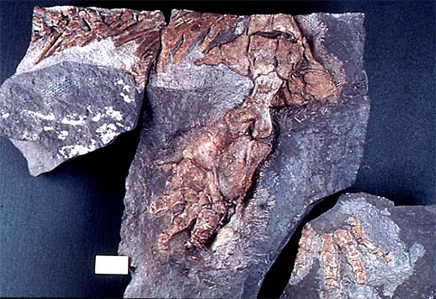
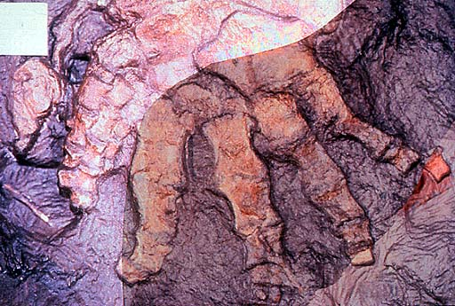
Ichthyostega sp.

Slide 24
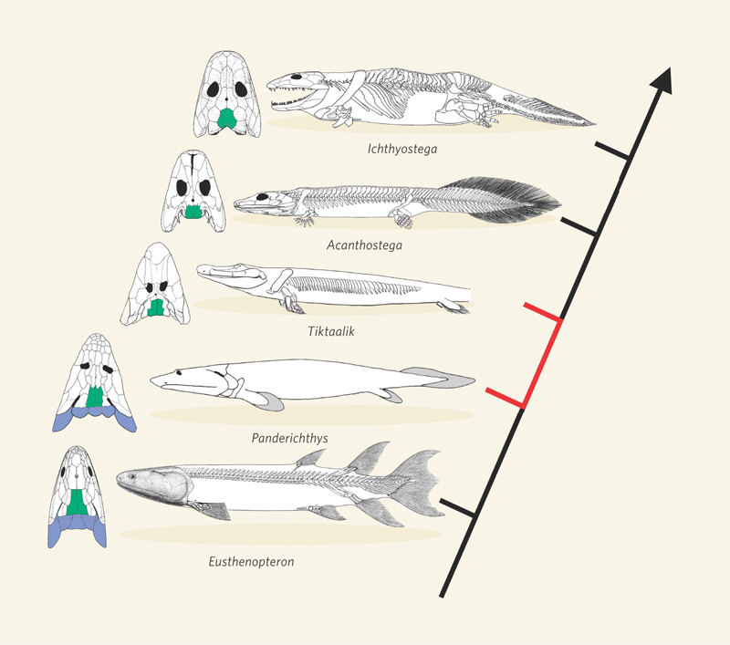
D. Devonian (417-354 mya)
- Placoderms
- Sharks
- Lobe-finned Fishes
365 mya
385 mya

Slide 25
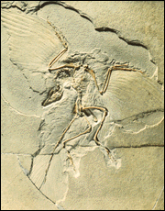
IV. Reconstructing Phylogenies
A. Fossil Evidence
1. Radioactive Decay and Geological Clocks
2. Transitional Fossils
b. The evolution of birds
Archeopteryx lithographica
REPTILES BIRDS
XXX – 150 mya
- Fingers, teeth, tail (Reptiles)
Feathers (birds)
- After reptiles, before birds (just where evolution predicts it should be)

Slide 26
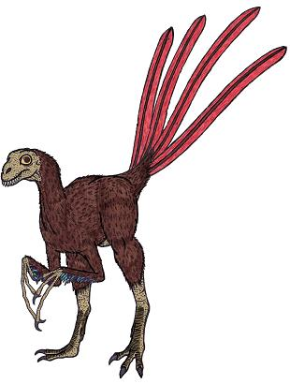
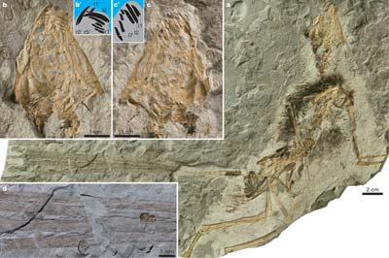
IV. Reconstructing Phylogenies
A. Fossil Evidence
1. Radioactive Decay and Geological Clocks
2. Transitional Fossils
b. The evolution of birds
Epidipteryx – 165 mya

Slide 27
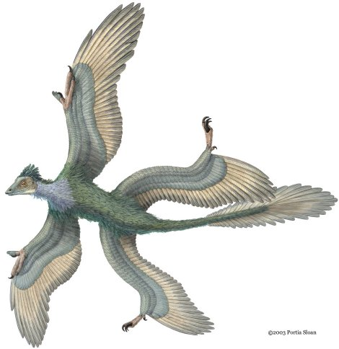
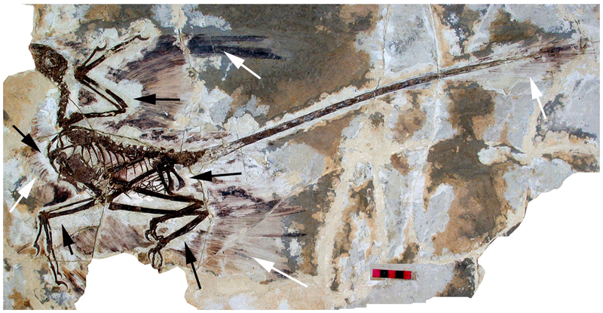
IV. Reconstructing Phylogenies
A. Fossil Evidence
1. Radioactive Decay and Geological Clocks
2. Transitional Fossils
b. The evolution of birds
Microraptor – 120 mya

Slide 28
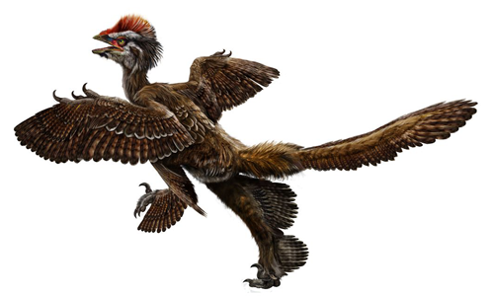
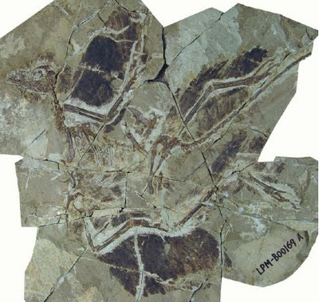
IV. Reconstructing Phylogenies
A. Fossil Evidence
1. Radioactive Decay and Geological Clocks
2. Transitional Fossils
b. The evolution of birds
Anchiornis – 160mya

Slide 29
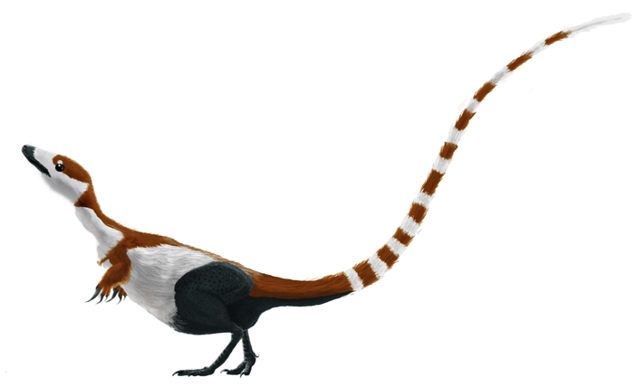
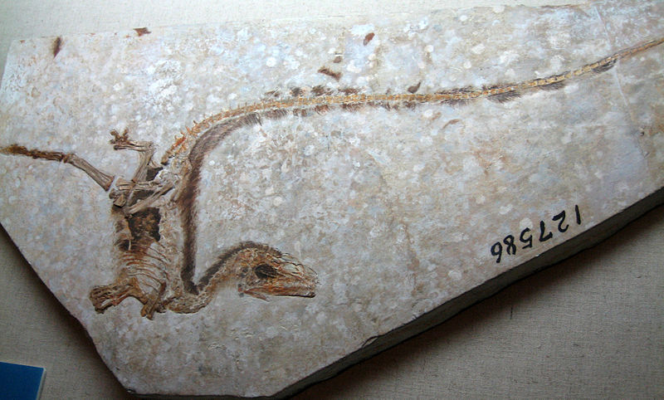
IV. Reconstructing Phylogenies
A. Fossil Evidence
1. Radioactive Decay and Geological Clocks
2. Transitional Fossils
b. The evolution of birds
Sinosauropteryx – 120mya

Slide 30
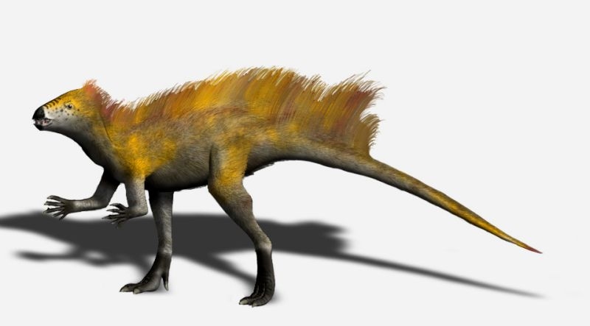
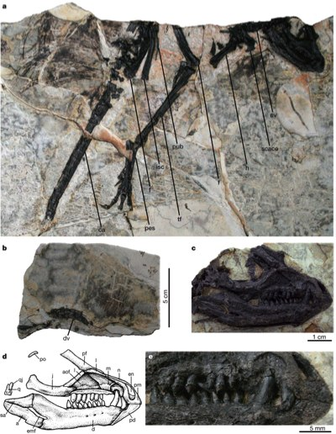
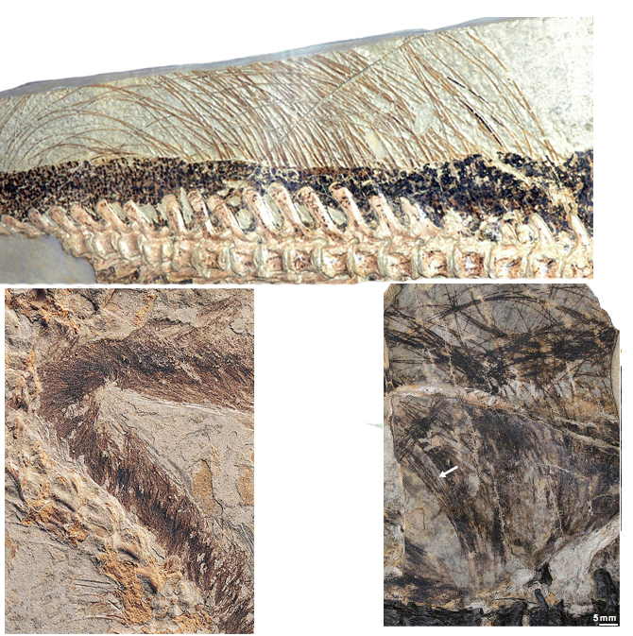
IV. Reconstructing Phylogenies
A. Fossil Evidence
1. Radioactive Decay and Geological Clocks
2. Transitional Fossils
b. The evolution of birds
Tianyulong – 200 mya

Slide 31
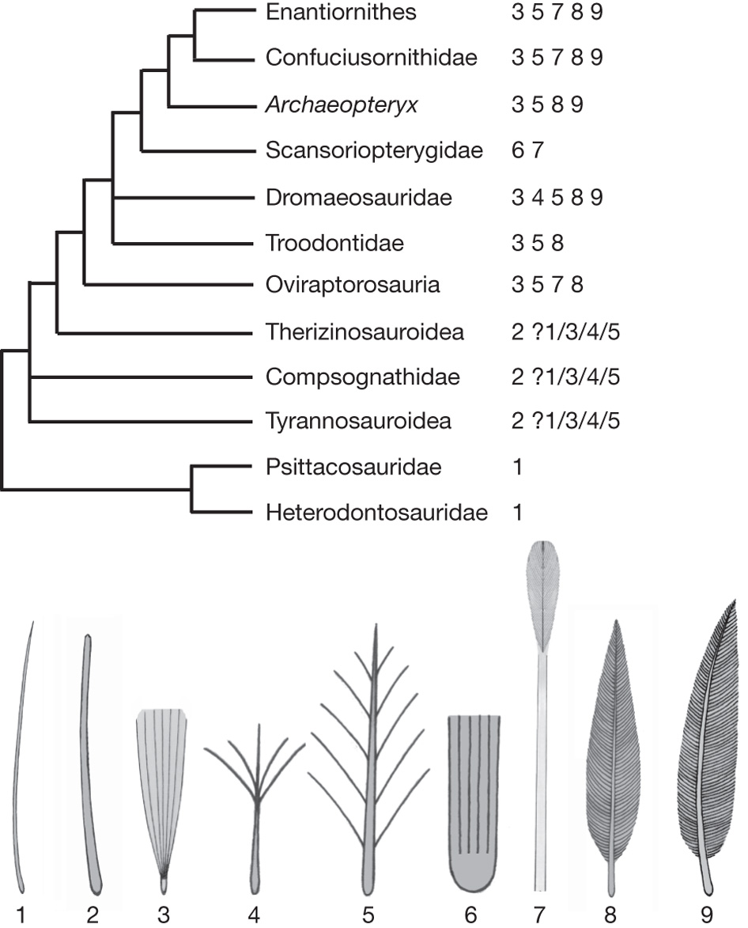
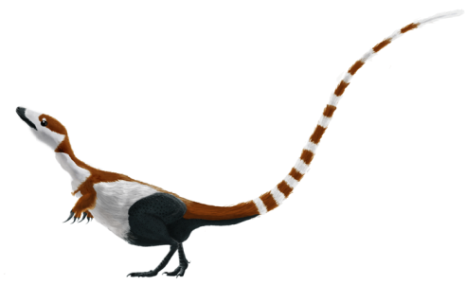

Slide 32
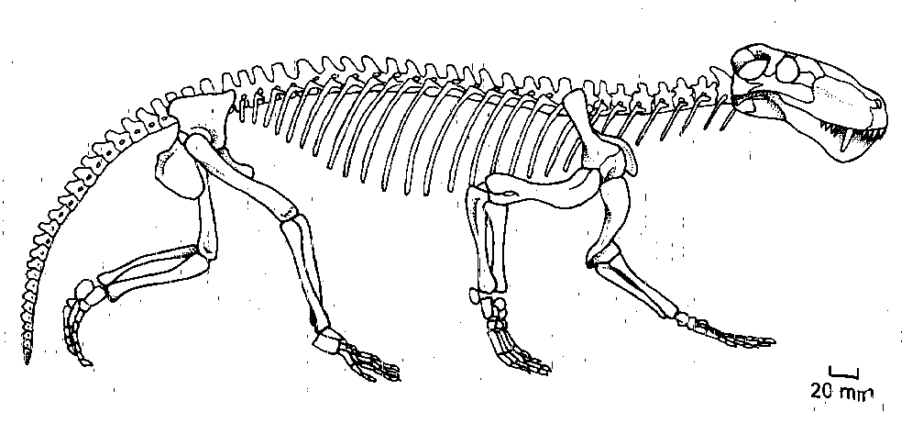
IV. Reconstructing Phylogenies
A. Fossil Evidence
1. Radioactive Decay and Geological Clocks
2. Transitional Fossils
c. The evolution of mammals
Therapsids
REPTILES MAMMALS
- Mammalian skeleton
Intermediate ear
primitive dentition
- After reptiles, before mammals (just where evolution predicts it should be)
XXX

Slide 33
Mammals from the Jurassic (185 mya)
Therapsids from the Permian (280 mya) to the Triassic (200mya)
Pelycosaur Reptiles of the Carboniferous (300 mya)

Slide 34
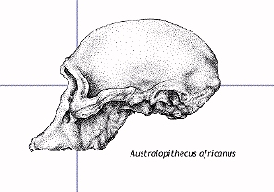
IV. Reconstructing Phylogenies
A. Fossil Evidence
1. Radioactive Decay and Geological Clocks
2. Transitional Fossils
d. The evolution of humans
Australopithecines
APES HUMANS
- After apes, before humans (just where evolution predicts it should be)
bipedal (human trait)
chimp-sized cranial volume
XXX

Slide 35
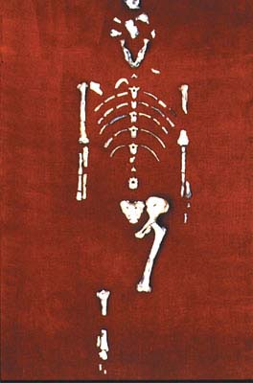
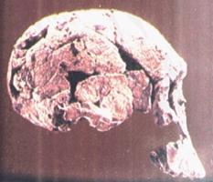
IV. Reconstructing Phylogenies
A. Fossil Evidence
1. Radioactive Decay and Geological Clocks
2. Transitional Fossils
d. The evolution of humans
Australopithecines
Australopithecus afarensis

Slide 36
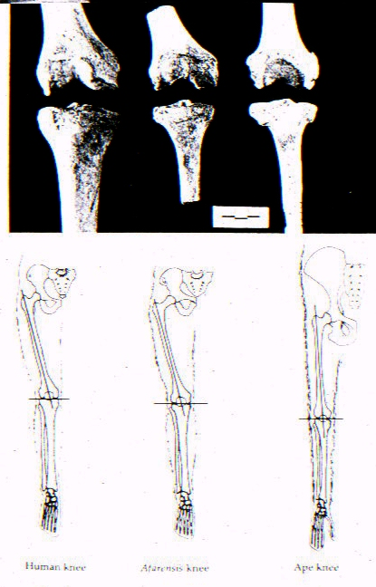
IV. Reconstructing Phylogenies
A. Fossil Evidence
1. Radioactive Decay and Geological Clocks
2. Transitional Fossils
d. The evolution of humans
Legs

Slide 37
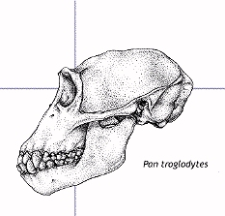
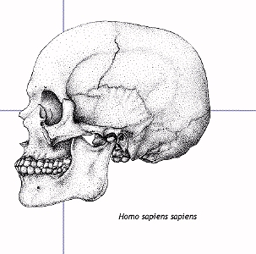
IV. Reconstructing Phylogenies
A. Fossil Evidence
1. Radioactive Decay and Geological Clocks
2. Transitional Fossils
d. The evolution of humans
Skulls

Slide 38
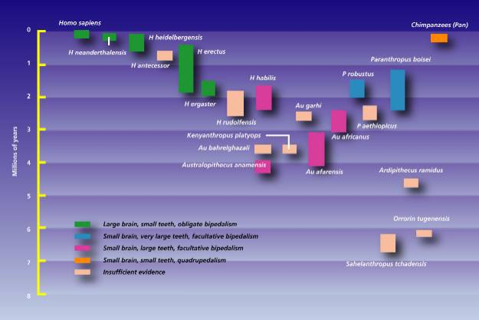
IV. Reconstructing Phylogenies
A. Fossil Evidence
1. Radioactive Decay and Geological Clocks
2. Transitional Fossils
d. The evolution of humans

Slide 39
IV. Reconstructing Phylogenies
A. Fossil Evidence
1. Radioactive Decay and Geological Clocks
2. Transitional Fossils
e. Summary
After 150 years of paleontology in the Darwinian age, we have remarkably good transitional sequences that link all major groups of vertebrates. This solves Darwin’s dilemma – sequences of intermediates DO exist – and we have found many of them, even though fossilization is a rare event.

Slide 40
IV. Reconstructing Phylogenies
A. Fossil Evidence
B. Genetic Evidence
1. Gross Chromosomal Similarities

Slide 41
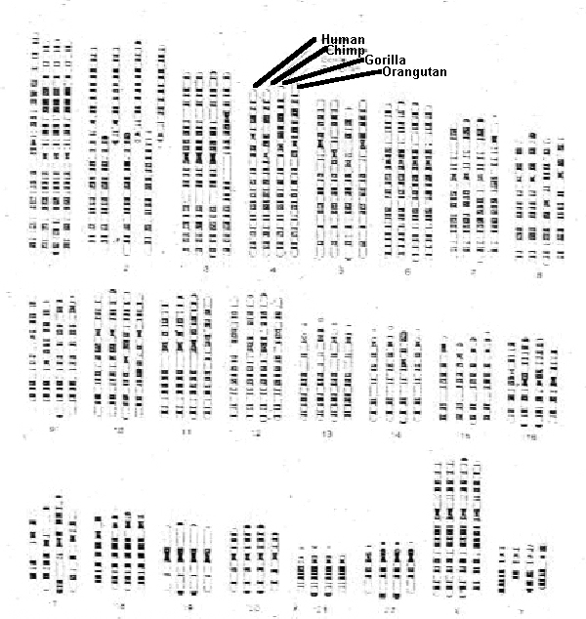

Slide 42
IV. Reconstructing Phylogenies
A. Fossil Evidence
B. Genetic Evidence
1. Gross Chromosomal Similarities
2. Mutational Clocks
- mutations tend to accumulate in a DNA sequence at a constant rate… so if we count up the genetic differences between organisms and we know the rate, we can determine how must time must have elapsed for these differences to accumulate. (Time since divergence).

Slide 43
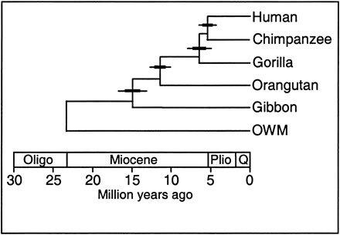
IV. Reconstructing Phylogenies
A. Fossil Evidence
B. Genetic Evidence
1. Gross Chromosomal Similarities
2. Mutational Clocks
3. Genetic Phylogenies
Stauffer, et al., (2001). J. Hered.

Slide 44
IV. Reconstructing Phylogenies
A. Fossil Evidence
B. Genetic Evidence
C. Concordant Phylogenies
Testing Evolutionary Theory (yet again)
IF species are descended from common ancestors (like people in a family), and
IF we know the rate of genetic change (mutation),
THEN we should be able to compare genetic similarity and predict when common ancestors lived.
AND, if the fossil record is also a product of evolution, THEN the species though to be ancestral to modern groups should exist at this predicted age, too.
In other words, we should be able to compare DNA and protein sequences in living species and predict where, in the sedimentary strata of the Earth’s crust, a third different species should be.

Slide 45
IV. Reconstructing Phylogenies
A. Fossil Evidence
B. Genetic Evidence
C. Concordant Phylogenies
Clustering analysis based on amino acid similarity across seven proteins from 17 mammalian species.

Slide 46
IV. Reconstructing Phylogenies
A. Fossil Evidence
B. Genetic Evidence
C. Concordant Phylogenies
Now, we date the oldest mammalian fossil, which our evolution hypothesis dictates should be ancestral to all mammals, both the placentals (species 1-16) and the marsupial kangaroo. …. This dates to 120 million years
16

Slide 47
IV. Reconstructing Phylogenies
A. Fossil Evidence
B. Genetic Evidence
C. Concordant Phylogenies
And, through our protein analysis, we already know how many genetic differences (nitrogenous base substitutions) would be required to account for the differences we see in these proteins - 98.
16

Slide 48
C. Concordant Phylogenies
So now we can plot genetic change against time, hypothesizing that this link between placentals and marsupials is ancestral to the other placental mammals our analysis.
16

Slide 49
C. Concordant Phylogenies
Now we can test a prediction. IF genetic similarity arises from descent from common ancestors, THEN we can use genetic similarity to predict when common ancestors should have lived...
16

Slide 50
C. Concordant Phylogenies
This line represents that prediction. Organisms with more similar protein sequences (requiring fewer changes in DNA to explain these protein differences) should have more recent ancestors...
16

Slide 51
C. Concordant Phylogenies
And the prediction here becomes even MORE precise. For example, we can predict that two species, requiring 50 substitutions to explain the differences in their proteins, are predicted to have a common ancestor that lived 58-60 million years ago...
16

Slide 52
C. Concordant Phylogenies
Let’s test that prediction. Rabbits and the rodent differ in protein sequence to a degree requiring a minimum of 50 nucleotide substitutions... Where is the common ancestor in the fossil record?

Slide 53
C. Concordant Phylogenies
Just where genetic analysis of two different EXISTING species predicts.
16

Slide 54
C. Concordant Phylogenies
OK, but what about all of our 16 "nodes"? Evolution predicts that they should also exist on or near this line....
16

Slide 55
C. Concordant Phylogenies
And they are. Certainly to a degree that supports our hypothesis based on evolution. Tested and supported.

Slide 56
C. Concordant Phylogenies
- We can compare the DNA in existing species and predict where, in the sedimentary layers of the Earth’s crust, a third DIFFERENT species should be.
- No explanation other than evolution predicts and explains this ability.
Evolution by Common Descent is a tested, predictive theory; like atomic theory or the heliocentric theory.

Slide 57
Modern Evolutionary Biology
I. Population Genetics
II. Genes and Development: "Evo-Devo"
III. Species
IV. Reconstructing Phylogenies
V. Modern Evolutionary Theory

Slide 58
V. Modern Evolutionary Theory
A. Peripatric Speciation

Slide 59
V. Modern Evolutionary Theory
A. Peripatric Speciation
B. Punctuated Equilibria – Eldridge and Gould - 1972

Slide 60
- 1972 - Eldridge and Gould - Punctuated Equilibrium
1. Consider a large, well-adapted population
VARIATION
TIME

Slide 61
- 1972 - Eldridge and Gould - Punctuated Equilibrium
1. Consider a large, well-adapted population
Effects of Selection and Drift are small - little change over time
VARIATION
TIME

Slide 62
- 1972 - Eldridge and Gould - Punctuated Equilibrium
2. There are always small sub-populations "budding off" along the periphery of a species range...
VARIATION
TIME

Slide 63
- 1972 - Eldridge and Gould - Punctuated Equilibrium
2. Most will go extinct, but some may survive...
VARIATION
X
X
X
TIME

Slide 64
- 1972 - Eldridge and Gould - Punctuated Equilibrium
2. These surviving populations will initially be small, and in a new environment...so the effects of Selection and Drift should be strong...
VARIATION
X
X
X
TIME

Slide 65
- 1972 - Eldridge and Gould - Punctuated Equilibrium
3. These populations will change rapidly in response...
VARIATION
X
X
X
TIME

Slide 66
- 1972 - Eldridge and Gould - Punctuated Equilibrium
3. These populations will change rapidly in response... and as they adapt (in response to selection), their populations should increase in size (because of increasing reproductive success, by definition).
VARIATION
X
X
X
TIME

Slide 67
- 1972 - Eldridge and Gould - Punctuated Equilibrium
3. As population increases in size, effects of drift decline... and as a population becomes better adapted, the effects of selection decline... so the rate of evolutionary change declines...
VARIATION
X
X
X
TIME

Slide 68
- 1972 - Eldridge and Gould - Punctuated Equilibrium
4. And we have large, well-adapted populations that will remain static as long as the environment is stable...
VARIATION
X
X
X
TIME

Slide 69
- 1972 - Eldridge and Gould - Punctuated Equilibrium
5. Since small, short-lived populations are less likely to leave a fossil, the fossil record can appear 'discontinuous' or 'imperfect'
VARIATION
X
X
X
TIME

Slide 70
- 1972 - Eldridge and Gould - Punctuated Equilibrium
5. Large pop's may leave a fossil....
VARIATION
X
X
X
TIME

Slide 71
- 1972 - Eldridge and Gould - Punctuated Equilibrium
5. Small, short-lived populations probably won't...
VARIATION
X
X
X
TIME

Slide 72
- 1972 - Eldridge and Gould - Punctuated Equilibrium
6. So, the discontinuity in the fossil record is an expected result of our modern understanding of how evolution and speciation occur...
VARIATION
X
X
X
TIME

Slide 73
- 1972 - Eldridge and Gould - Punctuated Equilibrium
6. both in time (as we see), and in SPACE (as changing populations are probably NOT in same place as ancestral species).
VARIATION
X
X
X
TIME

