Slide 1
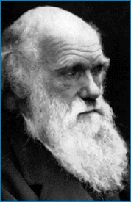
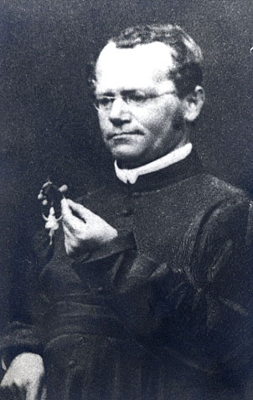
Lecture 6: Darwin and the Birth of Modern Biology
Overview
- Darwin (1859) Origin of Species
- Mendel (1865) Experiments in Plant Hybridization

Slide 2
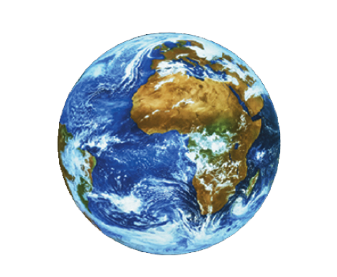
I. The Birth of Science
Overview

Slide 3
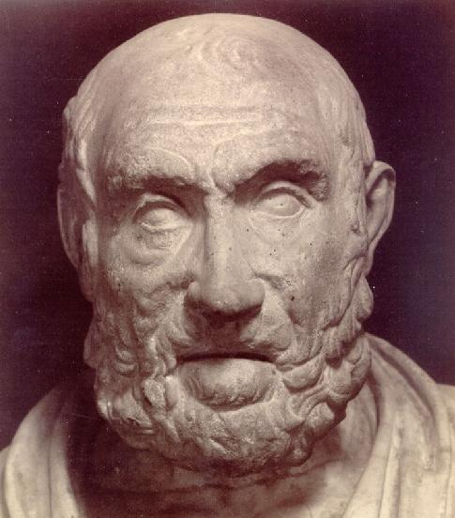
I. The Birth of Science
Overview
B. The Greeks
- Hippocrates

Slide 4
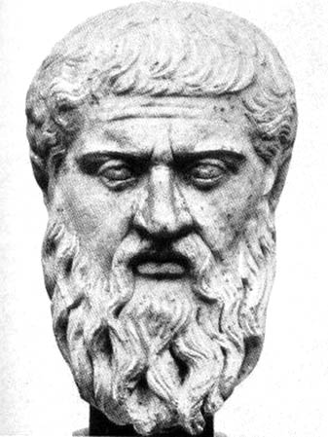
I. The Birth of Science
Overview
B. The Greeks
- Plato
UNIVERSAL PHILOSOPHY (four dogmas)
Essentialism (cave allegory)
Universal Harmony
Demi-Urge
Soul
The cave

Slide 5
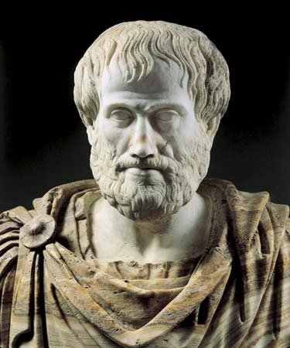
I. The Birth of Science
Overview
B. The Greeks (~400-300 bce)
- Aristotle
Logic
- induction could lead to new ideas
- to be evaluated by deduction
Scala Naturae

Slide 6
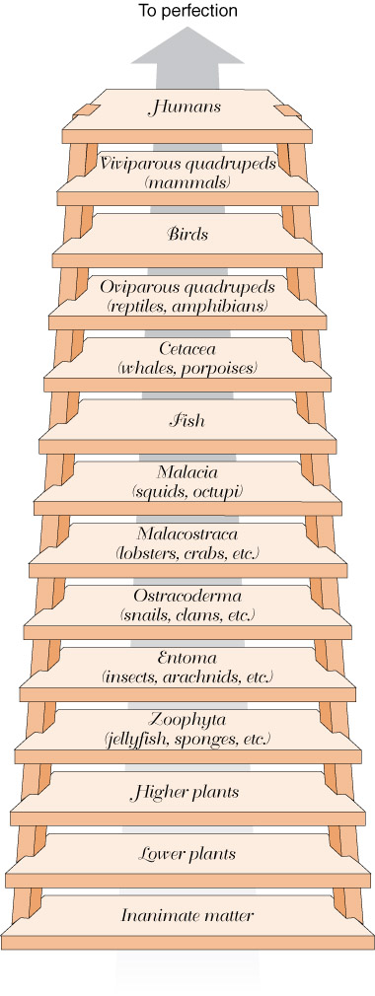

Slide 7
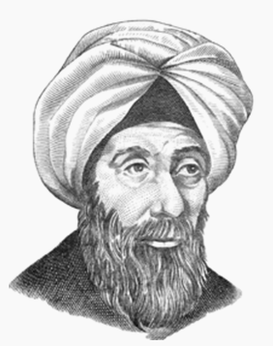
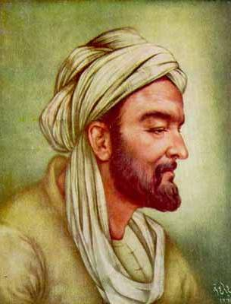
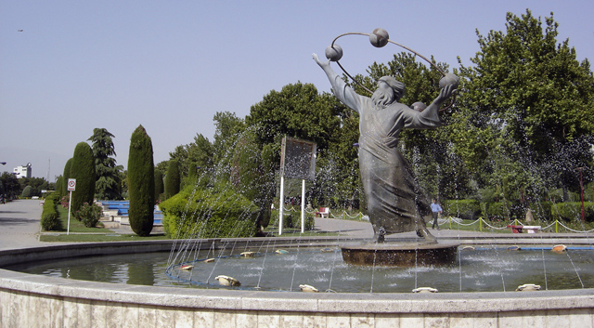
I. The Birth of Science
Overview
B. The Persians (~900-1000 ce)
- Ibn a-lHaytham (Alhazen): quantification
- al-Biruni: replication
- Ibn Sena (Avicenna): experimentation

Slide 8
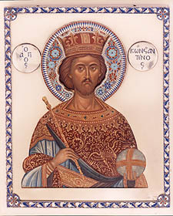
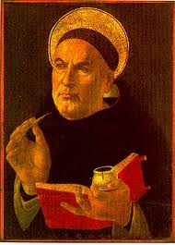
I. The Birth of Science
Overview
B. The Persians
C. Middle Ages (~450-1400)
- Constantine the Great
- Thomas Aquinas
- “translators”
Christianity absorbed Platonic Essentialism
- Single complete, harmonious creation by Christian God
- Static, unchanging
- Plenitude: created in totality and perfection
- no breaks in Aristotle's scale of nature

Slide 9
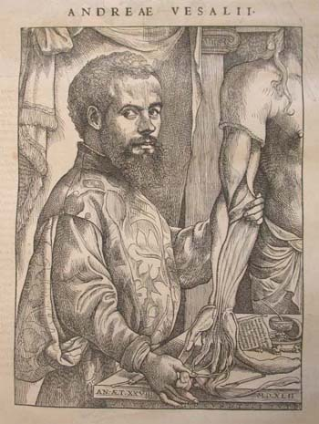
I. The Birth of Science
Overview
B. The Persians
C. Middle Ages
D. The Renaissance (~1400-1700)
- Copernicus
- Vesalius

Slide 10
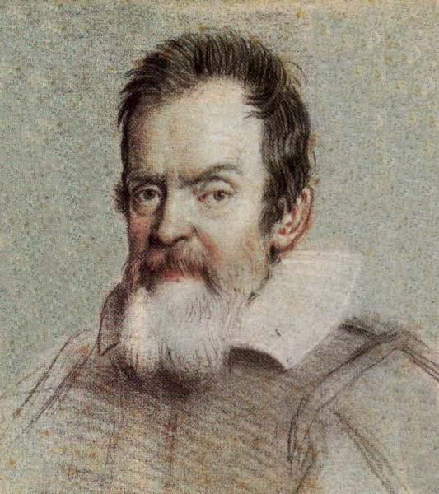
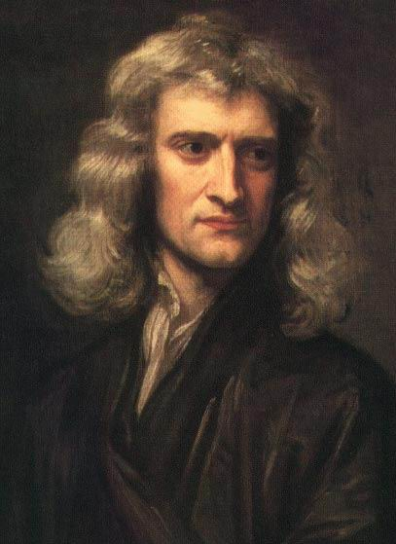
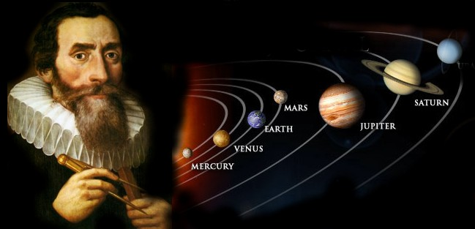
I. The Birth of Science
Overview
B. The Persians
C. Middle Ages
D. The Renaissance
- Copernicus
- Vesalius
- Kepler
- Galileo
- Newton

Slide 11
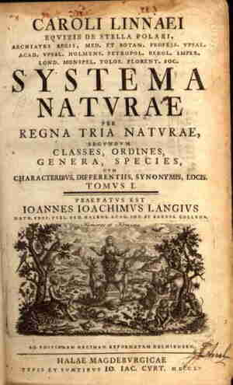
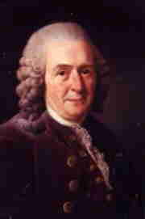
I. The Birth of Science
Overview
B. The Persians
C. Middle Ages
D. The Renaissance
E. The Enlightenment (1700’s)
- Linnaeus

Slide 12
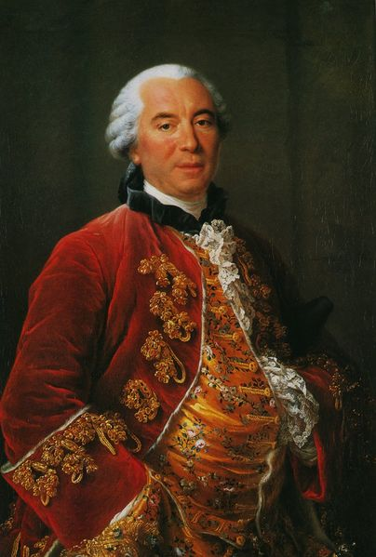
I. The Birth of Science
Overview
B. The Persians
C. Middle Ages
D. The Renaissance
E. The Enlightenment
- Linnaeus
- Buffon

Slide 13
"Not only the ass and the horse, but also man, the apes, the quadrupeds, and all the animals might be regarded as constituting but a single family... If it were admitted that the ass is of the family of the horse, and different from the horse only because it has varied from the original form, one could equally well say that the ape is of the family of man, that he is a degenerate man, that man and ape have a common origin; that, in fact, all the families, among plants as well as animals, have come from a single stock, and that all the animals are descended from a single animal, from which have sprung in the course of time, as a result of progress or of degeneration, all the other races of animals. For if it were once shown that we are justified in establishing these families; if it were granted that among animals and plants there has been (I do say several species) but even a single one, which has been produced in the course of direct decent from another species; if, for example, it were true that the ass is but a degeneration from the horse - then there would no longer be any limit to the power of nature, and we should not be wrong in supposing that, with sufficient time, she has been able from a single being to derive all the other organized beings. But this is by no means a proper representation of nature. We are assured by the authority of revelation that all animals have participated equally in the grace of direct Creation and that the first pair of every species issued forth fully formed from the hands of the Creator." George Louis Leclerc, Compte de Buffon, Histoire Naturelle (1753)

Slide 14
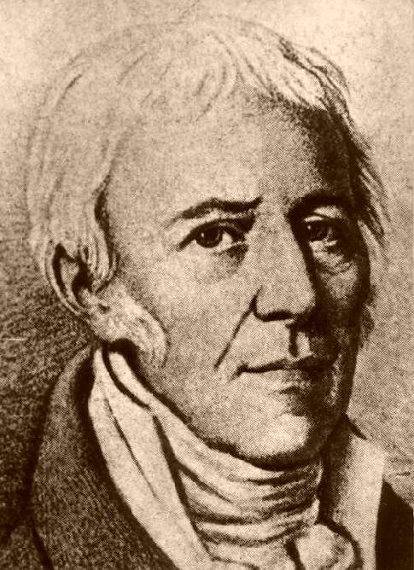
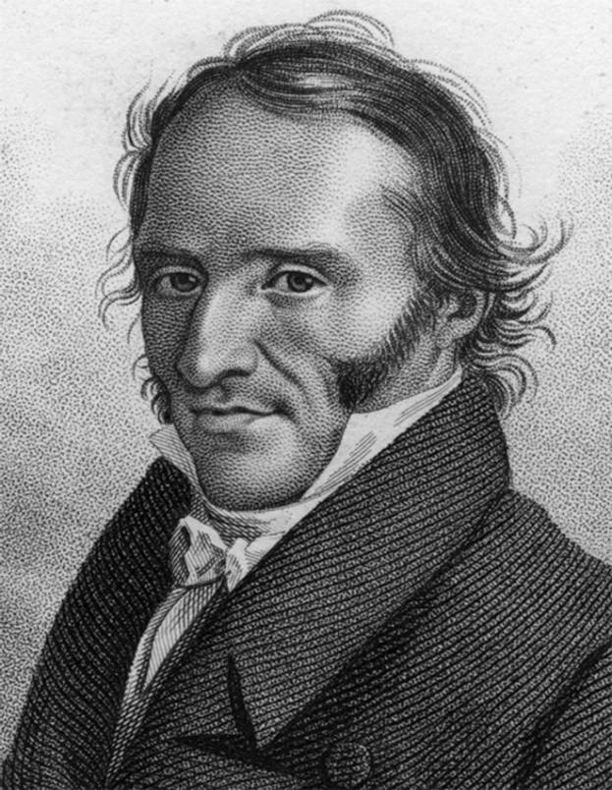
I. The Birth of Science
Overview
B. The Persians
C. Middle Ages
D. The Renaissance
E. The Enlightenment
- Linnaeus
- Buffon
- Lamarck
- Cuvier

Slide 15
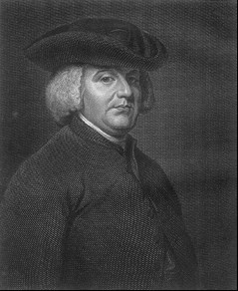
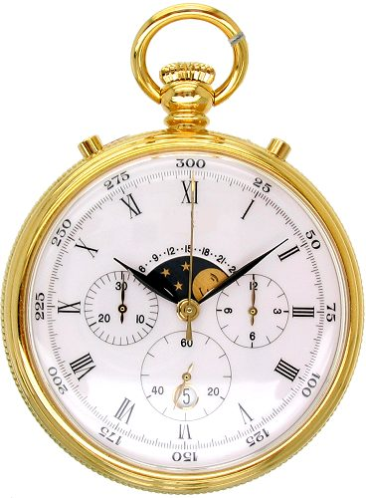
I. The Birth of Science
Overview
B. The Persians
C. Middle Ages
D. The Renaissance
E. The Enlightenment
- Linnaeus
- Buffon
- Lamarck
- Cuvier
- Paley

Slide 16
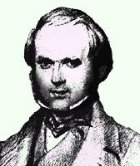
II. Darwin’s Contributions
A. Overview
1. Life
- Born Feb 12, 1809
- Graduated Cambridge, intending to join the clergy
- 1831-36, Naturalist on H.M.S. Beagle
- 1859: The Origin of Species
- Died April 19, 1882, interred in Westminster Abbey

Slide 17
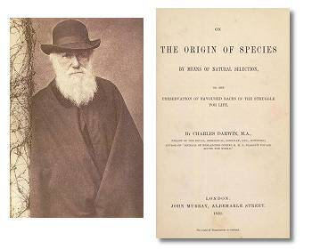
II. Darwin’s Contributions
A. Overview
1. Life
2. The Origin of Species (1859)

Slide 18
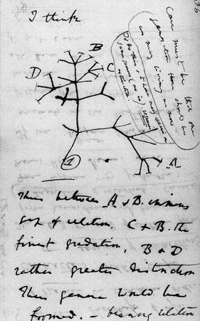
II. Darwin’s Contributions
A. Overview
1. Life
2. The Origin of Species (1859)
a. “One Long Argument”
- observations leading to the conclusions that:
- life changes through time
- species descend from shared ancestors

Slide 19
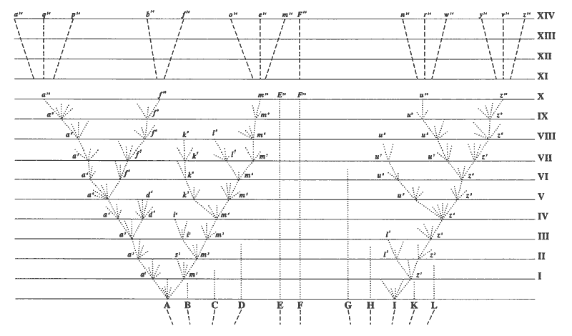
Figure from The Origin of Species (1859)

Slide 20
II. Darwin’s Contributions
A. Overview
1. Life
2. The Origin of Species (1859)
a. “One Long Argument”
b. Mechanism explaining HOW evolution occurs
- Natural Selection
c. Dilemmas – challenges and apparent inconsistencies

Slide 21
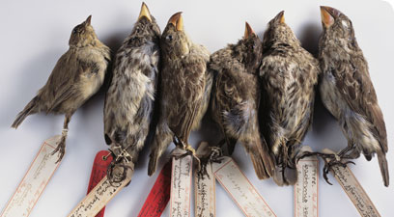
II. Darwin’s Contributions
A. Overview
B. Argument: Evidence for Evolution by Common Descent

Slide 22
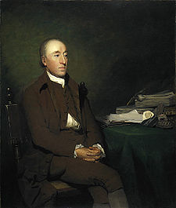
II. Darwin’s Contributions
A. Overview
B. Argument: Evidence for Evolution by Common Descent
1. Geology
a. James Hutton (1726-1797)

Slide 23
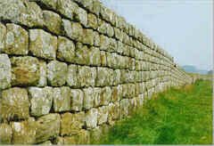
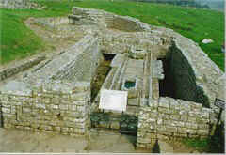
B. Argument: Evidence for Evolution by Common Descent
1. Geology
a. James Hutton (1726-1797)
- observed Hadrian’s Wall, but by the Roman Emperor Hadrian in 122 A.D.
1600 years old, but no sign of erosion. How much older must highly worn and eroded granite outcrops be?

Slide 24
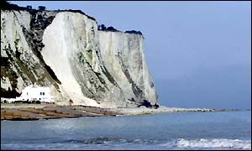
B. Argument: Evidence for Evolution by Common Descent
1. Geology
a. James Hutton (1726-1797)
- observed the White Cliffs of Dover – huge coccolith deposits. If sedimentation was slow and steady as it is today (‘uniformitarianism’), how long would it take to create such a deposit?

Slide 25
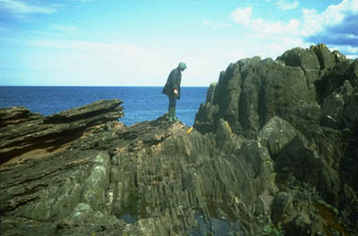
B. Argument: Evidence for Evolution by Common Descent
1. Geology
a. James Hutton (1726-1797)
- Observed and interpreted the unconformity at Siccar Point

Slide 26
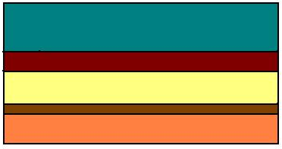
Process:
1. Initial depositional cycle

Slide 27
Process:
2. uplift (time)

Slide 28
Process:
3. erosion (time)

Slide 29
Process:
4. second depositional cycle (time)

Slide 30
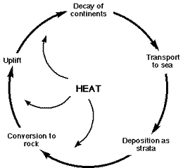
B. Argument: Evidence for Evolution by Common Descent
1. Geology
a. James Hutton (1726-1797)
- the rock cycles, so the earth has “no vestige of a beginning, no prospect of an end.” THE EARTH IS REALLY REALLY OLD

Slide 31
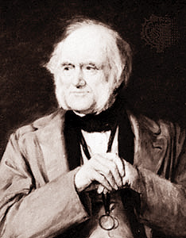
B. Argument: Evidence for Evolution by Common Descent
1. Geology
a. James Hutton (1726-1797)
b. Charles Lyell (1797-1875)
- Principles of Geology (1831-33)
- uniformitarianism
- Darwin’s friend

Slide 32
B. Argument: Evidence for Evolution by Common Descent
1. Geology
2. Paleontology
a. New types of organisms are added through the fossil record
recent
Mammals
Birds
Reptiles
Amphibians
Jawed fishes
past
Jawless fishes

Slide 33
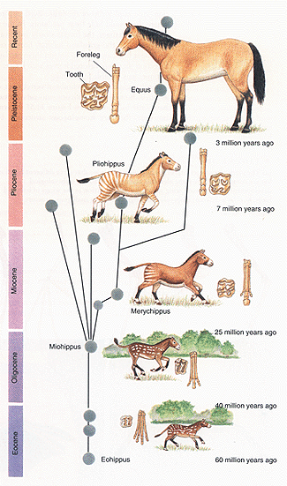
2. Paleontology
a. New types of organisms are added through the fossil record
b. Within a lineage, there are progressive changes through time. The fossils in recent strata are more similar to existing species than fossils in older (deeper) strata.

Slide 34
B. Argument: Evidence for Evolution by Common Descent
1. Geology
2. Paleontology
3. Comparative Anatomy

Slide 35
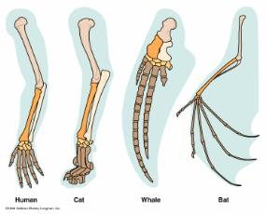
B. Argument: Evidence for Evolution by Common Descent
1. Geology
2. Paleontology
3. Comparative Anatomy
a. Homologous Structures
Same structure, but different uses in different environments
(correlated pattern)

Slide 36
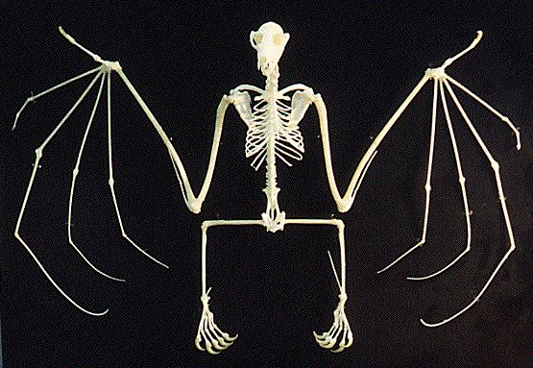
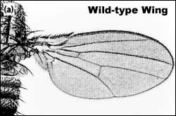
3. Comparative Anatomy
a. Homologous Structures
b. Analogous Structures
Different structures, but same uses in the same environment .
(again, a correlation between anatomy and environment)

Slide 37
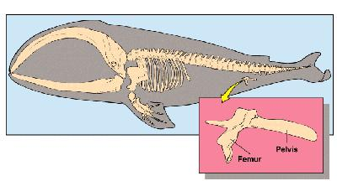
3. Comparative Anatomy
a. Homologous Structures
b. Analogous Structures
c. Vestigial Structures

Slide 38
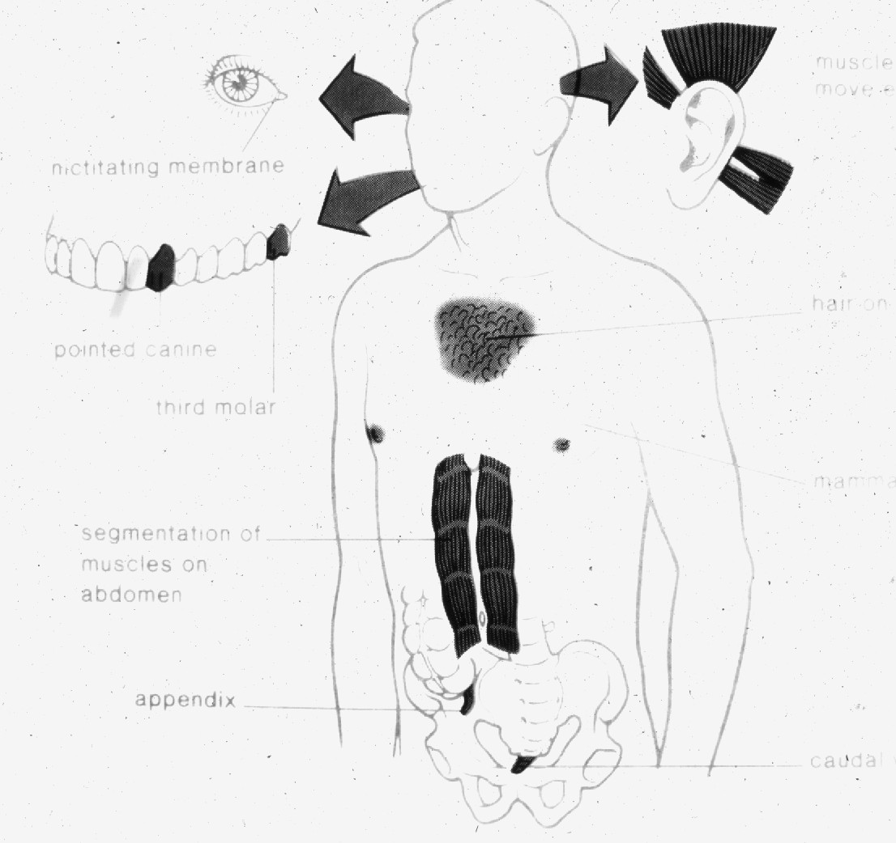
3. Comparative Anatomy
a. Homologous Structures
b. Analogous Structures
c. Vestigial Structures

Slide 39
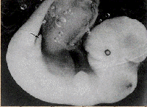
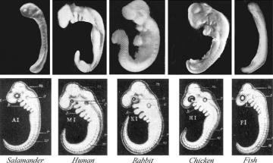
3. Comparative Anatomy
a. Homologous Structures
b. Analogous Structures
c. Vestigial Structures
d. Embryology
Whale embryo w/leg buds
photo
Haeckel (after Darwin)

Slide 40
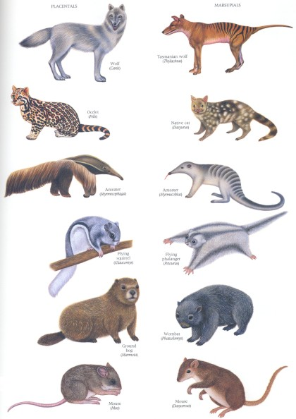
B. Argument: Evidence for Evolution by Common Descent
1. Geology
2. Paleontology
3. Comparative Anatomy
4. Biogeography
a. Convergent Communities
In similar environments, there are organisms that fill similar ecological roles – and they are morphologically similar (in an analogous, not homologous, manner).
Correlated patterns

Slide 41
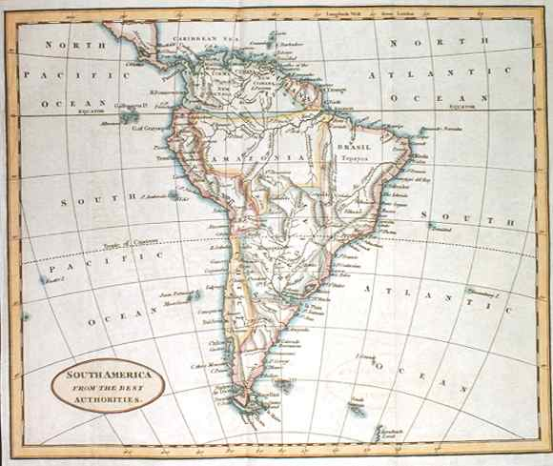
B. Argument: Evidence for Evolution by Common Descent
4. Biogeography
a. Convergent Communities
b. Island Communities

Slide 42
B. Argument: Evidence for Evolution by Common Descent
4. Biogeography
a. Convergent Communities
b. Island Communities
Uniqueness of inhabitants correlates with the degree of isolation.
- Galapagos – species different from mainland
- Fauklands – species same as mainland

Slide 43
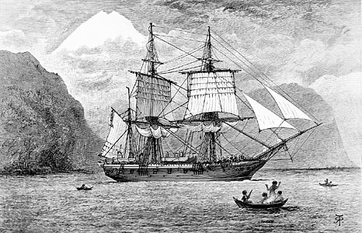
B. Argument: Evidence for Evolution by Common Descent
4. Biogeography
a. Convergent Communities
b. Island Communities
The Galapagos Archipelago

Slide 44
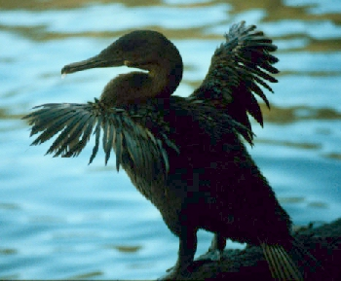
Voyage of the Beagle – Darwin (1845) "The natural history of these islands is eminently curious, and well deserves attention. Most of the organic productions are aboriginal creations, found nowhere else;
Flightless Cormorant

Slide 45
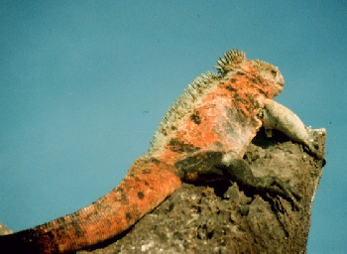
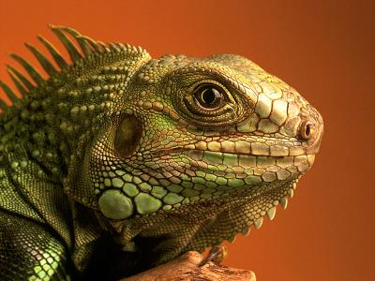
“…there is even a difference between the inhabitants of the different islands; yet all show a marked relationship with those of America, though separated from that continent by an open space of ocean, between 500 and 600 miles in width.”
Green Iguana – Central and South America

Slide 46
“…The archipelago is a little world within itself, or rather a satellite attached to America, whence it has derived a few stray colonists, and has received the general character of its indigenous productions. Considering the small size of the islands, we feel the more astonished at the number of their aboriginal beings, and at their confined range.”
Galapagos Land Iguana, pallid species, only on Santa Fe island.

Slide 47
“… Seeing every height crowned with its crater, and the boundaries of most of the lava streams still distinct, we are led to believe that within a period geologically recent the unbroken ocean was here spread out.”

Slide 48
“…Hence, both in space and time, we seem to be brought somewhat near to that great fact -- that mystery of mysteries -- the first appearance of new beings on this earth.”
The Voyage of the Beagle – Charles Darwin

Slide 61
B. Argument: Evidence for Evolution by Common Descent
4. Biogeography
a. Convergent Communities
b. Island Communities
- Uniqueness correlates with degree of isolation
- Dominated by dispersive forms

Slide 62
B. Argument: Evidence for Evolution by Common Descent
4. Biogeography
a. Convergent Communities
b. Island Communities
- Uniqueness correlates with degree of isolation
- Dominated by dispersive forms
- Variation among islands

Slide 63
- Finches

Slide 64
"Seeing this gradation and diversity of structure in one small, intimately related group of birds, one might really fancy that from an original paucity of birds in this archipelago, one species had been taken and modified for different ends."

Slide 65
B. Argument: Evidence for Evolution by Common Descent
4. Biogeography
a. Convergent Communities
b. Island Communities
- Uniqueness correlates with degree of isolation
- Dominated by dispersive forms
- Variation among islands
The fact that islands are populated by dispersive forms suggests that they came from populations on the mainland. However, the species on the islands are different from the mainland species. So, if the species originally came from the mainland, they must have changed through time to become the species we see today.

Slide 66
- Mockingbirds

Slide 67
- Mockingbirds
Darwin classified four varieties of one species:
One species

Slide 68
- Mockingbirds
John Gould, the premiere ornithologist of the day, classified these as four species:

Slide 69
- Mockingbirds
Darwin began to think… could the variation WITHIN species eventually lead to variation BETWEEN species?
Could organisms in a species become so different that they become different species?

Slide 70
Darwin's Mockingbirds

Slide 71
B. Argument: Evidence for Evolution by Common Descent
1. Geology
2. Paleontology
3. Comparative Anatomy
4. Biogeography
5. Argument For Evolution by Common Descent as Historical Fact
Premise 1: Species that are alive today are different from those that have lived previously.
Premise 2: Spontaneous Generation is refuted, so organisms only come from other organisms.
Conclusion 1: Thus, the organisms alive today must have come from those pre-existing, yet different, species.
Conclusion 2: There must have been change through time (evolution).
Conclusion 3: The fossil record, vestigial organs, and homologies are all suggestive of descent from common ancestors.

Slide 73
II. Darwin’s Contributions
A. Overview
B. Argument: Evidence for Evolution by Common Descent
C. Mechanism: Natural Selection

Slide 74
C. Mechanism: Natural Selection
Transitional Observations
a. ‘Artificial Selection’ and Domesticated Animals and Plants

Slide 75
C. Mechanism: Natural Selection
Transitional Observations
a. ‘Artificial Selection’ and Domesticated Animals and Plants

Slide 76
C. Mechanism: Natural Selection
Transitional Observations
a. ‘Artificial Selection’ and Domesticated Animals and Plants

Slide 77
C. Mechanism: Natural Selection
Transitional Observations
a. ‘Artificial Selection’ and Domesticated Animals and Plants

Slide 78
C. Mechanism: Natural Selection
Transitional Observations
a. ‘Artificial Selection’ and Domesticated Animals and Plants

Slide 79
C. Mechanism: Natural Selection
Transitional Observations
a. ‘Artificial Selection’ and Domesticated Animals and Plants

Slide 80
C. Mechanism: Natural Selection
Transitional Observations
a. ‘Artificial Selection’ and Domesticated Animals and Plants
Selection can create phenotypes beyond the initial range of expression.. There are no adult wolves as small as chihuahuas.

Slide 81
C. Mechanism: Natural Selection
Transitional Observations
a. ‘Artificial Selection’ and Domesticated Animals and Plants
b. 1938 – reading Malthus “Essay on the Principle of Population”
“In October 1838, that is, fifteen months after I had begun my systematic enquiry, I happened to read for amusement Malthus on Population…” - The Autobiography of Charles Darwin 1809-1882 (Barlow 1958).

Slide 82
C. Mechanism: Natural Selection
Transitional Observations
a. ‘Artificial Selection’ and Domesticated Animals and Plants
b. 1938 – reading Malthus “Essay on the Principle of Population”
Thomas Malthus (1766-1834)
Essay On the Principle of Population (1798)

Slide 83
C. Mechanism: Natural Selection
Transitional Observations
a. ‘Artificial Selection’ and Domesticated Animals and Plants
b. 1938 – reading Malthus “Essay on the Principle of Population”
Thomas Malthus (1766-1834)
Essay On the Principle of Population (1798)
P1: All populations have the capacity to ‘over-reproduce’
P2: Resources are finite
C: There will be a “struggle for existence”… most offspring born will die before reaching reproductive age.

Slide 84
C. Mechanism: Natural Selection
Transitional Observations
a. ‘Artificial Selection’ and Domesticated Animals and Plants
b. 1938 – reading Malthus “Essay on the Principle of Population”
“In October 1838, that is, fifteen months after I had begun my systematic enquiry, I happened to read for amusement Malthus on Population and being well prepared to appreciate the struggle for existence which everywhere goes on from long-continued observation of the habits of animals and plants, it at once struck me that under these circumstances favourable variations would tend to be preserved, and unfavourable ones to be destroyed. The result of this would be the formation of new species. Here, then, I had at last got a theory by which to work; but I was so anxious to avoid prejudice, that I determined not for some time to write even the briefest sketch of it. In June 1842 I first allowed myself the satisfaction of writing a very brief abstract of my theory in pencil in 35 pages; and this was enlarged during the summer of 1844 into one of 230 pages, which I had fairly copied out and still possess.” - The Autobiography of Charles Darwin 1809-1882 (Barlow 1958).

Slide 85
C. Mechanism: Natural Selection
Transitional Observations
2. The Theory of Natural Selection
P1: All populations have the capacity to ‘over-reproduce’
P2: Resources are finite
C: There will be a “struggle for existence”… most offspring born will die before reaching reproductive age.

Slide 86
C. Mechanism: Natural Selection
Transitional Observations
2. The Theory of Natural Selection
P1: All populations have the capacity to ‘over-reproduce’
P2: Resources are finite
C: There will be a “struggle for existence”… most offspring born will die before reaching reproductive age.
P3: Organisms in a population vary, and some of this variation is heritable

Slide 87
C. Mechanism: Natural Selection
Transitional Observations
2. The Theory of Natural Selection
P1: All populations have the capacity to ‘over-reproduce’
P2: Resources are finite
C: There will be a “struggle for existence”… most offspring born will die before reaching reproductive age.
P3: Organisms in a population vary, and some of this variation is heritable
C2: As a result of this variation, some organisms will be more likely to survive and reproduce than others – there will be differential reproductive success

Slide 88
C. Mechanism: Natural Selection
Transitional Observations
2. The Theory of Natural Selection
P1: All populations have the capacity to ‘over-reproduce’
P2: Resources are finite
C: There will be a “struggle for existence”… most offspring born will die before reaching reproductive age.
P3: Organisms in a population vary, and some of this variation is heritable
C2: As a result of this variation, some organisms will be more likely to survive and reproduce than others – there will be differential reproductive success.
C3: The population change through time, as adaptive traits accumulate in the population.

Slide 89
C. Mechanism: Natural Selection
Transitional Observations
2. The Theory of Natural Selection
P1: All populations have the capacity to ‘over-reproduce’
P2: Resources are finite
C: There will be a “struggle for existence”… most offspring born will die before reaching reproductive age.
P3: Organisms in a population vary, and some of this variation is heritable
C2: As a result of this variation, some organisms will be more likely to survive and reproduce than others – there will be differential reproductive success.
C3: The population change through time, as adaptive traits accumulate in the population.
Corollary: Two populations, isolated in different environments, will diverge from one another as they adapt to their own environments. Eventually, these populations may become so different from one another that they are different species.

Slide 90
C. Mechanism: Natural Selection
Transitional Observations
The Theory of Natural Selection
"It is interesting to contemplate an entangled bank, clothed with many plants of many kinds, with birds singing on the bushes, with various insects flitting about, and with worms crawling through the damp earth, and to reflect that these elaborately constructed forms, so different from each other, and dependent on each other in so complex a manner, have all been produced by laws acting around us. These laws, taken in the largest sense, being Growth with Reproduction; Inheritance which is almost implied by reproduction; Variability from the indirect and direct action of the external conditions of life, and from use and disuse; a Ratio of Increase so high as to lead to a Struggle for Life, and as a consequence to Natural Selection, entailing Divergence of Character and the Extinction of less-improved forms. Thus, from the war of nature, from famine and death, the most exalted object which we are capable of conceiving, namely, the production of the higher animals, directly follows. There is grandeur in this view of life, with its several powers, having been originally breathed into a few forms or into one; and that, whilst this planet has gone cycling on according to the fixed law of gravity, from so simple a beginning endless forms most beautiful and most wonderful have been, and are being, evolved". - The Origin of Species (Darwin 1859).

Slide 91
II. Darwin’s Contributions
A. Overview
B. Argument: Evidence for Evolution by Common Descent
C. Mechanism: Natural Selection
D. Dilemmas:
“Long before having arrived at this part of my work, a crowd of difficulties will have occurred to the reader. Some of them are so grave that to this day I can never reflect on them without being staggered; but, to the best of my judgment, the greater number are only apparent, and those that are real are not, I think, fatal to my theory.” – Charles Darwin, The Origin of Species (1859).

Slide 92
II. Darwin’s Contributions
A. Overview
B. Argument: Evidence for Evolution by Common Descent
C. Mechanism: Natural Selection
D. Dilemmas:
1. The evolution of complex structures – addressing Paley
“Can we believe that natural selection could produce, on the one hand, organs of trifling importance, such as the tail of a giraffe, which serves as a fly-flapper, and, on the other hand, organs of such wonderful structure, as the eye, of which we hardly as yet fully understand the inimitable perfection?”– Charles Darwin, The Origin of Species (1859).

Slide 93
II. Darwin’s Contributions
A. Overview
B. Argument: Evidence for Evolution by Common Descent
C. Mechanism: Natural Selection
D. Dilemmas:
1. The evolution of complex structures
“To suppose that the eye, with all its inimitable contrivances for adjusting the focus to different distances, for admitting different amounts of light, and for the correction of spherical and chromatic aberration, could have been formed by natural selection, seems, I freely confess, absurd in the highest possible degree. Yet reason tells me, that if numerous gradations from a perfect and complex eye to one very imperfect and simple, each grade being useful to its possessor, can be shown to exist; if further, the eye does vary ever so slightly, and the variations be inherited, which is certainly the case; and if any variation or modification in the organ be ever useful to an animal under changing conditions of life, then the difficulty of believing that a perfect and complex eye could be formed by natural selection, though insuperable by our imagination, can hardly be considered real. Charles Darwin, The Origin of Species (1859).

Slide 94
Dawkins: Evolution of the Camera Eye

Slide 95
D. Dilemmas:
1. The evolution of complex structures

Slide 96
D. Dilemmas:
1. The evolution of complex structures
2. Where are modern and fossil intermediates?
“…why, if species have descended from other species by insensibly fine gradations, do we not everywhere see innumerable transitional forms? Why is not all nature in confusion instead of the species being, as we see them, well defined? … as by this theory innumerable transitional forms must have existed, why do we not find them embedded in countless numbers in the crust of the earth?” – Charles Darwin, The Origin of Species (1859)

Slide 97
D. Dilemmas:
1. The evolution of complex structures
2. Where are modern and fossil intermediates?
?
X
X
X
?
X
X
X

Slide 98
D. Dilemmas:
1. The evolution of complex structures
2. Where are modern and fossil intermediates?
“As natural selection acts solely by the preservation of profitable modifications, each new form will tend in a fully-stocked country to take the place of, and finally to exterminate, its own less improved parent or other less-favoured forms with which it comes into competition. Thus extinction and natural selection will, as we have seen, go hand in hand. Hence, if we look at each species as descended from some other unknown form, both the parent and all the transitional varieties will generally have been exterminated by the very process of formation and perfection of the new form.” –,The Origin of Species (Darwin 1859)

Slide 99
D. Dilemmas:
1. The evolution of complex structures
2. Where are modern and fossil intermediates?
X
Better adapted descendant outcompetes ancestral type
X

Slide 100
D. Dilemmas:
1. The evolution of complex structures
2. Where are modern and fossil intermediates?
X
X
Better adapted descendant outcompetes ancestral type
X
X

Slide 101
D. Dilemmas:
1. The evolution of complex structures
2. Where are modern and fossil intermediates?
X
X
X
Better adapted descendant outcompetes ancestral type
X
X
X

Slide 102
D. Dilemmas:
1. The evolution of complex structures
2. Where are modern and fossil intermediates?
?
X
X
X
“…I believe the answer mainly lies in the record being incomparably less perfect than is generally supposed…”
- Charles Darwin, The Origin of Species (1859)
X
X
X

Slide 103
D. Dilemmas:
1. The evolution of complex structures
2. Where are modern and fossil intermediates?
1861 – Archaeopteryx lithographica
“…and still more recently, that strange bird, the Archeopteryx, with a long lizardlike tail, bearing a pair of feathers on each joint, and with its wings furnished with two free claws, has been discovered in the oolitic slates of Solenhofen. Hardly any recent discovery shows more forcibly than this, how little we as yet know of the former inhabitants of the world.” – Charles Darwin, The Origin of Species, 6th ed. (1876)

Slide 104
D. Dilemmas:
1. The evolution of complex structures
2. Where are modern and fossil intermediates?
3. What is the source of heritable variation?

Slide 105
D. Dilemmas:
1. The evolution of complex structures
2. Where are modern and fossil intermediates?
3. What is the source of heritable variation?
"These laws, taken in the largest sense, being Growth with Reproduction; Inheritance which is almost implied by reproduction; Variability from the indirect and direct action of the external conditions of life, and from use and disuse; a Ratio of Increase so high as to lead to a Struggle for Life, and as a consequence to Natural Selection…". - The Origin of Species (Darwin 1859).
- Inheritance of acquired characters – (wrong)
- Use and disuse – (sort of, but not as he envisioned it)

Slide 106
II. Darwin’s Contributions
A. Overview
B. Argument: Evidence for Evolution by Common Descent
C. Mechanism: Natural Selection
D. Dilemmas:
E. Darwin’s Model of Evolution

Slide 107
II. Darwin’s Contributions
A. Overview
B. Argument: Evidence for Evolution by Common Descent
C. Mechanism: Natural Selection
D. Dilemmas:
E. Darwin’s Model of Evolution
Sources of Variation Agents Causing Evolution
?
Natural Selection
V
A
R
I
A
T
I
O
N

